Slide 1
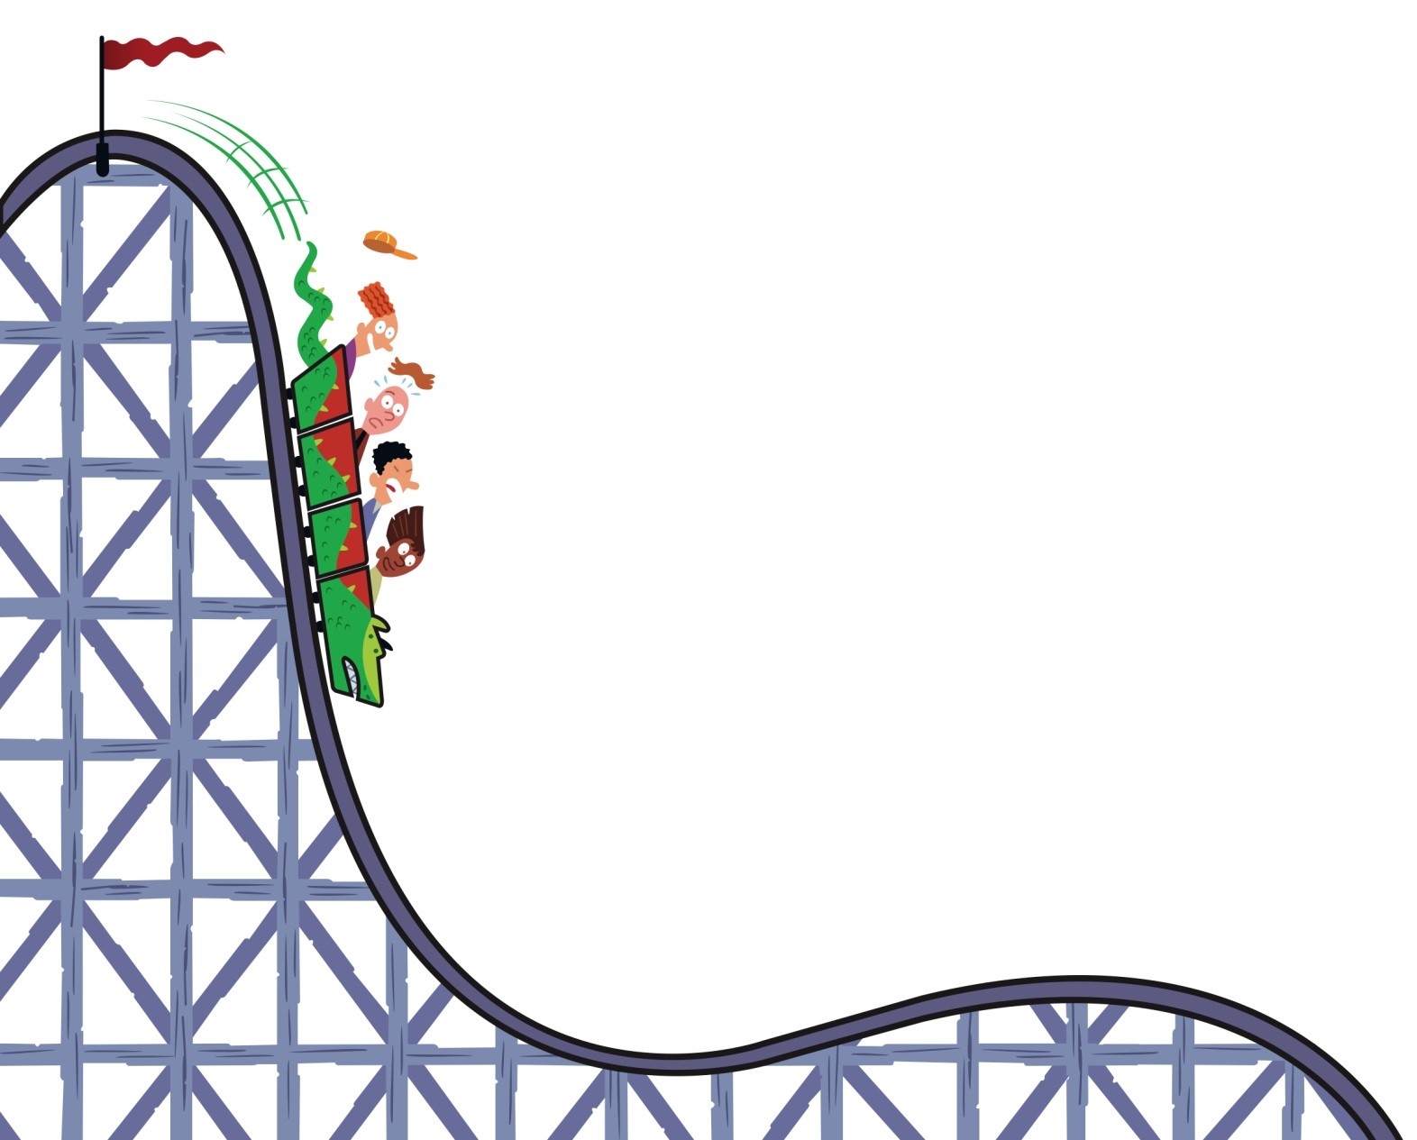
Math will never be the Same!
Bree Drapa
Westford Public Library
www.bedtimemath.org

Slide 2
Making Math as Great as Dessert
Bedtime Math is a small nonprofit, founded in 2012
Mission: To help kids learn to love numbers so they can handle the math in real life
Make math the fun thing to do after school!
Post a zany new problem every day for parents:
on bedtimemath.org, via free email subscription or free app

Slide 3
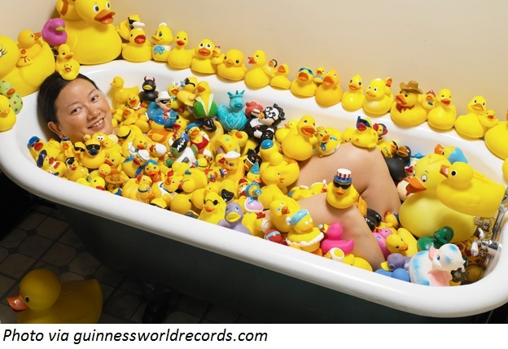
Sample Bedtime Math Problem
Most of us love bath toys. But having over 5,000 rubber ducks swim around with us is another story. In 2011 Charlotte Lee broke the world record for the biggest collection of rubber ducks, at 5,631. She’s been collecting them since 1996, and no one has broken the record yet. Or maybe someone has, but he’s still trying to climb out of the tub.
Wee ones: If you have 6 ducks, what numbers would you say to count them?
Little kids: If you have 9 of those small rubber ducks and 2 giant ones, how many rubber ducks do you have in total?
Big kids: For how many years has Charlotte been collecting ducks?

Slide 4
They also have books…...
… for those tech wary parents!

Slide 5
Bedtime Math: Summer of Numbers
sdd
Buy at shopcslp.com (cost $4.75 for per 25)

Slide 6
Bedtime Math: Summer of Numbers
You can give out incentives for complete logs, let kids set a goal, or whatever you do for your Summer Reading Program.
It adds one more thing for families to do together and helps with the math summer slide.

Slide 7
Bedtime Math also offers….

Slide 8
Crazy 8s: The Basics
Four 8-week “seasons” available
Two levels: grades K-2 and grades 3-5
Must have 10-16 kids
Clubs meet once a week for an hour
Social aspect is key
Same kids each week
Cooperative, not competitive

Slide 9
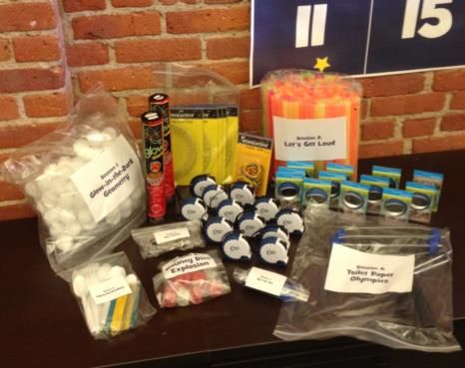
Crazy 8s: Our Commitment
Bedtime Math provides a free kit including:
Full directions for each week’s session (online)
Most materials
Coach support
Most sessions have some sort of take home or giveaway

Slide 10
Crazy 8s: Your Commitment
After-school program provides:
An enthusiastic coach (at least two adults)
Get kids up and moving
A little “crazy” helps!
A few standard supplies
Shopping list provided
Average cost $10/week or less (you have most things in your library - pencils, markers, etc)
Commitment to Crazy 8s Honor Code

Slide 11
Crazy 8s Honor Code
Voluntary registration
Kids choose to sign up and are not assigned to the club
Not remedial
Not homework or tutoring
With the same kids each week
Between 10 and 16 kids per club
Doesn’t work with 100 kids in a gym!
Grades K-2 or grades 3-5
Not blended K-5
Not for middle school kids

Slide 12
Crazy 8s Honor Code
Outside school hours
Before or after school, never during school day
During the school year (not summer camp)
1 hour weekly for 8 weeks
2 kits to start: 1 grades K-2 kit and/or 1 grades 3-5 kit
If you have many more kids who want to participate, start a waiting list!
You can apply for fresh Season 1 kits to start new clubs when you move the first groups on to Season 2.
Using the Crazy 8s name, so kids feel they are part of something big!

Slide 13
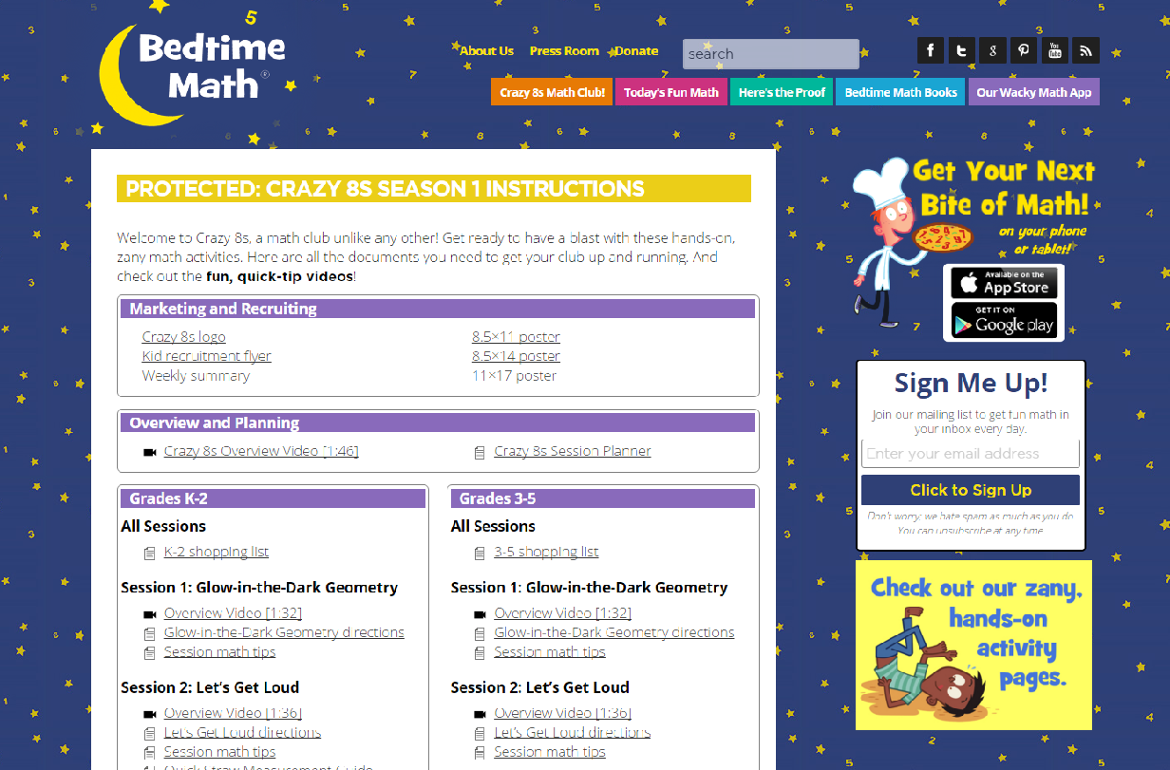
Crazy 8s Coach’s Area
Overview videos
Shopping list
Recruiting posters and flyers
Lesson Plans and scripts

Slide 14
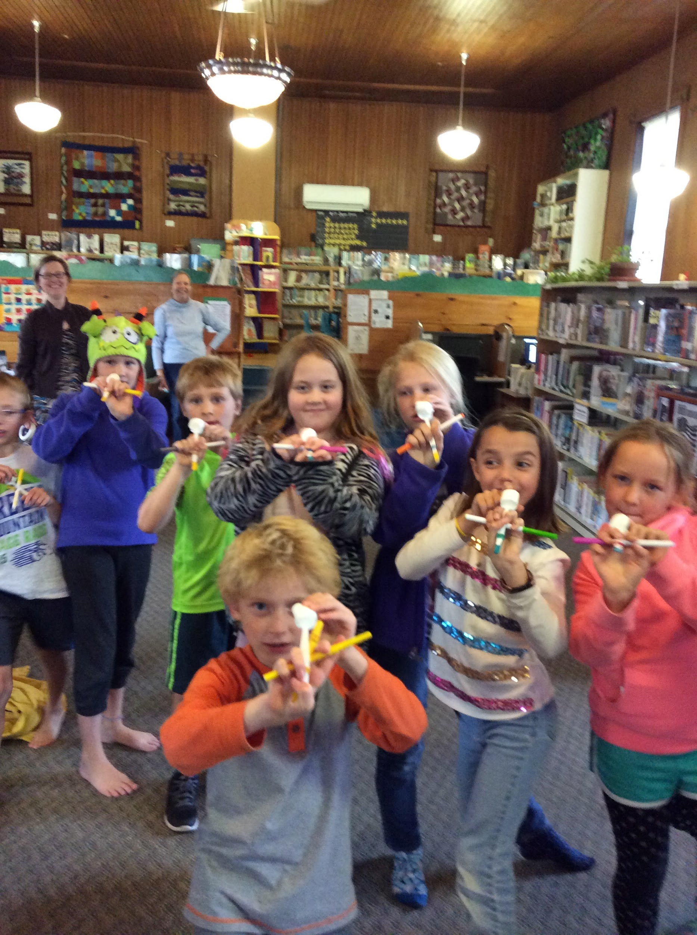
Don’t FREAK out - you CAN do this!
Kids need good, FREE, after school options
Most of the planning and supplies are taken care of
You like kids, right?
You don’t have to like math - fake it! (it’s good for kids to see you fail or struggle too)
Partner with local school(s) - we’re a bus stop - parents pick up at the library
Get parents or teachers to help out - snacks, coach

Slide 15
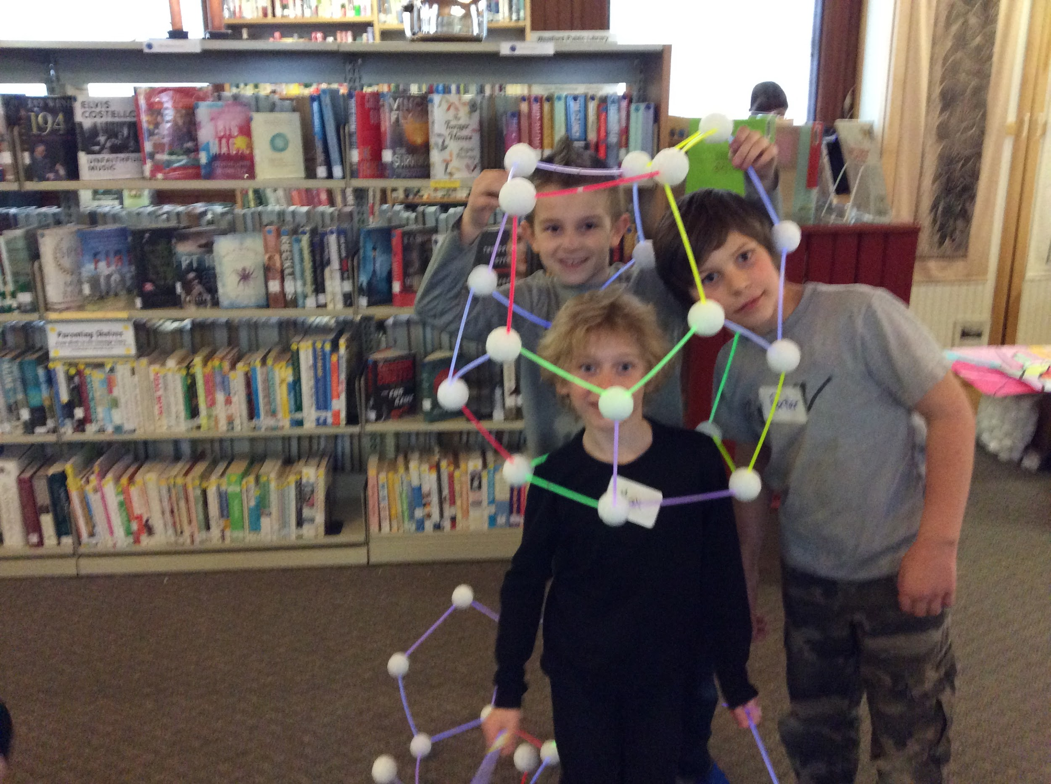
What we do in Westford…..
We run 2 clubs two days a week after school (same basic prep even if different ages)
Don’t be afraid to go off script or think outside the box
Bus brings kids, eat snack, club 3:30-4:30pm, parents have the option to pick up at 5:00pm
Are classes are FULL with waiting lists
You need a partner in crime or two
Take a break between sessions!

Slide 16
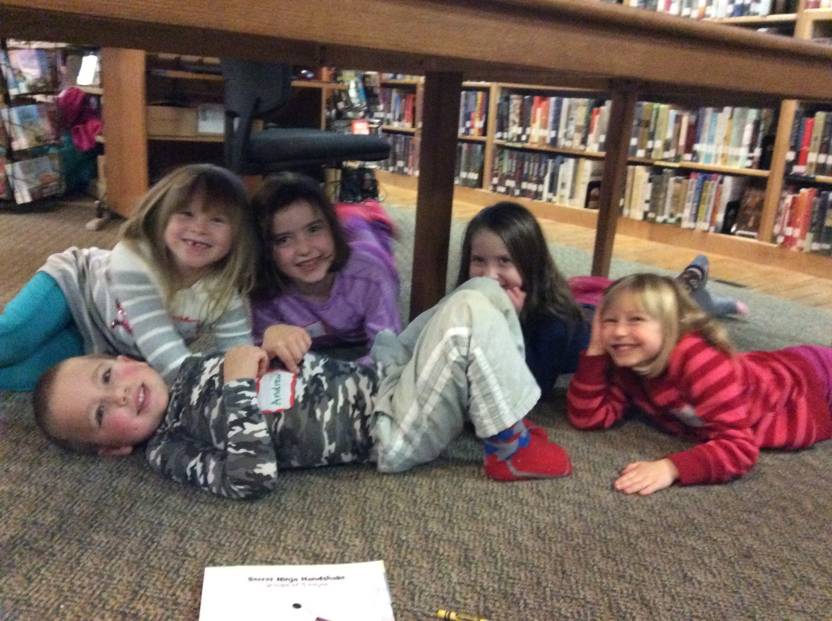
Wanna know the best thing…..
There is no post event reporting! No numbers, no write ups - NOTHING!

Slide 17
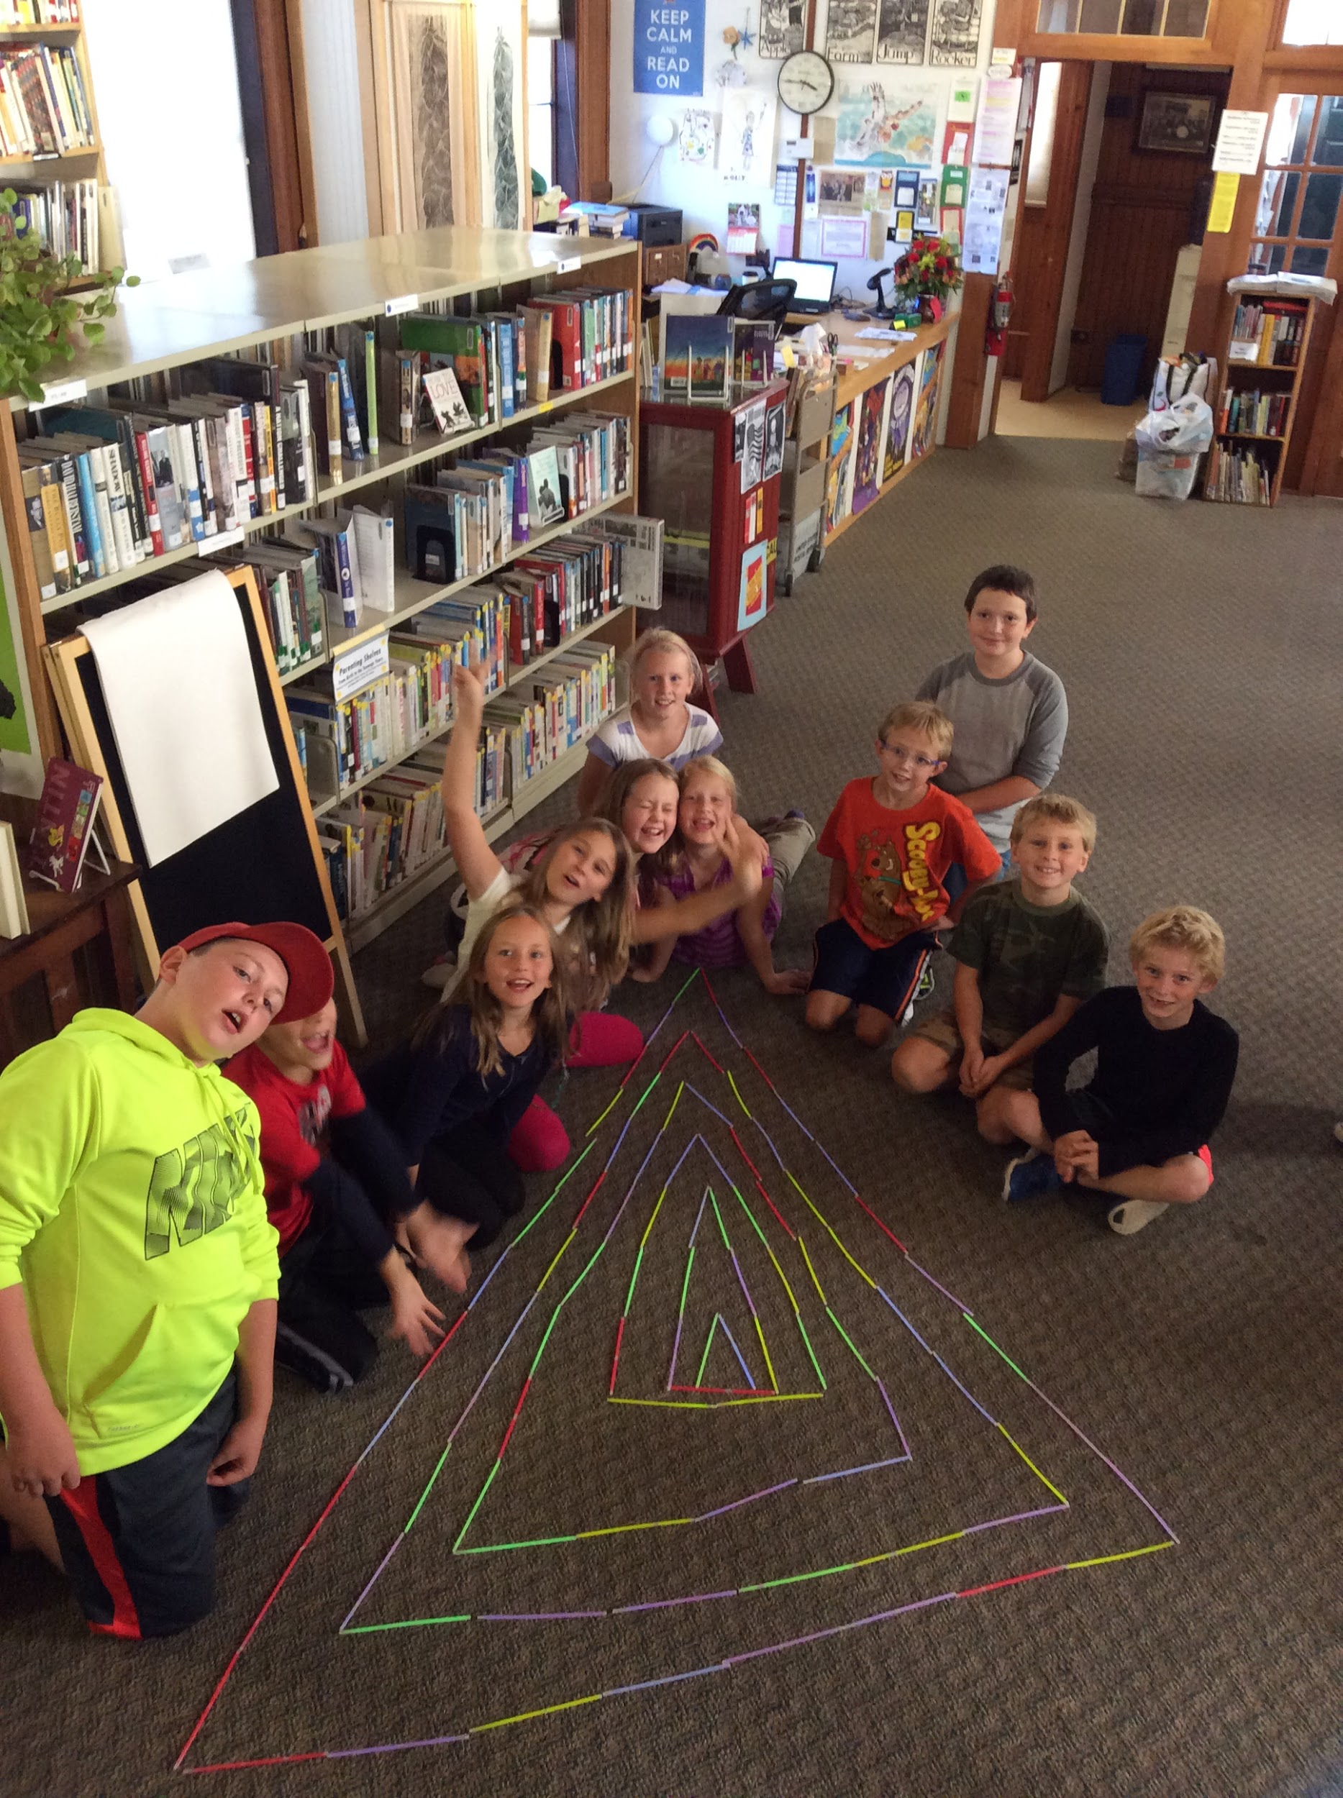
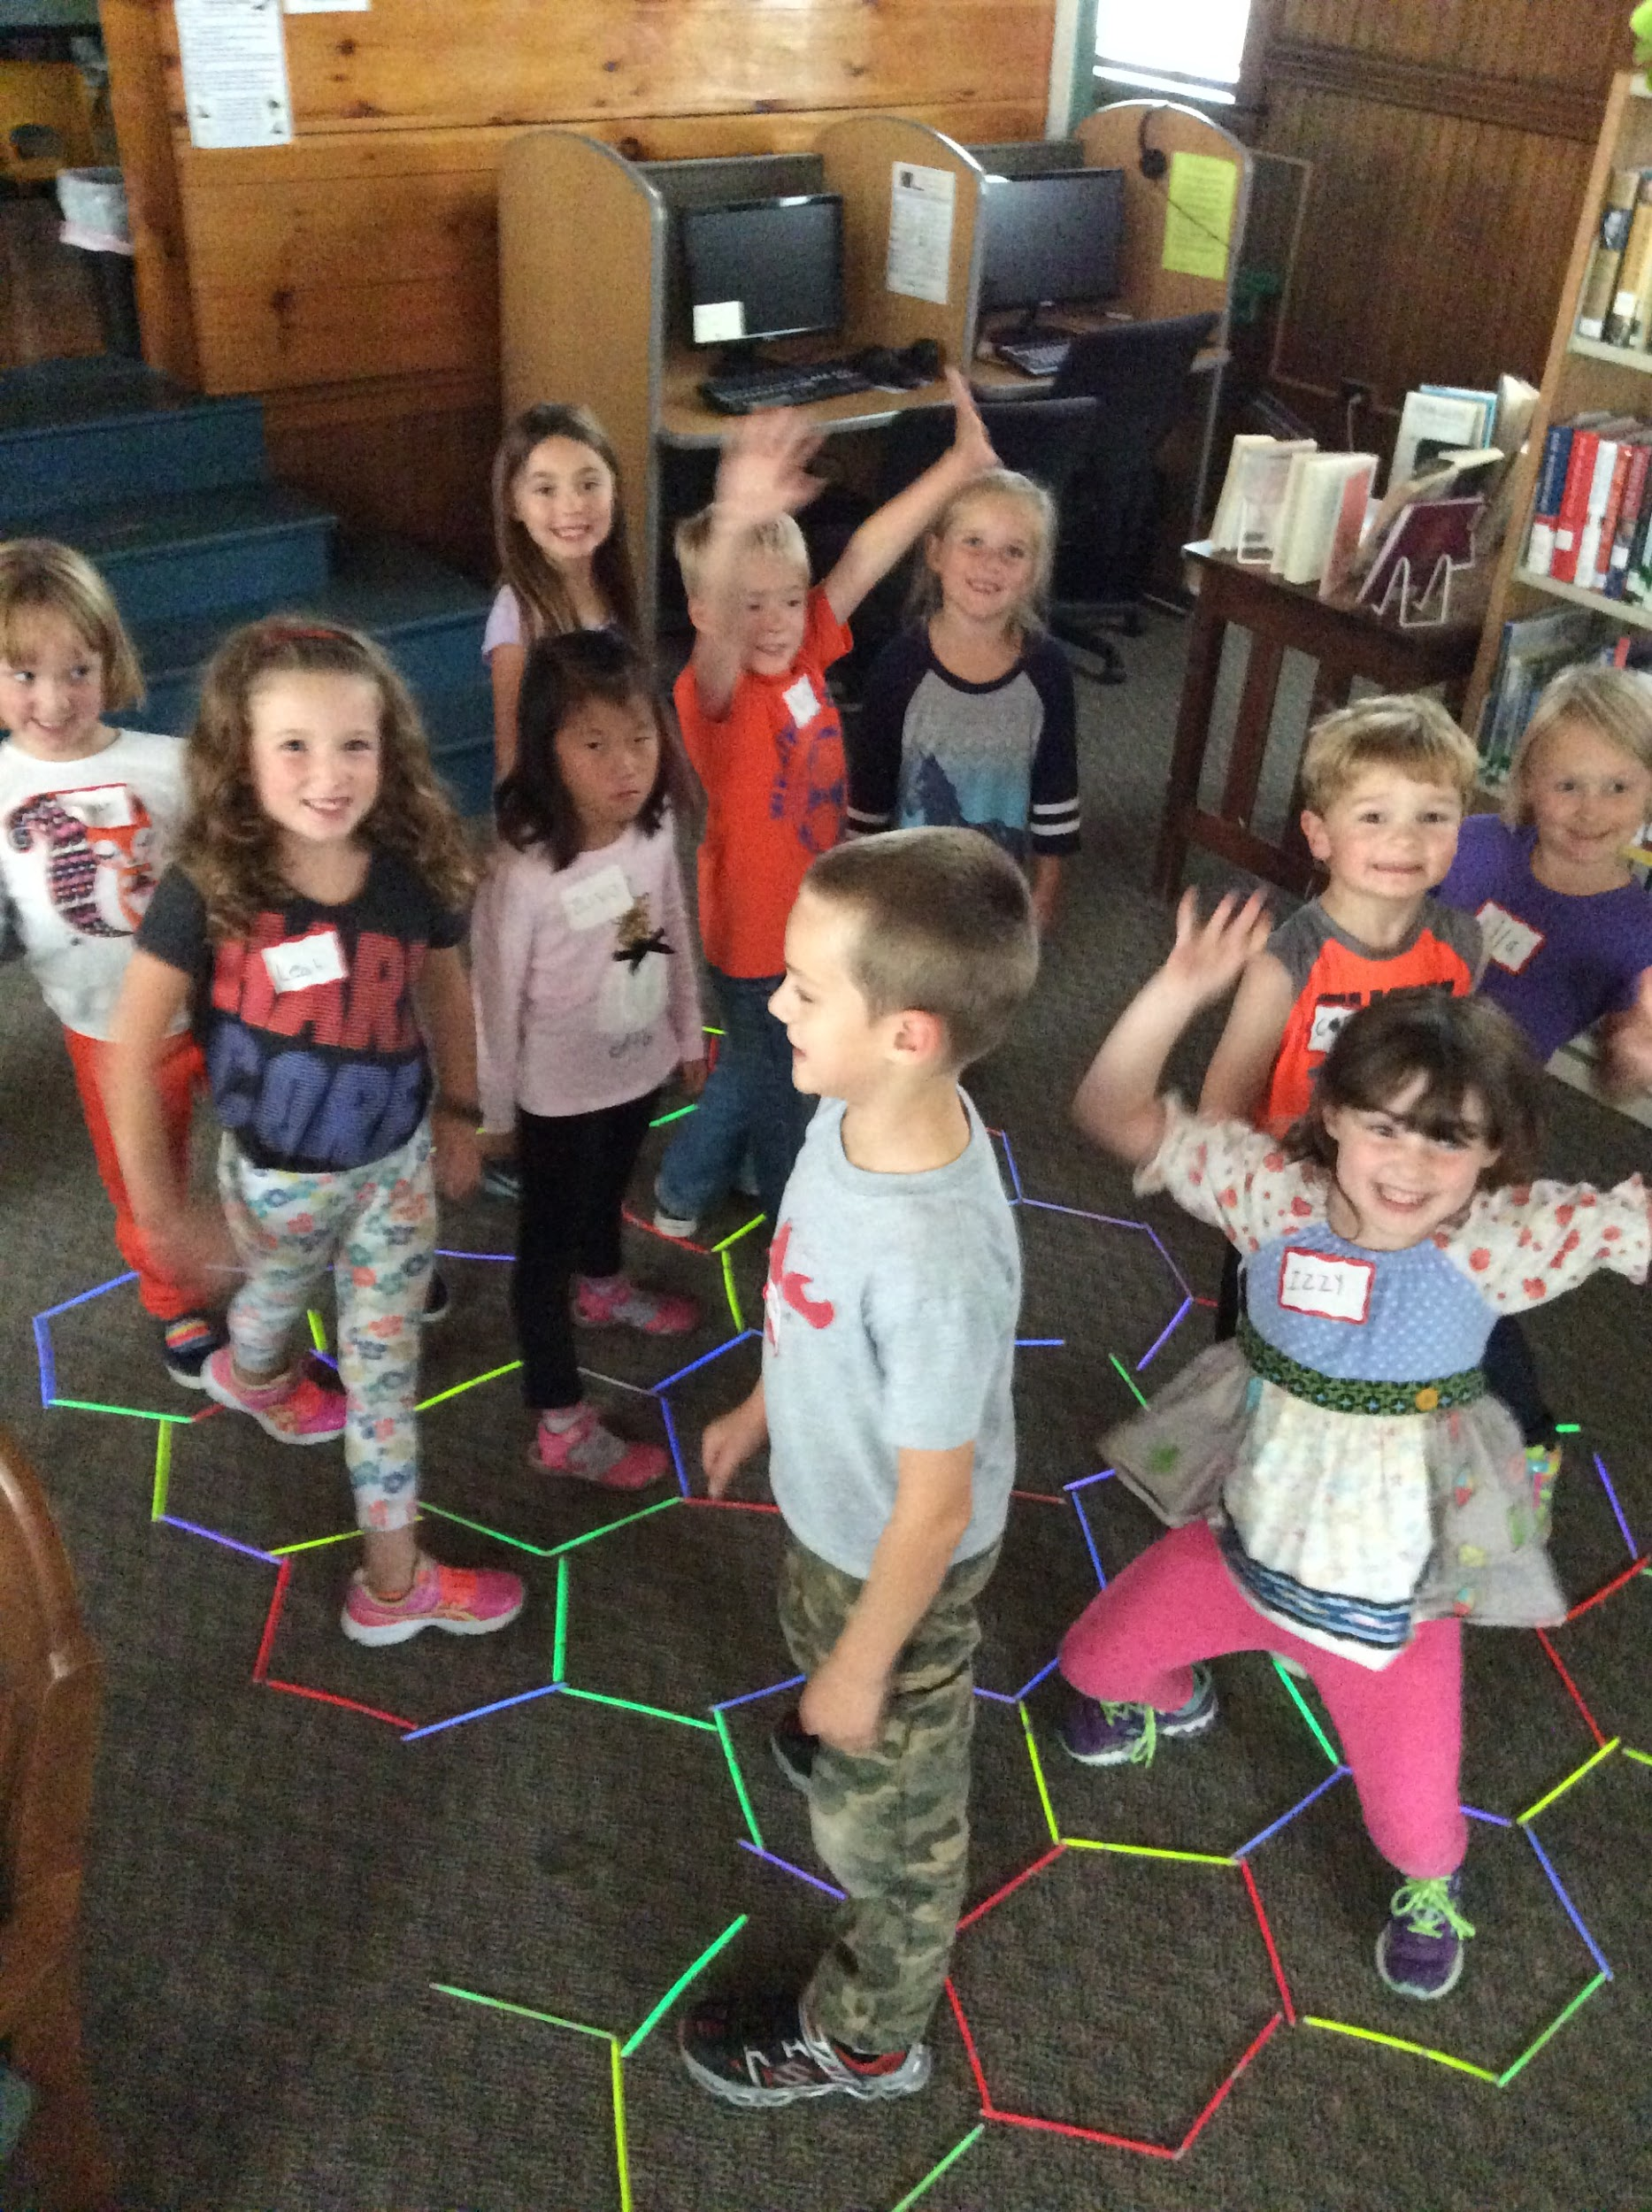
Bedtime Math makes Math come ALiVE!

Slide 18
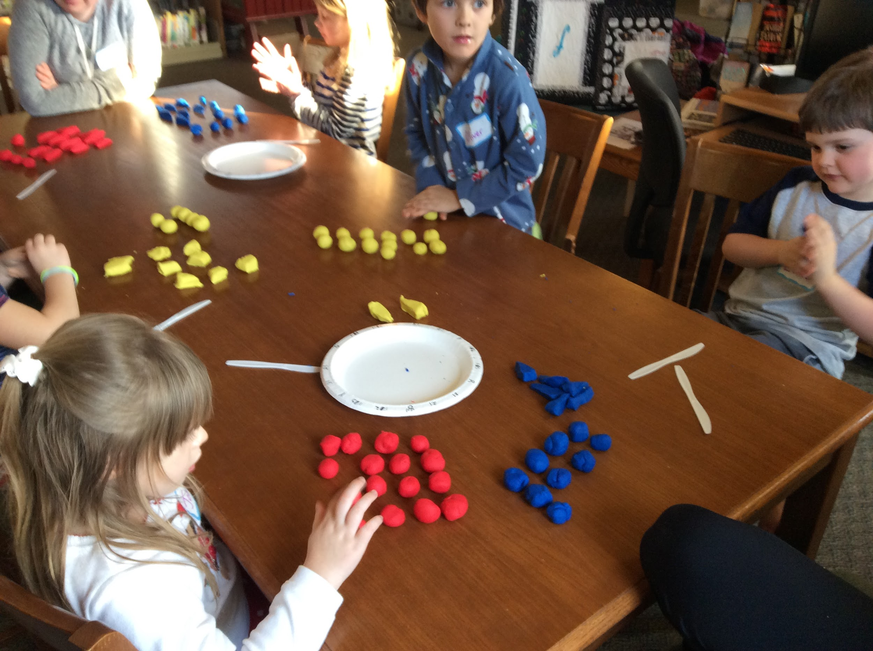
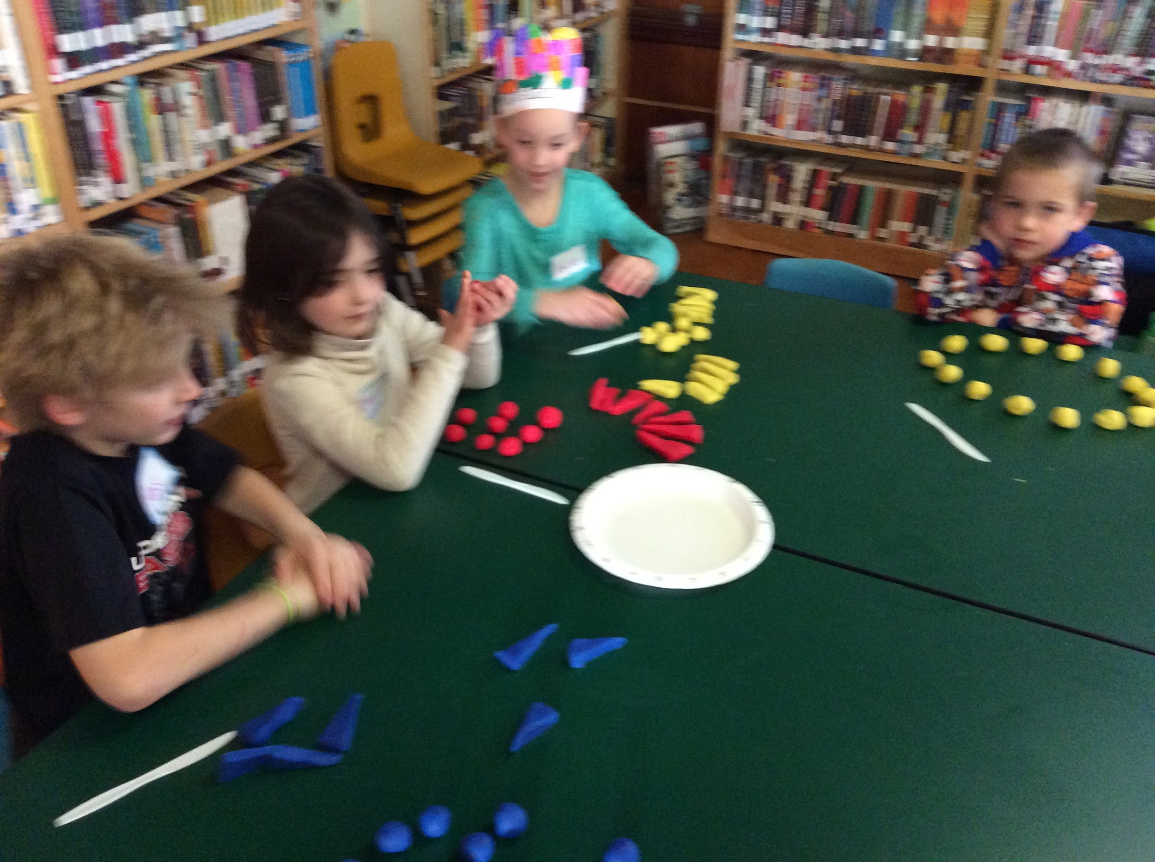
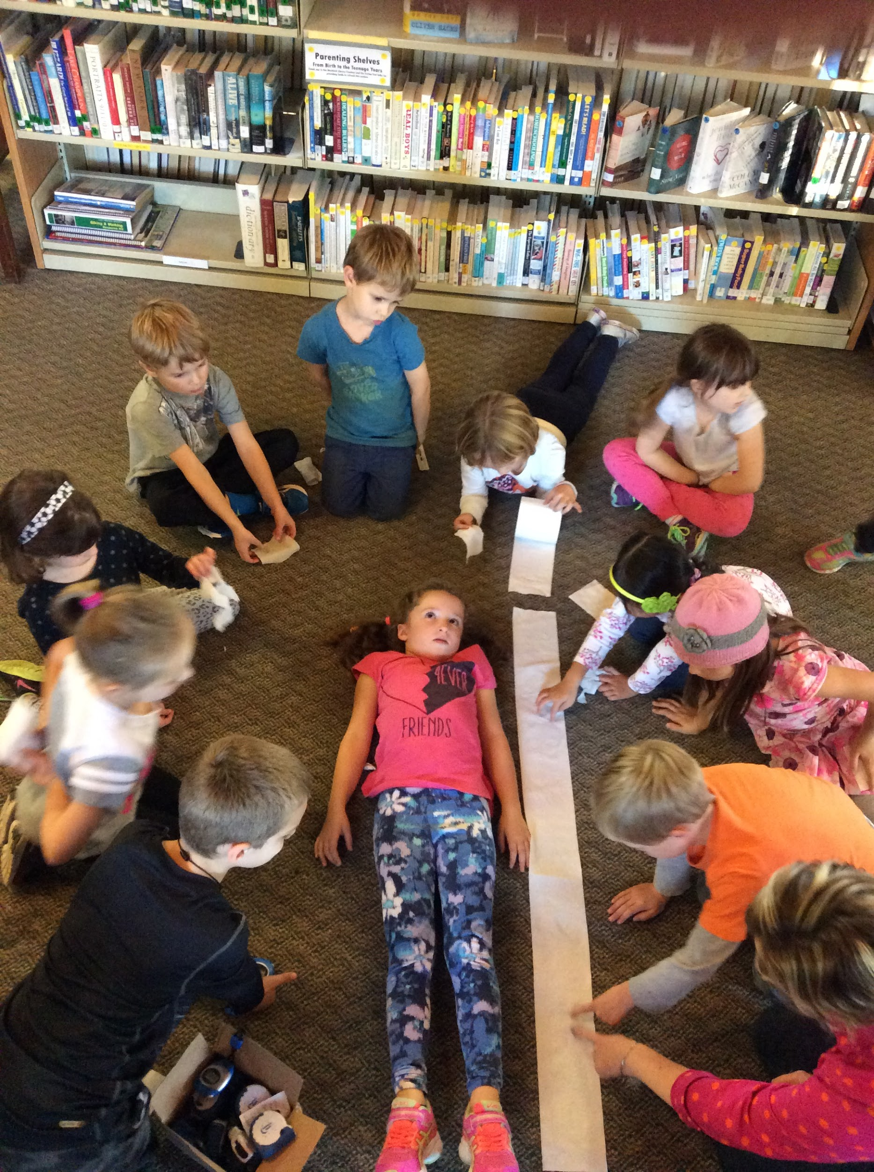
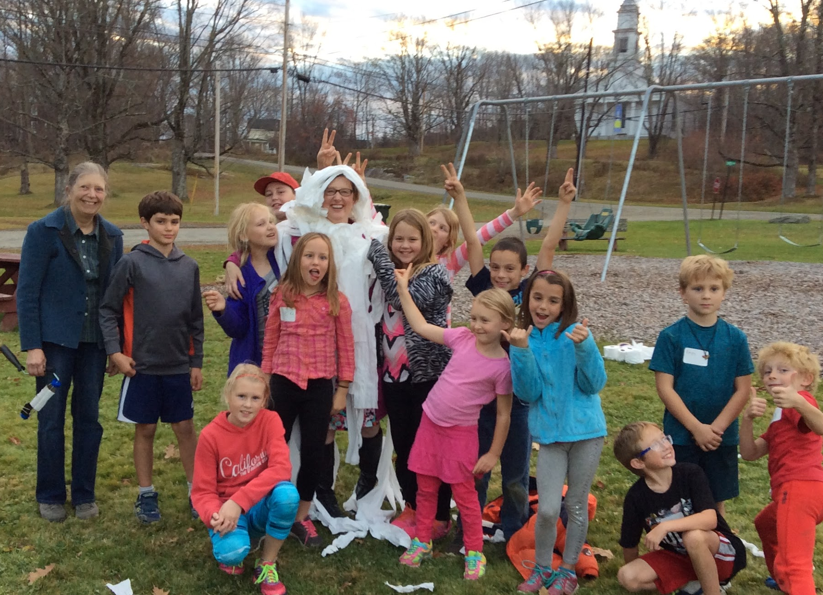

Slide 19
How to Get Your Kit
Apply online at:
crazy8s.bedtimemath.org
As part of the donation approval process, the application form will ask you to schedule a quick (10 minute) phone call to review the kit and answer any questions you may have.
Questions? Please contact:
Joy Kalfus, Crazy 8s Crew Chief
joy@bedtimemath.org

