Slide 1
Building Capacity
Strengthening Trustee & Friends Boards

Slide 2
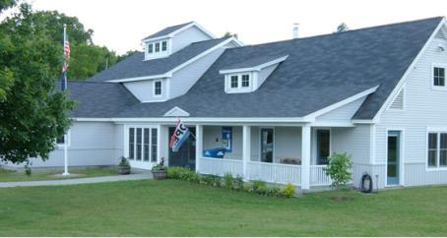
Hartland Public Library
Municipal Library
New Building: 2001
Serves a Population of 3,400
Approx. 2,000 Patrons
Staff: 2.5 FTE; 21 Volunteers

Slide 3
Our Trustees
5-person Board
Elected to Serve a 3-Year Term; Max. 2 Terms
Composition: Ages 45-60; Working Professionals or Full-Time Caregivers
Current Board Actively Seeks Out New Trustees

Slide 4
What do we look for?
Understand the Library’s Mission and its Role in the Community
Good Spokespeople: Can attend a Select Board Meeting and/or Town Meeting and Advocate for the Library
Connected to Other Community Organizations
Right “Fit”—Personality and Attitude
Notes:
Don’t generally look for demographic representation; we like that our board is small (5 Trustees), though it can be a problem if one is absent

Slide 5
Training
Initial Meeting with Library Director and Trustees Chair to Discuss:
By-laws
Library Policies
Staff—Names and Roles
Trustee Manual from the Vermont Dept of Libraries

Slide 6
Ongoing Support
Trustees are Encouraged to Attend Conferences (Library Pays All Costs)
Annual Volunteer Appreciation Lunch: Networking
Future Ideas:
Annual “Refresher” on Role of Trustees
Board of Trustees Self-Assessment
Other? (Looking for Ideas!)

Slide 7
Online Resources
Vermont Dept. of Libraries Trustee Orientation:
http://www.slideshare.net/vtgoodideas/trustee-orientation-for-vermont-public-libraries
Friends of Tennessee Libraries:
http://www.friendstnlibraries.org/wp-content/uploads/Comparison-of-Responsibilities-Tennessee-2013.pdf
United for Libraries:
http://www.ala.org/united/trustees

Slide 8
Working with Friends
Friends of the Hartland Public Library—History:
Small Group; Focused on Raising Funds for the Library Building in 2001; “Burned Out”; No Longer Very Active
Big Event: 4th of July Book Sale
Funding is Limited ($1200-1500 annually); we think strategically about requests to them (e.g. not as interested in technology investments)

Slide 9
Future Efforts
Creating a Closer Connection Between Friends of HPL and Trustees:
Invitation to Monthly Trustees Meeting
Working Group for our Annual Appeal
Encourage Friends to Open up Membership
Other?

