Slide 1
Trustee Board Training
Lara Keenan
State Library Consultant, Governance & Management
September 2019

Slide 2
Why Do Public Libraries Exist? VSA Title 22
Chapter 3, § 67
(a) The General Assembly declares it to be the policy of the State of Vermont that free public libraries are essential to the general enlightenment of citizens in a democracy and that every citizen of the State of Vermont should have access to the educational, cultural, recreational, informational, and research benefits of a free public library.
Notes:
Amazing language in the statutes that recognizes the importance of public libraries.
State Statute set up public libraries to emphasize the important role of the trustees to guide the library’s direction and to protect the privacy of library users. The success of the public library depends a great deal on the wisdom, guidance, and strategic thinking of its volunteer board.
And as this statute language emphasizes, libraries are essential to our democracy. The work you do is vital.

Slide 3
What is the Primary Duty of the Trustees?
Well-Being of the Library

Slide 4
Primary Responsibility of Trustees
Well-Being of the Library
Understand the community and its needs
Understand the law & avoid Conflict of Interest
Exercise discretion and respect confidentiality outside board meetings
Put personal agendas aside when making decisions
Plan for the future: Resilience
Notes:
Well-Being of library is of utmost importance – and the purpose of the VTLIB is to support the institution of the library and its health, and that’s why we are here to train and support the governing board of the library: you!
Need to be responsive – embed yourself deeply in the community so that library is essential to health of community, not an optional department.
Open meeting law, local laws, ethical considerations – want to be squeaky clean
Executive Session items
Again - well-being of library is most important. Your personal politics or preferences should not be part of the decision-making process.
Involves a lot – strategic planning, succession planning, budget planning, advocacy – knowing what’s happening in the community and the world of libraries – and planning for resilience

Slide 5
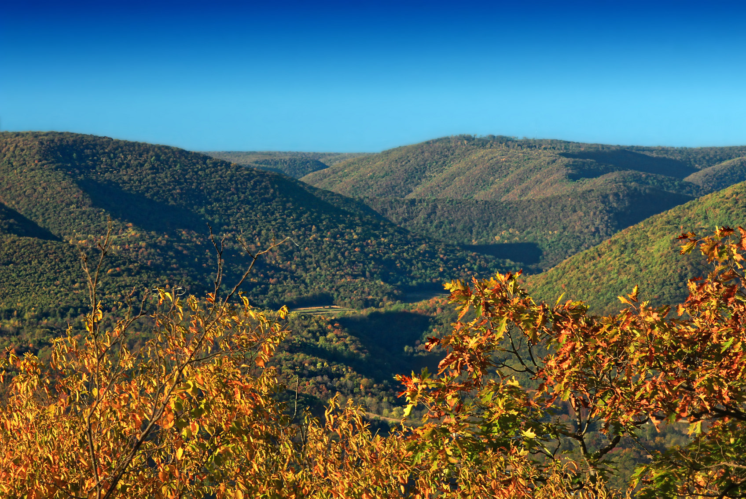
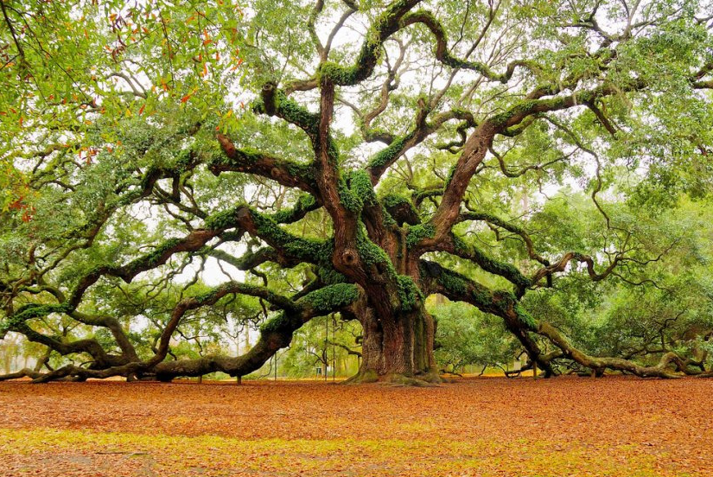
OVERSIGHT
DAILY MANAGEMENT
Source: https://www.flickr.com/photos/nicholas_t/10250370544/
Source:
https://www.flickr.com/photos/amon-ra123m5/5624590992/
Notes:
One way to understand how you can look out for the well-being of the library is to consider the difference between your duties as trustees – oversight – and the duties of your director – daily management.

Slide 6
Library Board Basic Tasks - Oversight
Policy & Bylaws
Advocate
Strategic/long-range planning
Promote & evaluate library
Hire, fire, & evaluate a director
Budget & funding sources
Building/Grounds Safety & Vibe
Community Link
Notes:
1. Set, review, & update library policy; create & maintain bylaws - List of policies – can provide. Focus – on meeting needs of community and creating a specific atmosphere/vibe for your library. When look at your library’s policies – do the meet the needs of the community and create the vibe you want?
2. Advocate for the library - You know the players in your community – important for governing board of the library (YOU) to be consistent advocates of how central your library is to your community and how it helps ppl throughout the community. Lots of advocacy resources & training out there – Turn the Page, etc.
3. Oversee strategic/long-range planning - Create a guide to ensure that library meets needs of community and vision for the future.
4. Promote library use; evaluate overall effectiveness of the library - Promote throughout the community and evaluate with director how effective library resources & services are. Open enough hours? Have enough staff?
5. Hire, fire, & evaluate a qualified library director - One of the most important things – the right director can be a powerful leader, team builder, visionary – or they can sour the community on the library.
6. Approve & submit budget; be aware of funding sources - Budget – responsible for setting a budget that will meet current and future operating needs of library; responsible use of taxpayer funds. Other funding sources for the “gravy” – supplemental needs of the library. Grant funding, fundraising, bequests, etc.
7. Attend to safety & atmosphere of library building & grounds - Depends on the agreement library has with the building owner – could be the Town, or another entity. Municipal library – town might be ultimately owner (and library building might fall under Town’s insurance policy) – but Trustees are responsible for atmosphere of building and safety of staff & patrons – and building is a huge part of that.
8. Serve as a link to the community - You live in the community. Your director might not. You know the players and the issues & “talk of the town”

Slide 7
Director Basic Tasks – Daily Management
Daily operations & budget management
Hire, train, supervise, & fire staff
Connect public with information
Select materials
Track materials & members
Implement policies
Keep & report statistics
Inform board of trends & local implications
Act as spokesperson at meetings & with Press
Notes:
1. Oversee daily operations of library & manage budget spending - Keep library running, make sure bills are paid correctly.
2. Hire, train, supervise, & fire staff - Very important duty of the director – not the trustees.
3. Help public find information - Do this directly – and through work of the staff. Libraries still serve function as info centers, and Director needs to lead this.
4. Select materials to build library collection - Collection development essential to library director’s duties – most public libraries, library collection is still an essential element to library function.
5. Develop procedures to track materials & members - Reporting stats is essential to proving worth – stats are only as good as the data collected, so need procedure for collecting data accurate.
6. Implement policies - Policies developed by Trustees in conjunction with the Director – and Director must develop procedures for implanting the policies passed by the board.
7. Keep statistics & report to the board, state, & nation - Report stats regularly and in a way that proves effective – has impact.
8. Inform board of library trends & local implications - Director needs to be plugged into professional literature and translate national trends to local impact, if any.
9. Serve as spokesperson for library at meetings & with Press - Be visible to the community and to departments of the Town and local organizations, service-providers. Press contacts library – director must be able to effectively community about the library.

Slide 8
Comparison of Roles
Trustees
Library Director
Hire/Supervise Director
Hire/Supervise Staff
Create Long-Range/Strategic Plan
Create/Implement Plan
Fiscal Oversight, Budget Approval
Create, Spend, Report on Budget
Approve All Policies
Recommend/Implement Policies
Ensure Library Has a Marketing Plan
Coordinate/Implement Marketing Plan
OVERSIGHT
DAILY MANAGEMENT

Slide 9
Ongoing Trustee Duties

Slide 10
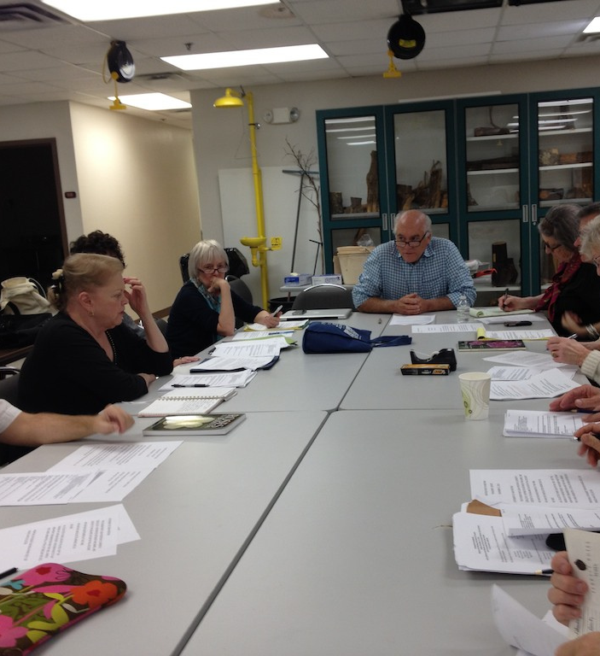
Prepare for board meetings; attend & participate
Ongoing Trustee Duties
Source: https://www.flickr.com/photos/mmmavocado/10925542573
Notes:
Agenda materials need to be sent out so that trustees have plenty of time to review them prior to the meeting. Read materials and keep track of questions you have so you can ask them at the meeting (or send them ahead to the director or Trustee chair so that responses can be gathered/prepared). Important that all trustees attend all meetings – otherwise, won’t have informed decisions that allow everyone to have a voice in the discussion. Also, will waste time catching people up.

Slide 11
Get to know the legal stuff: State & Federal Laws
Ongoing Trustee Duties
Source:
https://www.flickr.com/photos/pamwood707/5646757752
Notes:
Need to know the laws that govern your work and the work of the library.

Slide 12
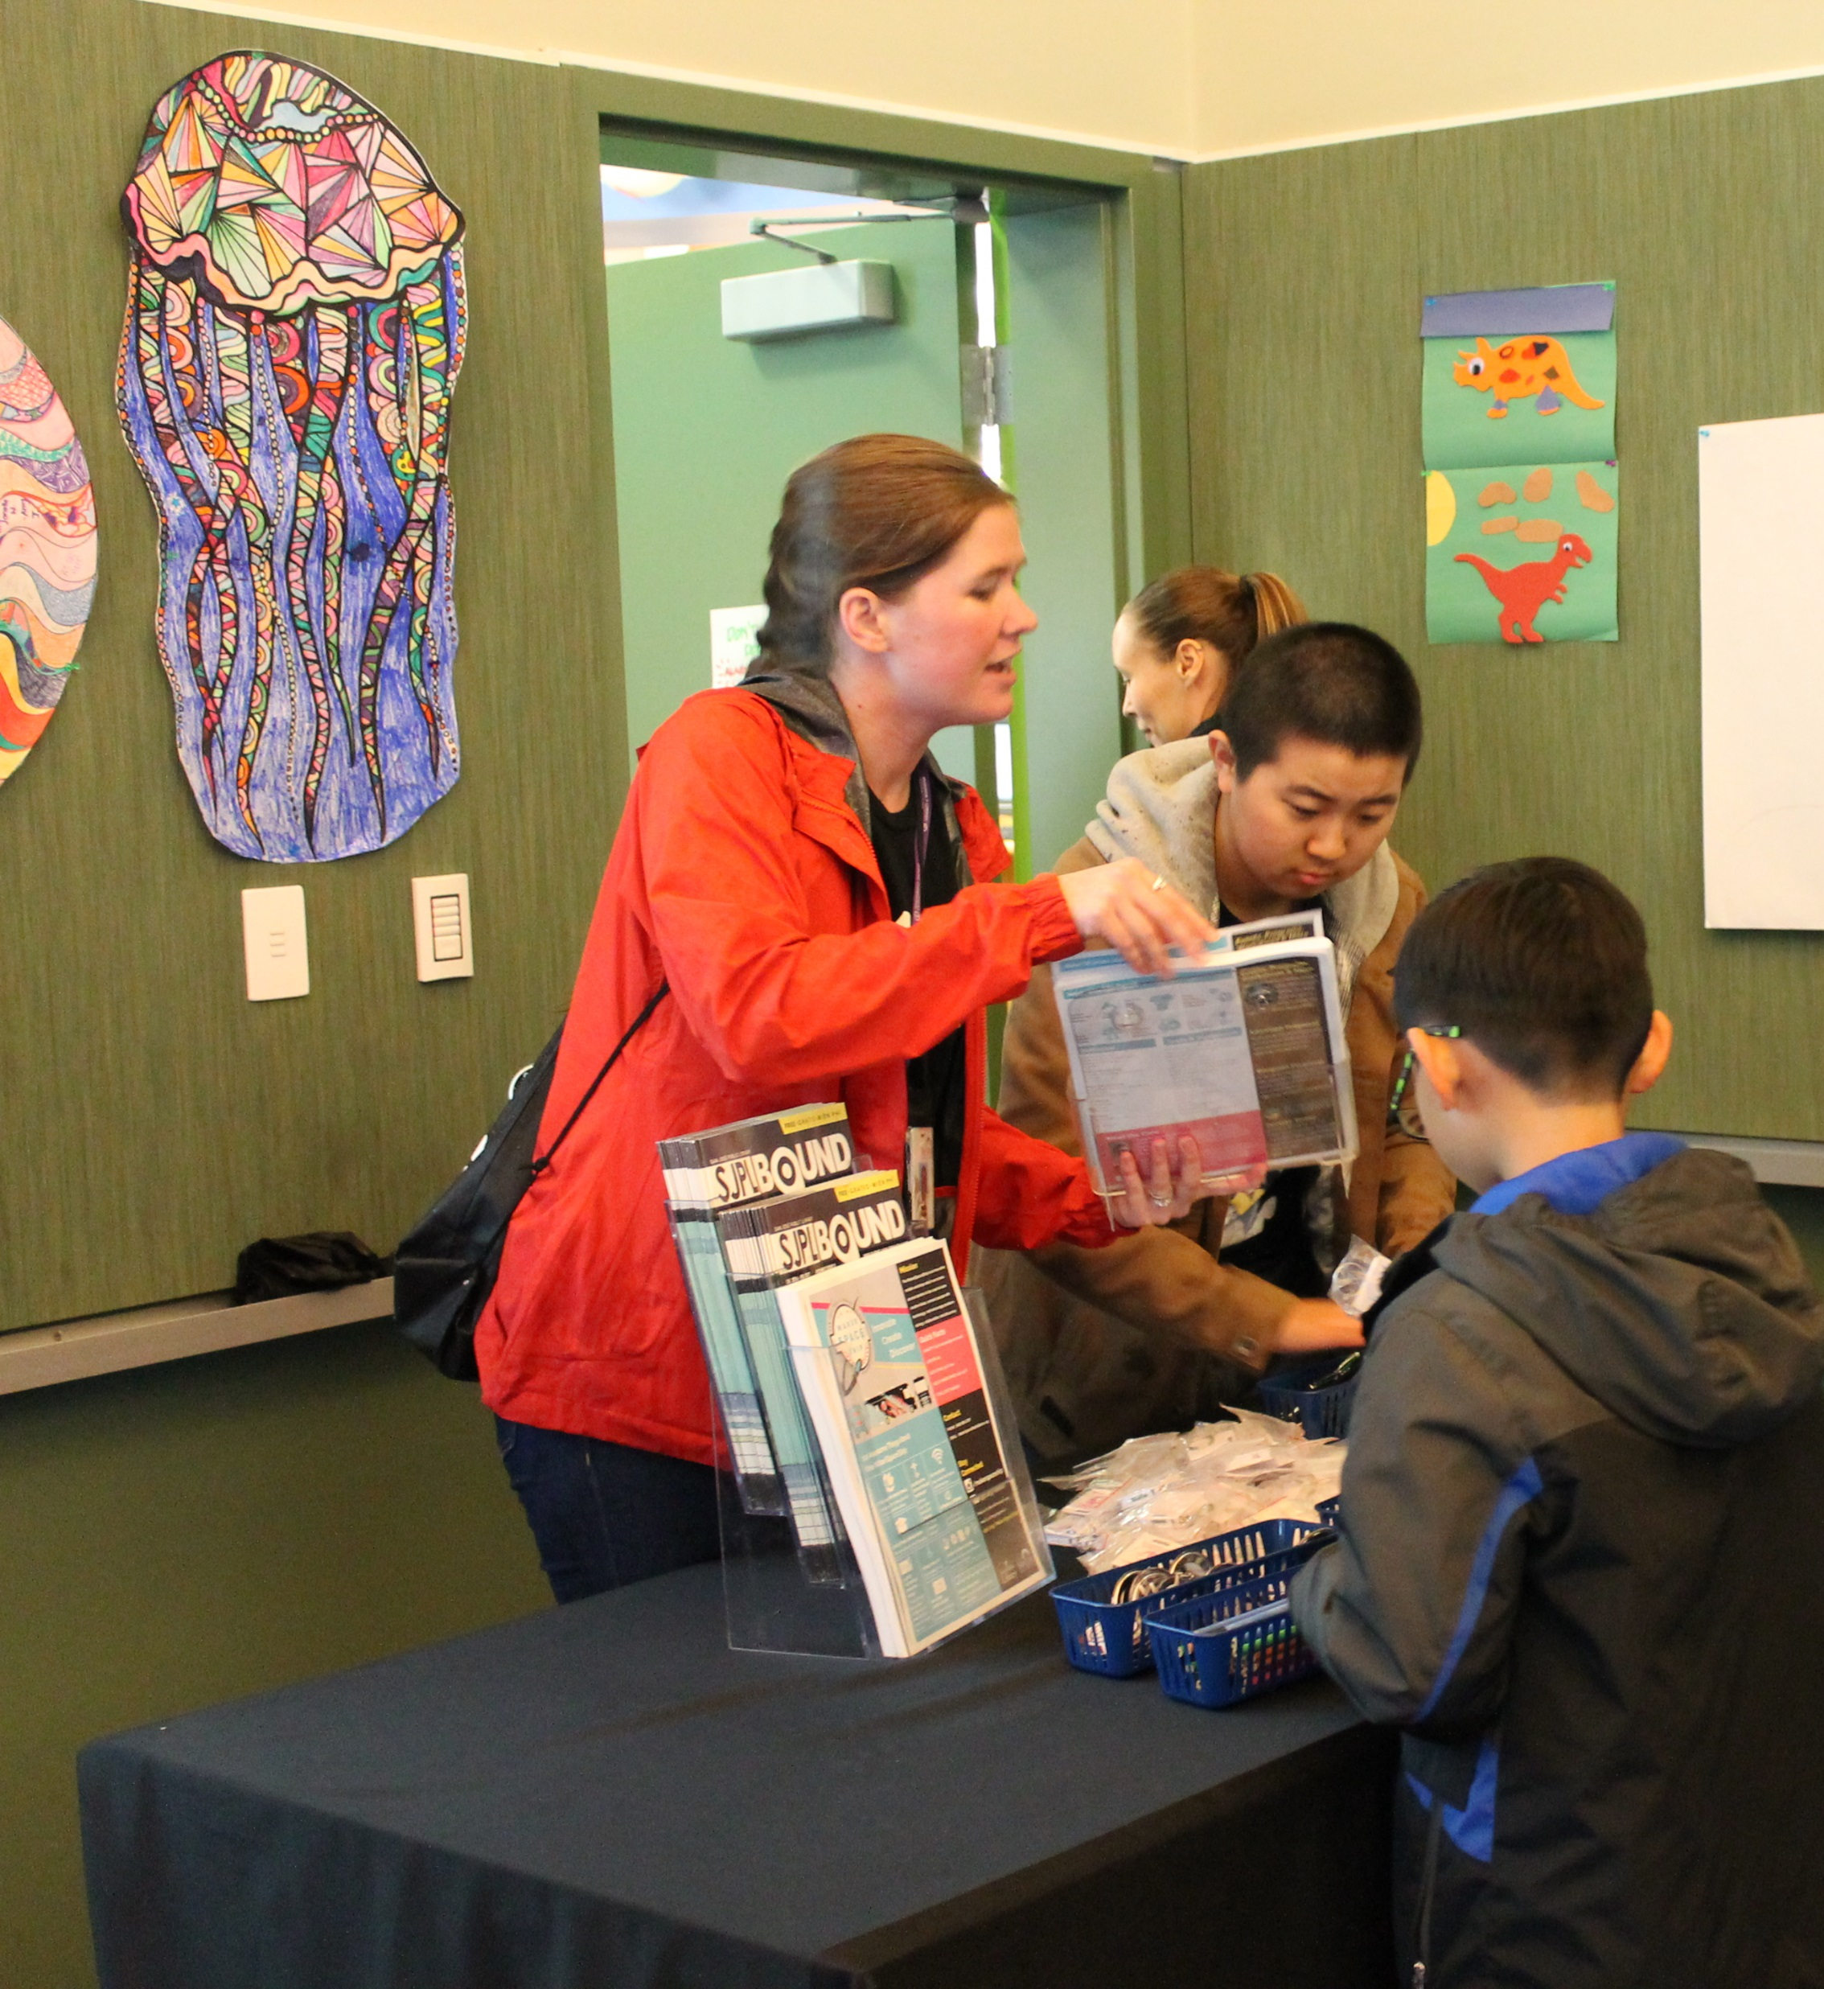
Support Library Services: Visit & Observe
Ongoing Trustee Duties
Source: San Jose Public Library https://www.flickr.com/photos/sanjoselibrary/31234520260
Notes:
Need to be a user of the library. Experience the resources and services to get a user perspective.

Slide 13
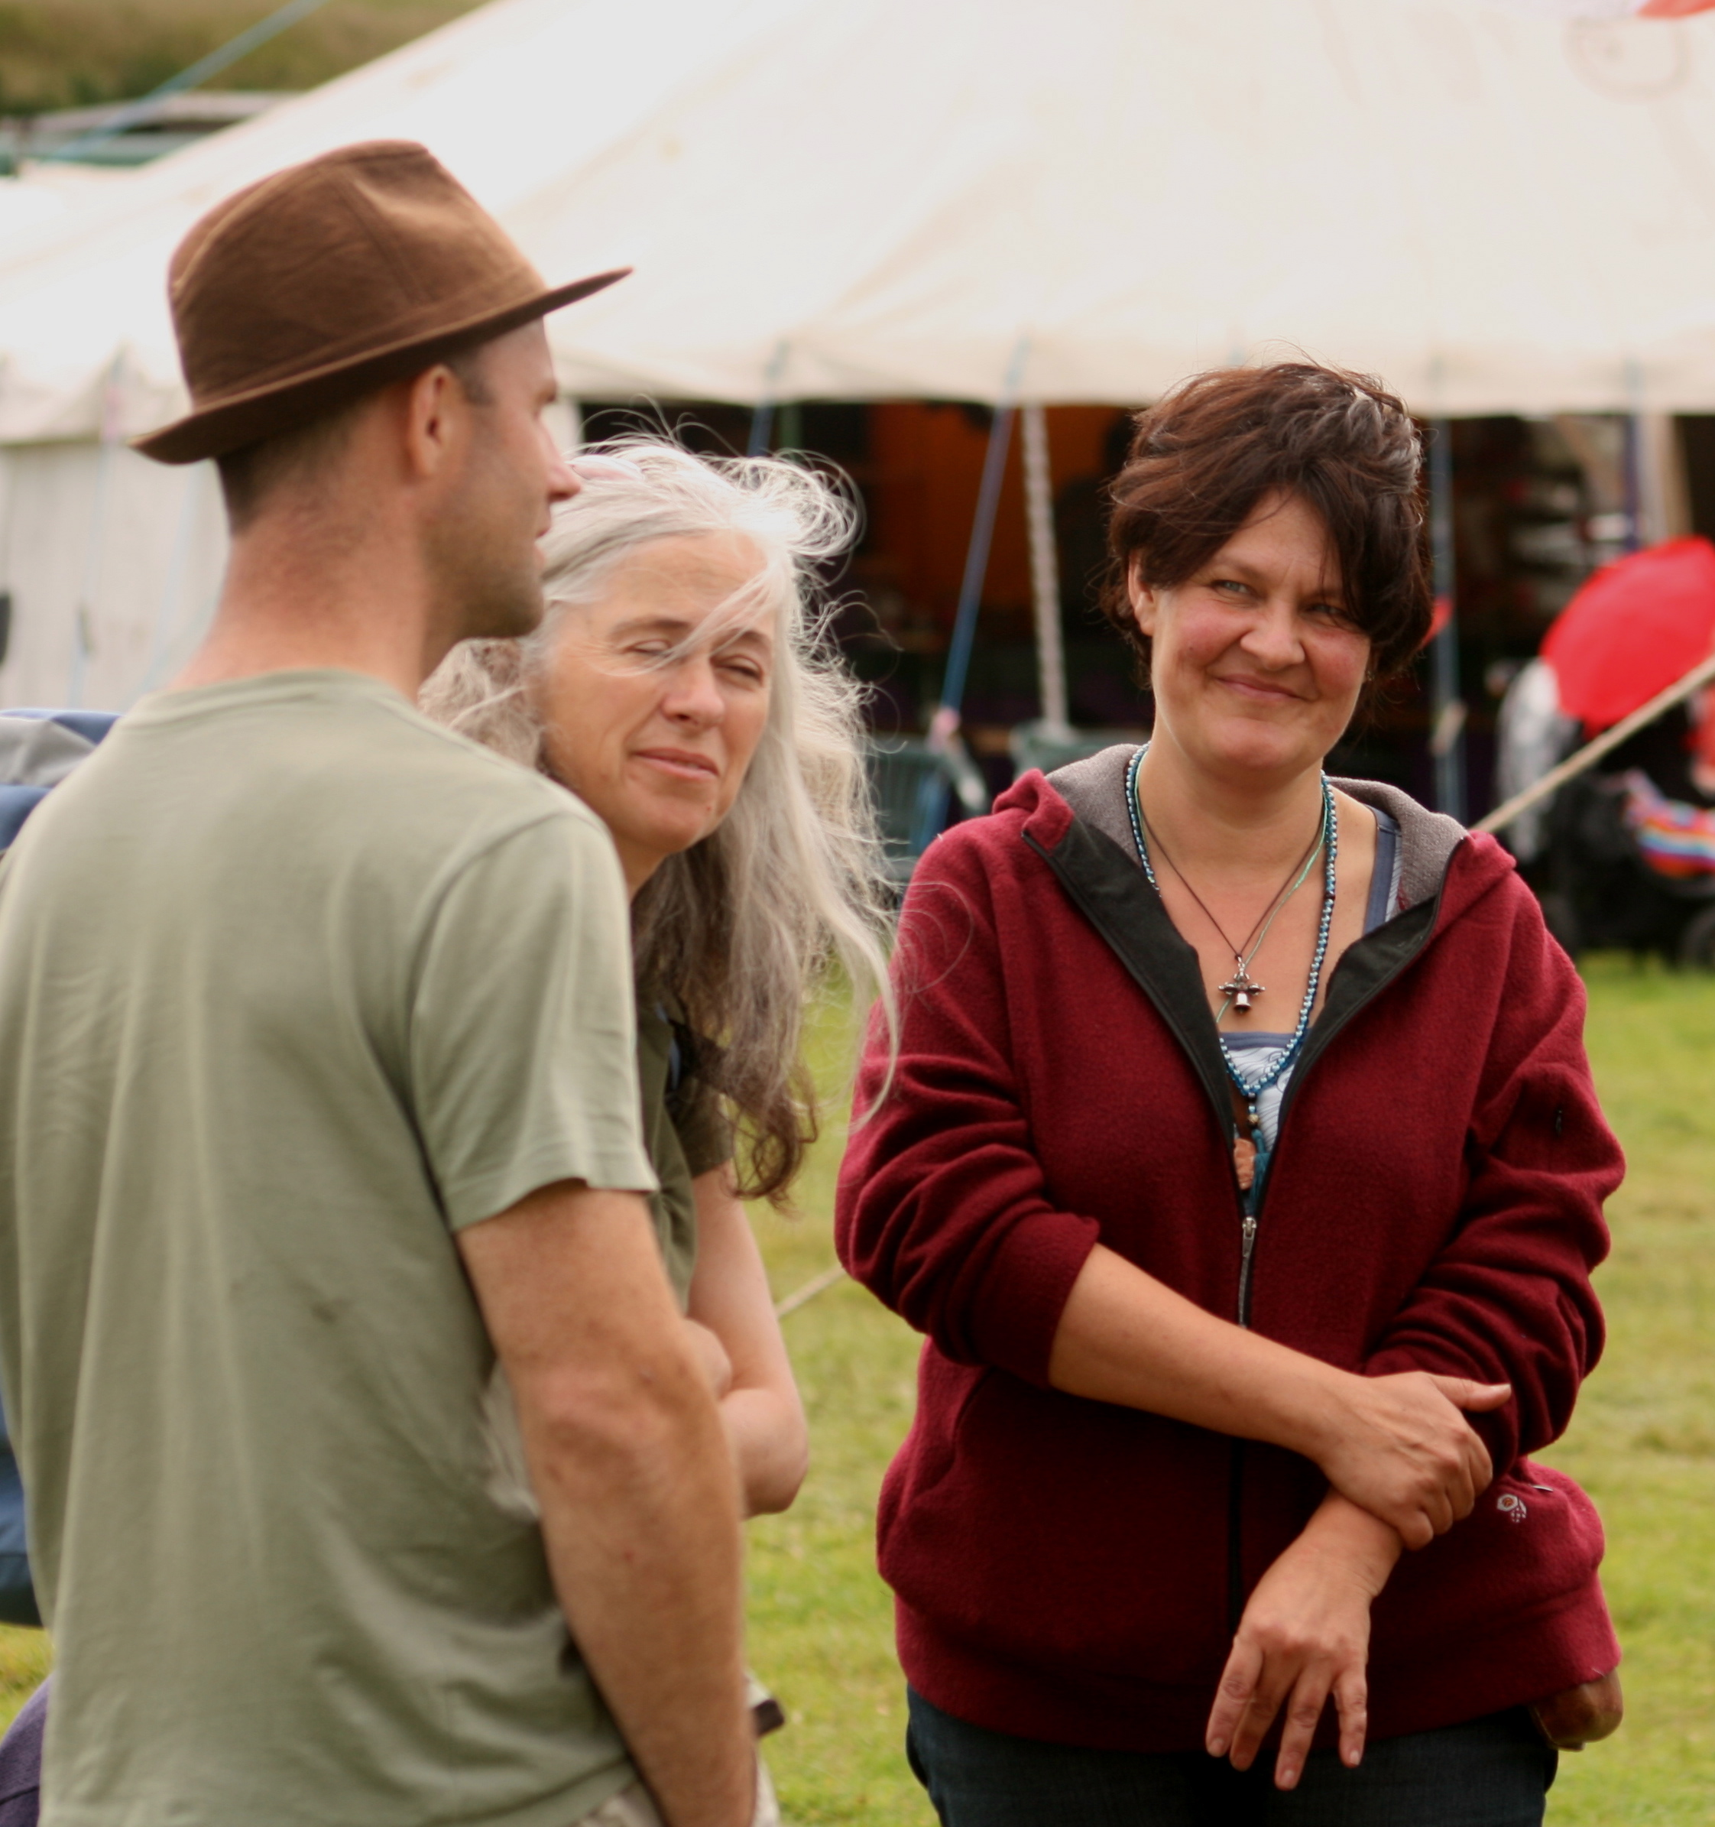
Talk About the Library in the Community
Ongoing Trustee Duties
Source: https://www.flickr.com/photos/90664717@N00/2686040967
Notes:
As a trustee, you are a representative of the library – an ambassador. The Board’s voice as an advocate for importance of the library as an institution.

Slide 14
Keep open to the future: read, think, listen
Ongoing Trustee Duties
Source: http://www.ala.org/tools/librariestransform/future/engage/TrendCards
Notes:
Be plugged into/aware of the changing needs of your community and how your library fits into larger trends. United for Libraries from ALA. Trustee Conference. Library Journal.

Slide 15
What Laws Govern Your Work?

Slide 16
Why Do Public Libraries Exist? VSA Title 22
Chapter 3, § 67
(a) The General Assembly declares it to be the policy of the State of Vermont that free public libraries are essential to the general enlightenment of citizens in a democracy and that every citizen of the State of Vermont should have access to the educational, cultural, recreational, informational, and research benefits of a free public library.
Notes:
Amazing language in the statutes that recognizes the importance of public libraries.
State Statute set up public libraries to emphasize the important role of the trustees to guide the library’s direction and to protect the privacy of library users. The success of the public library depends a great deal on the wisdom, guidance, and strategic thinking of its volunteer board.
And as this statute language emphasizes, libraries are essential to our democracy. The work you do is vital.

Slide 17
Division of Powers: Trustees & SelectBoard
Important: We Are All In This Together
Also Important: Knowing The Law of Public Libraries
Municipal Library Trustees: “Shall have full power” 22 V.S.A. § 143
Incorporated Library Trustees: “have control and management of the affairs and property of the corporation” 22 V.S.A. § 105
It’s a delicate balance to maintain and nurture
Notes:
The legislature has set it up so that there is a division of powers – to protect our patrons from the threat of having their library usage monitored by the government. If people are going to be true participants in a democracy and have the freedom to read and access materials with a true promise of privacy, then they need to know that their SelectBoard does not have the power to dictate what materials are available and monitor what individual patrons are accessing. At the same time, it’s very important for the trustees to work closely with the Town Administration, Town Clerk, and SelectBoard – because we are all in this together, especially in the small towns of Vermont. We are all here to serve our patrons/taxpayers.
So what powers do the Trustees have? It’s important to know them – and the limits of them.
So – making sure the Selectboard and Town Admin know what you have jurisdiction over is important – while also making sure to play nice and follow procedures, benefits, and expectations set forth in other Town Departments or – if you deviate – make sure you can clearly articulate why you feel it’s important to do so.

Slide 18
Who Is In Charge?
Know Your Library’s Sources of Authority
Become Familiar with the Law of Public Libraries
Our Laws Do Not Address Every Possible Scenario
Work Together on Behalf of Your Community
When In Doubt, Consult Your Legal Counsel
Source: https://www.flickr.com/photos/99558277@N07/10875349695/

Slide 19
Ideas for Working Together
Community Needs Assessment
Source: https://www.flickr.com/photos/airbnb/13915193802/
Notes:
Library Trustees and Selectboards can work together to assess the community – to turn outward and see what the community needs and how the library and the town can work together to meet those needs. Community Needs Assessments can help the Town create its overall Town Plan – and can help the library connect with institutions, organizations, businesses, and other community members to meet a range of needs.

Slide 20
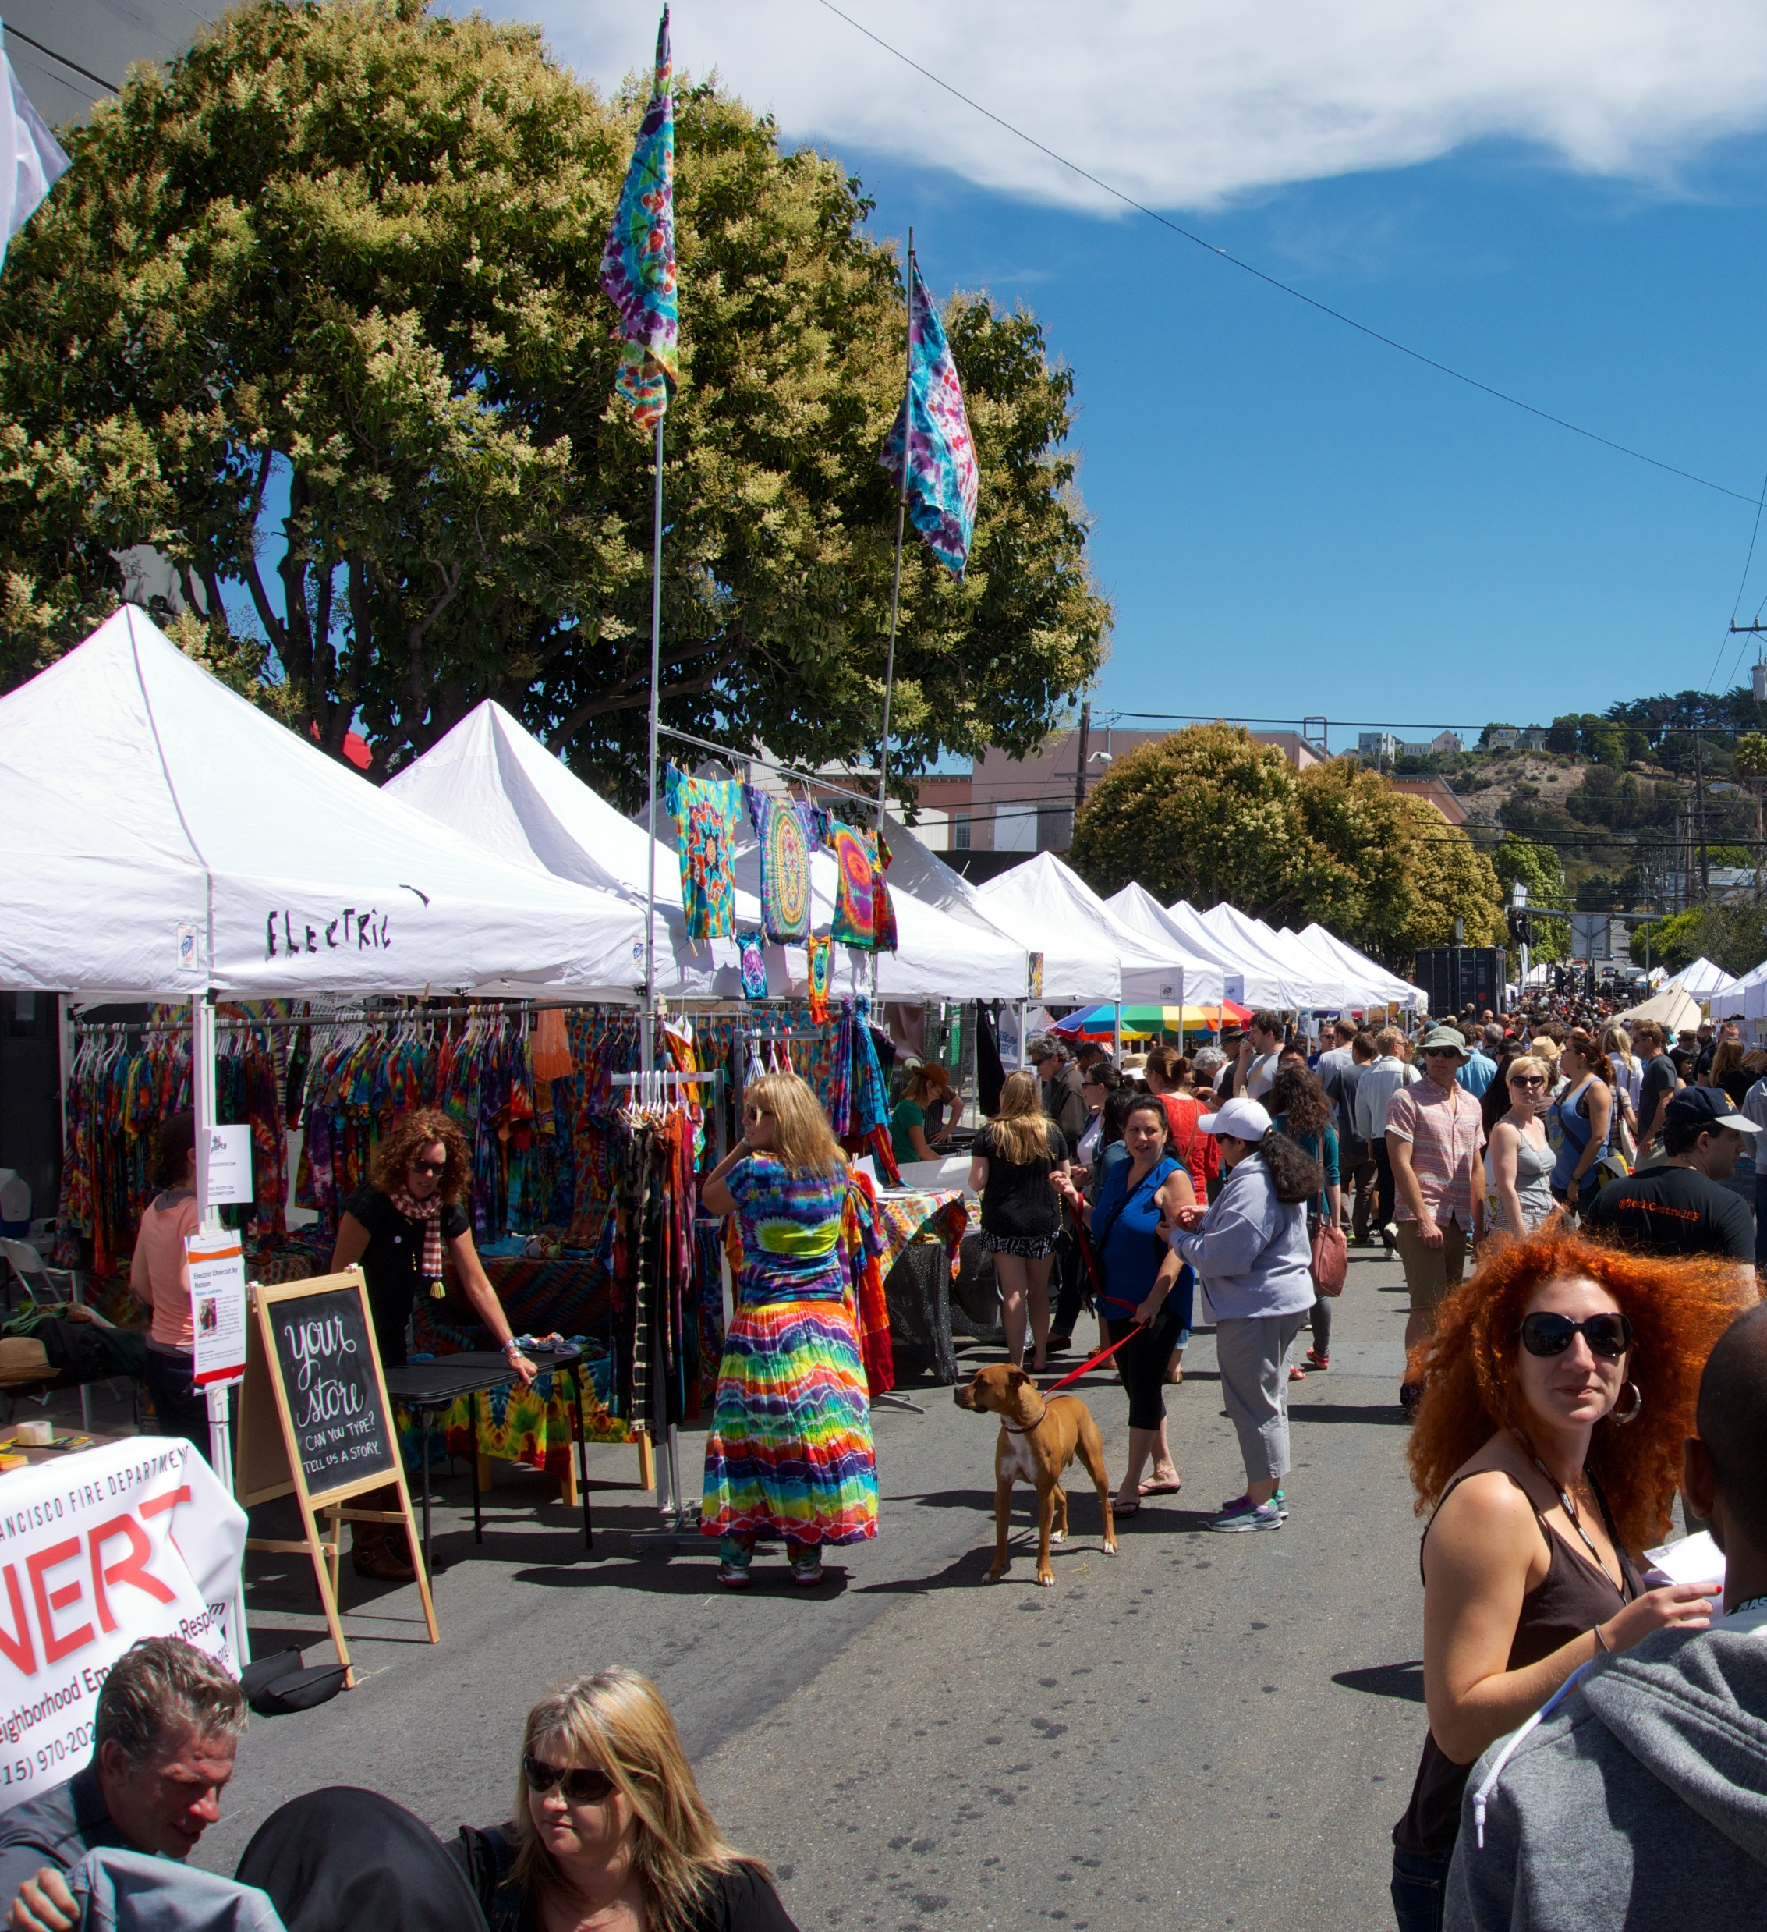
Community-Wide Initiatives
Ideas for Working Together
Source: https://www.flickr.com/photos/niallkennedy/9587071278/
Notes:
Involve the library in community-wide initiatives – ex: Town Plan, Community Celebrations, Community Revitalization efforts, Opioid Awareness or other Drug Taskforces, Block Parties, (and Town Meeting). The library is the one place where people from all parts of your community gather to access resources and see their neighbors – and socialize with the librarians. Because of this, librarians often hear the concerns of a wide range of community members – and know about the struggles people in your community face. Librarians are resourceful – and passionate about connecting people with resources. People use the library for a large number of reasons – and you can connect with the library and – in doing so – connect with a wide range of the taxpayers in your community.

Slide 21
Research Assistance & Information Dissemination
Ideas for Working Together
Source:
https://www.flickr.com/photos/pamwood707/5646757752
Notes:
Librarians are good at collecting information. If your town needs to research something, consider connecting with your librarian to see what resources they might have or what research they can do.
If you need to disseminate information to the town, consider approaching the library for help in doing so. They see a wide-range of people and are good advocates.

Slide 22
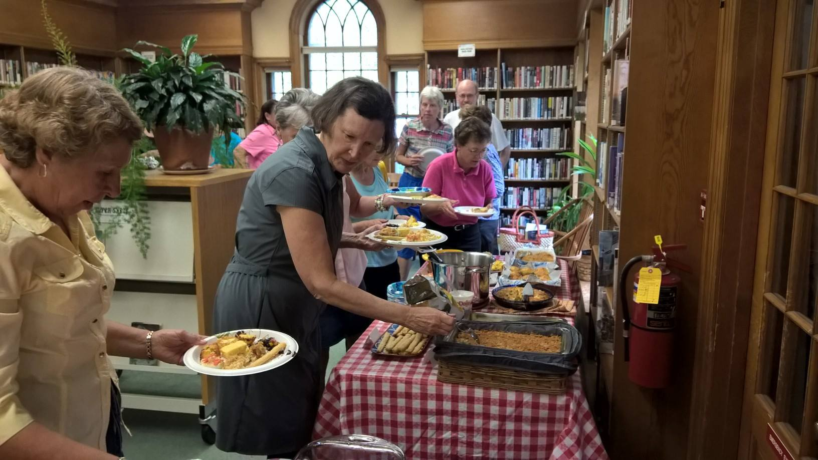
How Libraries Benefit Your Community
Libraries serve as a Community Hub - bringing the entire community together
Source: Burnham Mem. Lib. Facebook Page
Notes:
People who might not normally connect in life will bump into one another at the library. The services and resources offered by the library are available to everyone – regardless of religion, socioeconomic status, age, or ability. At some libraries in VT, the only time people see one another is when they attend book club or storytime – or when they read the latest edition of their favorite magazine. The good will that the majority of citizens have for public libraries draws people to their library. And the resourcefulness and innovative mindset of library workers results in unexpected programs and services that can meet a wide range of community needs.

Slide 23
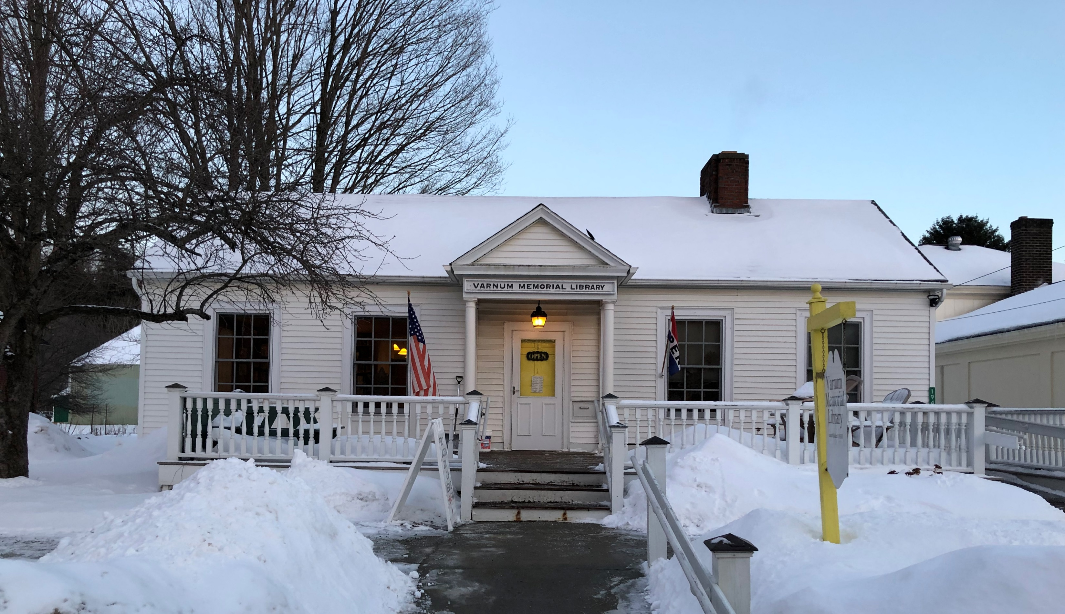
How Libraries Benefit Your Community
Libraries are vital to a functioning democracy
Varnum Memorial Library, Cambridge
Notes:
People who might not normally connect in life will bump into one another at the library. These interactions encourage civility, engagement, and relationship building. Libraries host programs that encourage citizens to engage in debate around tough questions. By fostering community engagement and civil discourse, libraries play a key role in preserving and strengthening our democracy. Libraries provide unfettered access to information – and in order for a democracy to function effectively, citizens need access to information so they can make informed decisions.

Slide 24
How Libraries Benefit Your Community
Libraries provide a space for educational, social, cultural, and recreational engagement
Source: https://www.flickr.com/photos/sanjoselibrary/31234520260
Notes:
The library space is a valuable asset for the community –and most public libraries are eager to have their communities use the library space to meet their community’s needs.

Slide 25
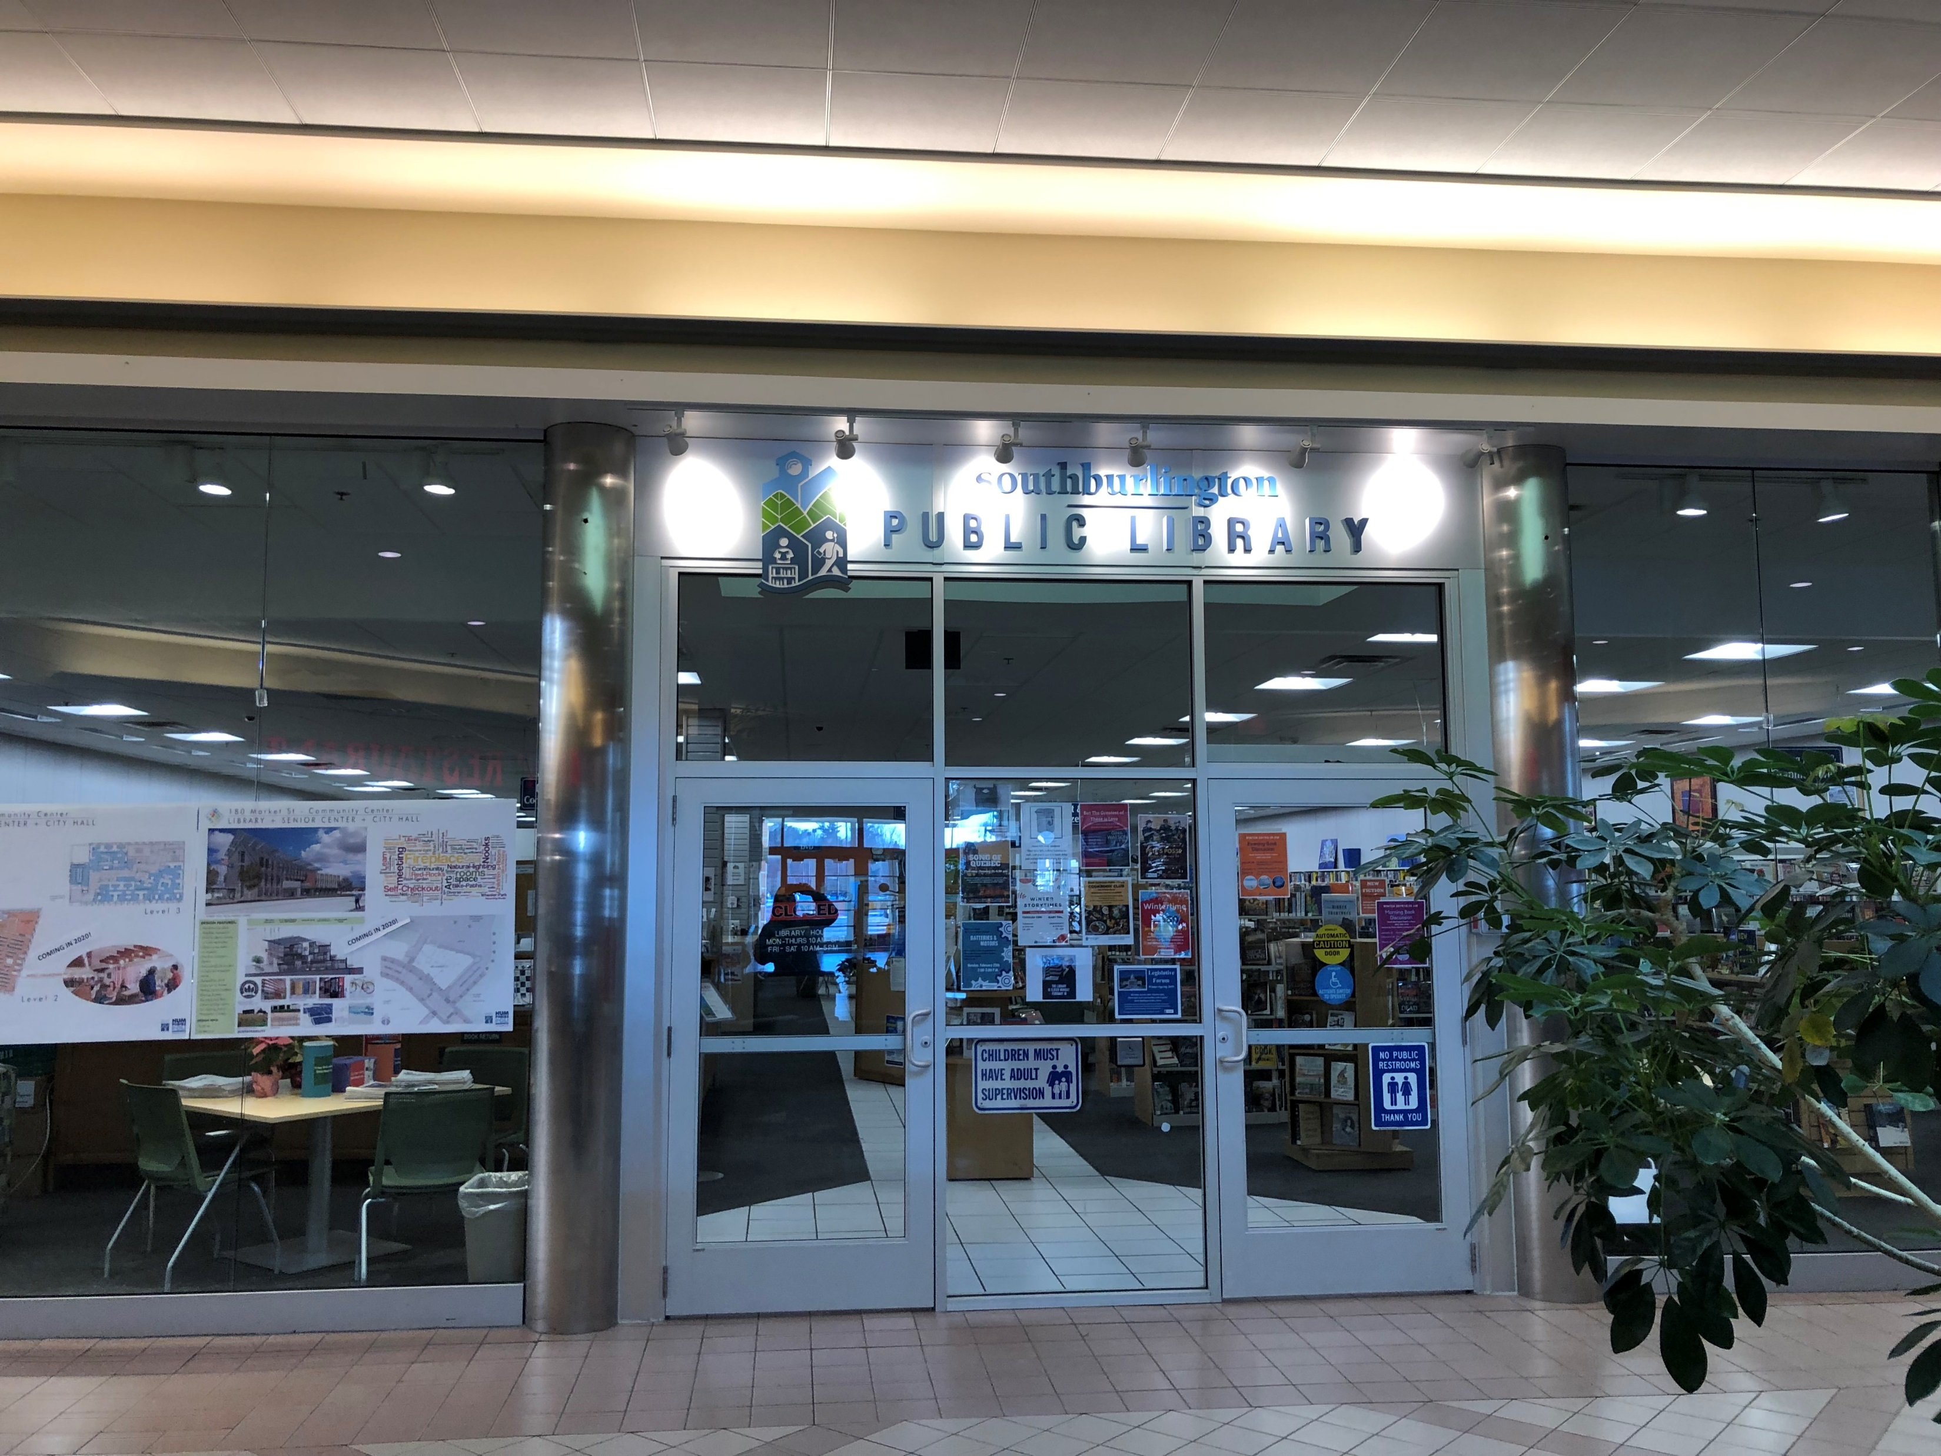
How Libraries Benefit Your Community
Libraries help your taxpayers connect with local government.
South Burlington Public Library
Notes:
Municipal Libraries – as part of the local government – are a fantastic way for taxpayers to have a positive interaction with their local government. In many towns, more taxpayers visit their local library than they do the clerk’s office. How can town officials and library directors to capitalize on this?

Slide 26
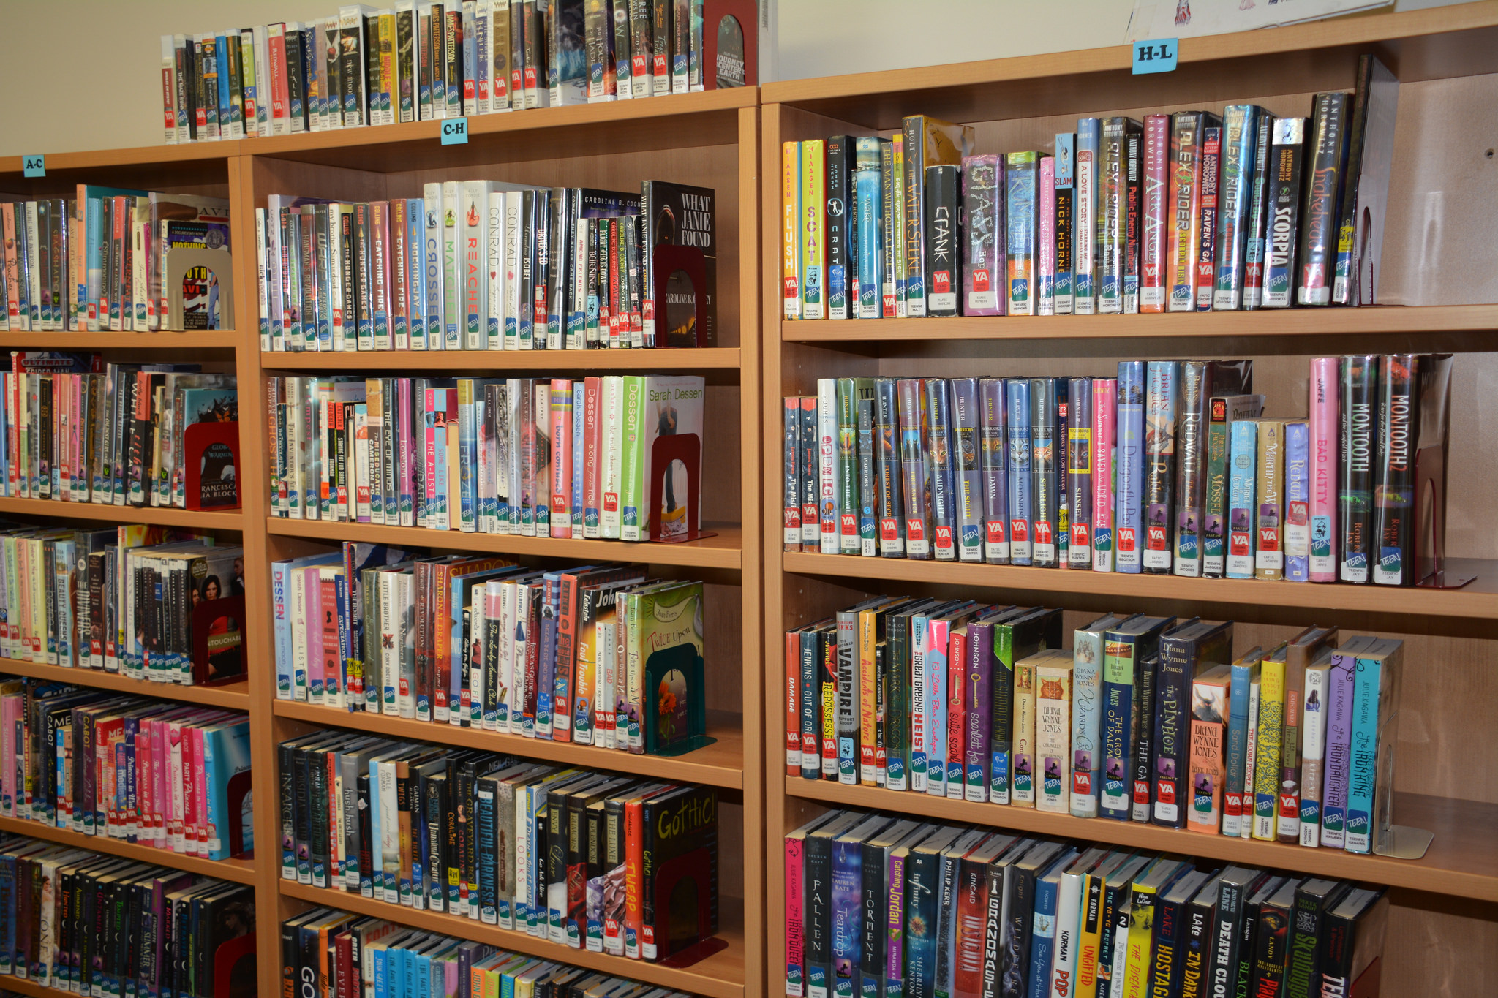
How Libraries Benefit Your Community
Libraries are the ultimate renewable resource
Source: https://www.flickr.com/photos/awesomelibraryservices/16393118653
Notes:
Libraries purchase a physical or electronic copy of items that can be used by everyone. Rather than purchasing one copy and – when you are done with it – letting it sit on a shelf, libraries provide an easy way for resources to be used again and again. They are fundamentally green, renewable resource providers.

Slide 27
How Libraries Benefit Your Community
Libraries Offer a Fantastic ROI*
*Library Value Calculator http://www.ala.org/advocacy/library-value-calculator
Source: https://www.flickr.com/photos/143843618@N03
Notes:
Libraries provide a wide range of materials and services at a relatively low cost per capita. In most towns, the per capita cost of the public library is less than the retail cost of 2 hardcover books. Taxpayers can access resources worth thousands of dollars- and through interlibrary loan tens-of-thousands of dollars - for a very low investment of taxpayer funds. Taxpayers can access internet service, library events, and research assistance for the same low investment. There are few ROI better than that.

Slide 28
Laws: State, Federal, Local, & ALA Guidelines
Wide Range of Laws & Guidelines to Follow
Similar to Running a Small Business
See Handout – “Trustee Training: Laws That Govern Your Work”
Important to Read and Understand ALA Guidelines:
Code of Ethics
Freedom to Read & Library Bill of Rights

Slide 29
What are the Fiduciary Duties of the Trustees?
Notes:
Trustees – by definition – have fiduciary (or held-in-trust) responsibilities. Common law of VT is established by over 2 centuries of cases which provide a foundation for understanding the fiduciary and proprietary duties of trustees.

Slide 30
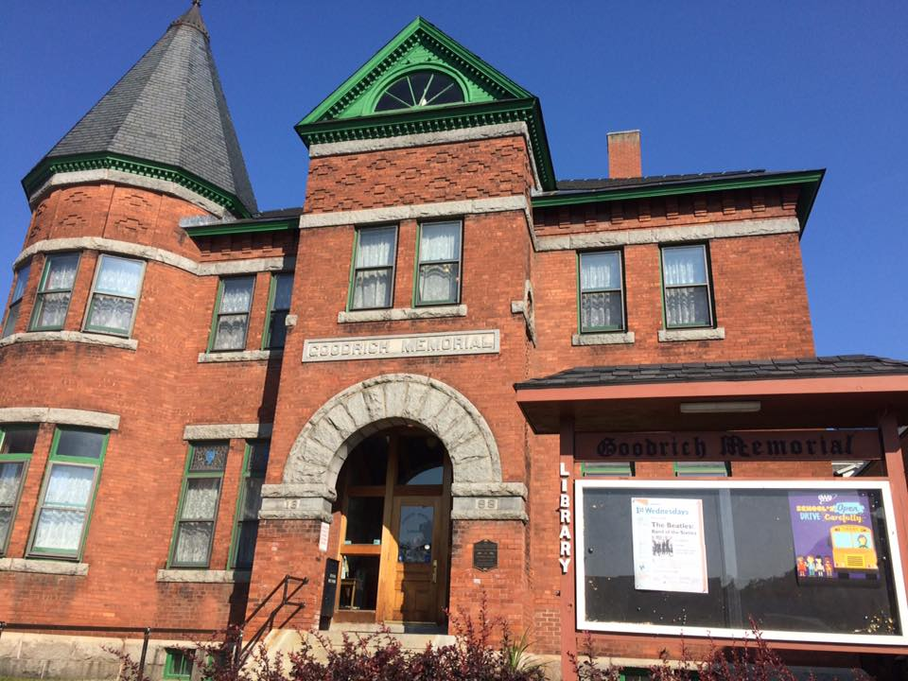
Duty of Care or Diligence
Behave in the best interests of the library
Notes:
Three Duties established by this Common Law: #1: Duty of Care or Diligence
“Act with the care that a reasonably prudent person in a similar position would use under similar circumstances.”
Perform duties in good faith
As Trustee, you are entrusted with the well-being of the library and expected to focus on the best interests of that library in your deliberations and trustee duties. This is why it’s so important to avoid appearance of conflict of interest.

Slide 31
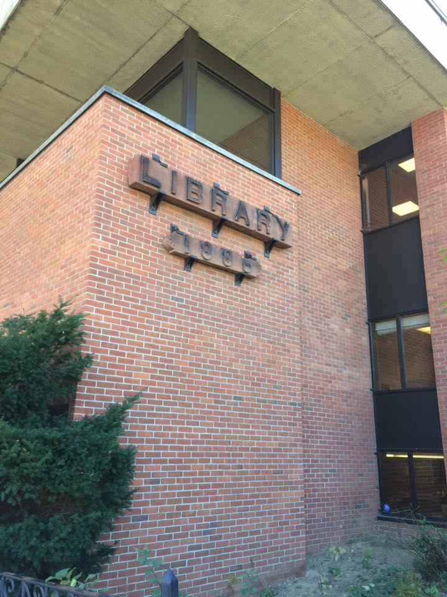
Duty of Loyalty
Avoid conflict between duty to the library & self-interest
Notes:
Stay aware of the territory between personal activities which might hurt the library & board activities
Avoid even the appearance of a conflict of interest
COI – mainly related to personal gain, and it comes into play especially in small communities when trustees might be related to an employee of the library, or might have a job outside their trustee duties that could appear to benefit from decisions the trustees make.

Slide 32
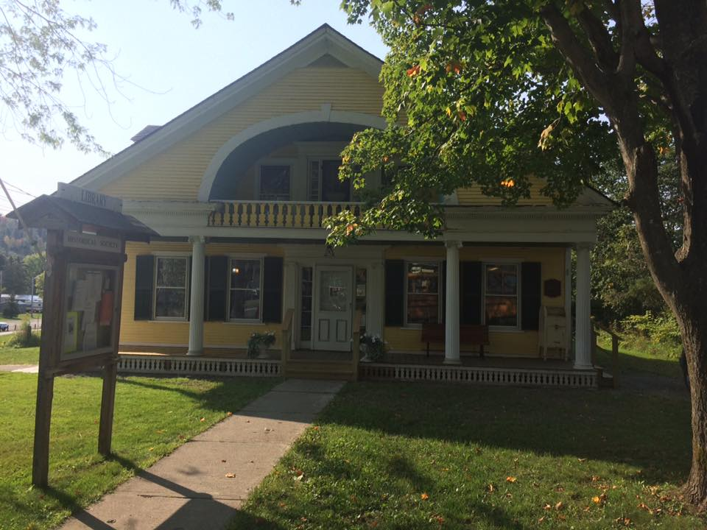
Duty of Obedience
Understand the Statutes, Charter, and Bylaws
Notes:
Understand the Statutes (Vermont & Federal)
Don’t overstep the powers given to the trustees
Important to know what laws govern your actions as a Trustee – everything from Open Meeting Law to your own bylaws – and avoid overstepping your duties.
Also why it’s important to have updated and accurate bylaws to effectively guide your work.

Slide 33
What Laws Should Govern Trustee Meetings?

Slide 34
What Rules Govern Meetings?
Roberts Rules of Order – if by-laws demand it
Note: Roberts Rules are not required by VT statute
VT Open Meeting Law for municipal libraries
VT Open Meeting Law for incorporated libraries that wish to meet the VT Minimum Standards for Public Libraries
Norms or ground rules set by the board

Slide 35
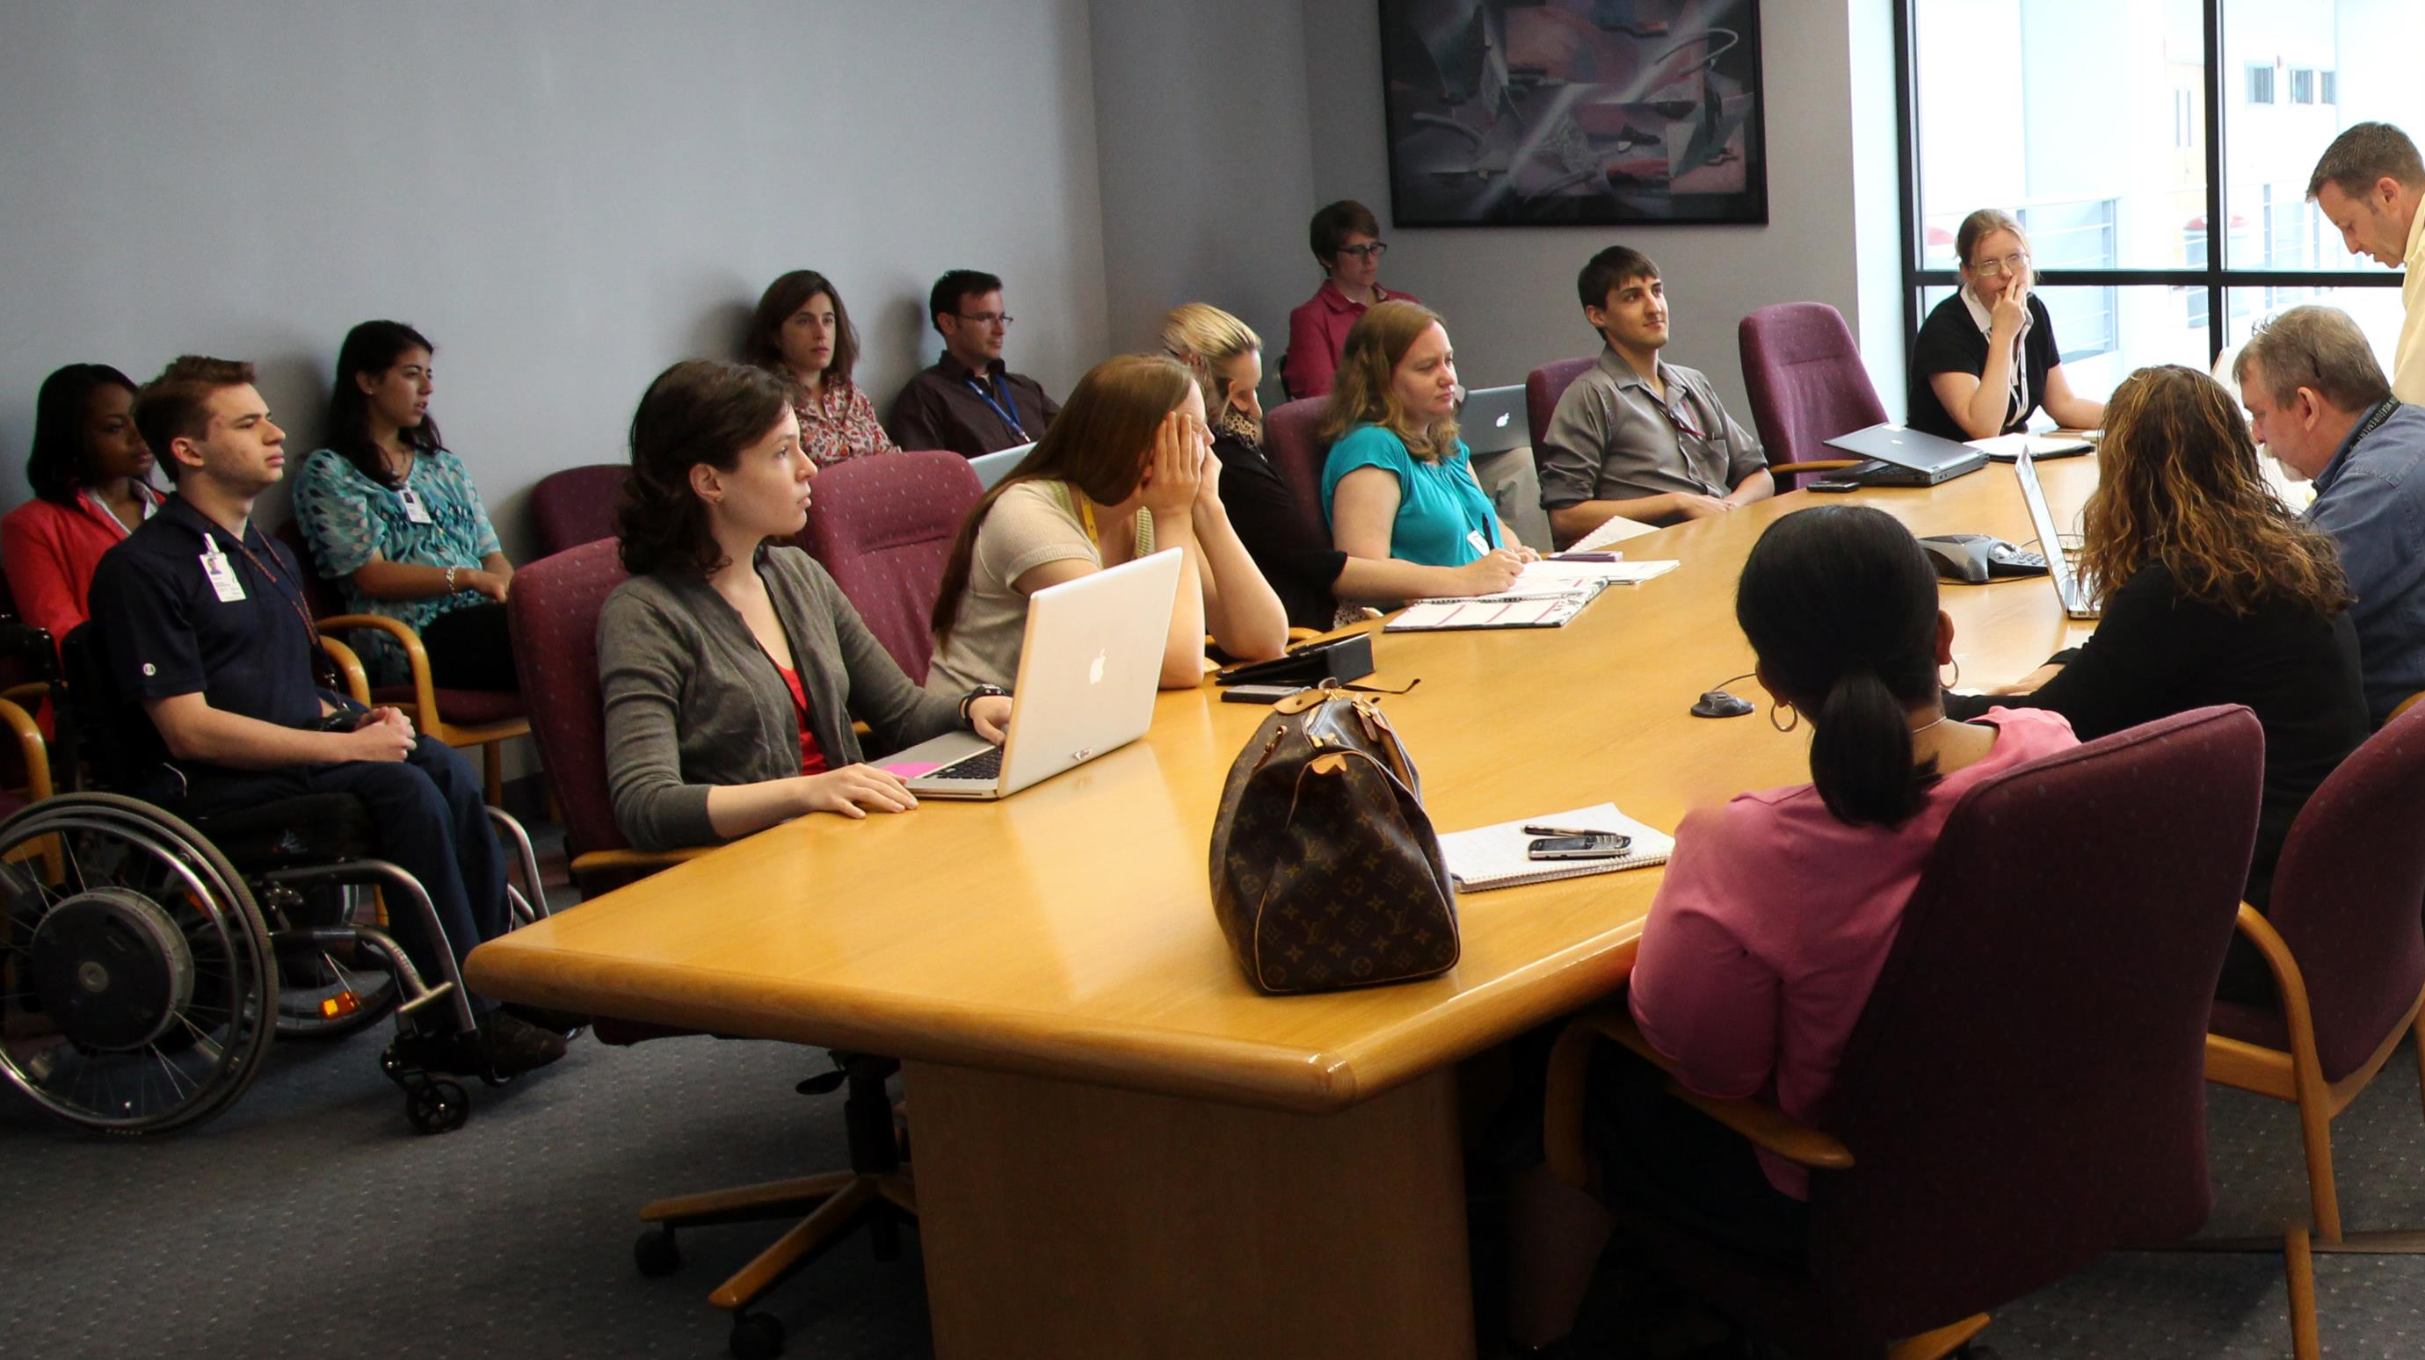
When Does Open Meeting Law Apply?
A quorum of the board meets to discuss library business
Source: https://www.flickr.com/photos/wwworks/9111274504

Slide 36
When Does Open Meeting Law Apply?
An official committee of the board meets to discuss library business
Source: https://www.flickr.com/photos/wwworks/9111274504
Notes:
NOTE: Applies regardless of the physical location of the members
Phone, web, email, and text conversations – no “reply all”
The members don’t all have to be in the same room at the same time for it to be considered a “meeting” under the Law. Furthermore, time is not a factor.

Slide 37
What is the Point of Open Meeting Law?
Give the public a fair & open opportunity to participate in discussions of, & decisions made by, their government
Source: https://www.flickr.com/photos/wwworks/9111274504

Slide 38
What is the Point of Open Meeting Law?
Make Government More Transparent
Source: https://www.flickr.com/photos/wwworks/9111274504
Notes:
You are using taxpayer money – I recommend that you be as open and as transparent as possible. You want taxpayers and supporters to know that you are not hiding anything. That you are being forthright and honest in your governance of this amazing, important public resource.

Slide 39
Requirements of Open Meeting Law
Provide advance notice
Create & post an agenda
Conduct business in open meeting
Allow public comment
Record & post minutes
Respond to violation complaints
Vote by roll call (electronic participation & not unanimous)
Source: https://www.flickr.com/photos/149902454@N08/35417844812
Follow executive session rules
Notes:
Agenda – not needed for emergency meetings – timelines for posting get to in a bit.
VT League of Cities and Towns says: items should only be added to that agenda when necessary to deal with an unforeseen occurrence or condition requiring immediate action. In all other cases, an item that has not been listed on a posted agenda should not be discussed as a last-minute addition. Instead, the body should place the item on the agenda of their next regular meeting or, if necessary, call a duly-noticed special meeting to address that item. Taking this approach will assure that the public has adequate advance notice and an opportunity to be heard on all topics to be discussed and decided by the public body.
Public Comment – put on the agenda

Slide 40
Agenda Posting
Regular Meetings: 48 hours in advance
Special Meetings: 24 hours in advance
Emergency Meetings – rare; only for situations requiring immediate attention
Post on/in:
website that the public body designates
municipal office
2 other places designated by municipality

Slide 41
Minutes
Public Records
Available within 5 Calendar Days
Names of Board Members & Active Participants
All motions, proposals, resolutions, & results of votes
Not a transcript: “true indication of the business of the meeting”

Slide 42
Executive Session: How To
Make a motion: indicate reason, state statutory provision
Vote must pass by majority to enter
Chair asks public to exit
Board may invite staff, clerks, legal counsel, & persons whose information is needed to stay
Source: https://www.flickr.com/photos/lenzmoser/20849912438
Notes:
1. Make a motion to enter into Executive Session during the regular meeting and indicate the nature of the business to be discussed. State the specific statutory provision that gives authority to enter into an Executive Session – Ones that concern you will likely be real estate transactions or personnel issues.
2. Vote must pass by majority to enter into Executive Session
3. Wait outside

Slide 43
Inside Executive Session
Discuss issue; make no decisions
Discuss only subject matter of motion
Decisions from discussion must be voted on outside of executive session
Source: https://www.flickr.com/photos/lenzmoser/20849912438
Notes:
1. In Executive Session the board discusses the issue, but does not make any decisions (except for entering into a real estate purchase option)
2. Only the subject matter of the motion to enter Executive Session may be discussed
3. All decisions resulting from the discussion must be voted on outside of Executive Session

Slide 44
Discussing problems, solutions, & other library business over email or text with a quorum
The Unintended Meeting
Notes:
Most board members communicate by email or text
When a quorum of board members discusses problems & solutions by email or text, they effectively hold an unwarned meeting outside of public scrutiny
If a quorum is conducting a group email or text discussion of library business, they are likely violating Open Meeting Law

Slide 45
Fundraising

Slide 46
What about the Friends Group?
Separate entity from the library
Establish MOU between Friends and Trustees
Differentiate types of fundraising done by each group & help public understand
Engage the Friends in Strategic Planning
Notes:
Be careful you are not trying to control them. Ideally separate 501c3 nonprofit.
MOU important – because it helps clarify roles.
To help clarify further, establish the types of fundraising done by friends vs. Trustees. Perhaps Trustees focus on larger items? Estates, wills, etc. Establish something with VT Community Foundation
Friends are advocates and already engaged. Need to keep them engaged and ask them for input when do strategic planning.

Slide 47
Fundraising
What types are needed?
Annual Campaign
1-on-1 Donor Development
Capital Campaign
Endowment Drive
Bequests/Planned Giving
Book Sales
Events
Grants
Source: https://www.flickr.com/photos/143843618@N03

Slide 48
Bequests, Endowments, & Other Large Monetary Gifts
Importance of Being Responsible Stewards of Funds for the Future Viability of the Library
Work with a Financial Advisor
VT Community Foundation
Nonprofit Entity
Designated Funds Option
Works with Donors to Set up Funds
Works with Many Libraries

Slide 49
Why Do You Need a Gift Acceptance Policy?
Protect the Library
Legal Liabilities
Undesired Restrictions
Unforeseen Consequences
Set Up the Library to Succeed in the Future
Establish Guidelines & Consistency for Donors
Donors Expect It (especially those giving large gifts)

Slide 50
Fundraising
Do you need a fundraising consultant?
Feasibility study & Follow-Up Work
Are you set up to fundraise?
Gift Acceptance Policy
Appropriate Accounts Established
Record-Keeping System
Donor Management System
Clear and Inspiring Statement of Need
Notes:
Someone who can help you learn how to set up your campaign, how to solicit donations, create timelines and to-dos, create a statement of need, keep track of donors, develop your messaging, etc.
A. Feasibility study – Capacity, start relationship building, get valuable insights on what need to do, what major donors might want from you.
Lots of items need to be established before you engage in any fundraising efforts:
Gift acceptance policy – what types of gifts will you accept, who will decide if something is accepted, how will gifts be used, can people attach conditions?
Where does the money go? What types of accounts? Foundation? Checking/savings? Special account with the town? VCF? Different line items for donations with conditions or donated for a specific purpose?
How do you ensure that money raised for a specific purpose is only used for that purpose? If you have an audit, how prove that money was spent appropriately?
How do you know who has donated what? Did you send them a thank you note? A tax-deductible letter (if applicable)? Why did they donate and when? What else should be recorded about this donor so that you can personalize asks in the future?
Donors want to really, clearly understand why you are asking for money and how it will be used. Experienced donors want reassurance that their money will be used responsibly.

Slide 51
Fundraising
What is worth the effort, and what do you (& the community) have capacity for?
What is your overall strategy?
Build the leadership team & train to the role
Visionaries/Honorary Members
Askers
Worker Bees
Others?
Notes:
House parties, events, annual appeals, 1-on-1, general publicity, book sales, bond issues, special tax districts, etc. – Events can be both outreach and fundraising – but you have to go into it with that mindset, because it might be a lot of work for little financial reward, but that is okay if you are using it to build goodwill. Still – need to be very strategic. What can your community support? Who else is doing fundraising and what are they doing? Do you have the team you need and the capacity for the work required – or do you need to hire someone? How do you make sure your efforts align with what else is happening in the community, what the community wants, etc? Listening tour?
Overall Strategy – How does fundraising fit into your other work? Your strategic plan? Your library’s long-term sustainability? What is your fundraising calendar? What will success look like?
Who can you get on your team, what might each team member do, and what training does each team member need?
Who know people and can give advice and maybe help with introductions
Those who do the asks – can be a professional or trained team member
Worker Bees – who run events, do the background work/record keeping

Slide 52
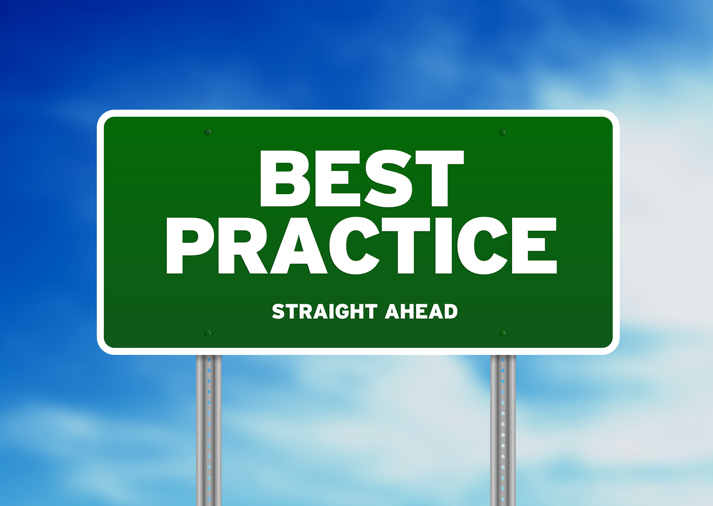
Best Practices for Library Trustees
Source:
https://www.flickr.com/photos/the-seo-company/8114460868

Slide 53
Provide Orientation for
New Board Members
Notes:
Trustee handbook – at very least. Go over bylaws and details of library function. Review minutes of last 6 months of meetings. Tour the library.
Super important – prep folks and train them. Use Trustee manual, handouts from this presentation, etc.

Slide 54
Understand & Follow
Open Meeting Law
Notes:
Read The Law of Public Libraries put out by the VT Secretary of State’s office.

Slide 55
Stick to Your
Meeting Agenda
Notes:
Respect open meeting law and people’s time.
Follow agenda. Depending on communication of your board, you may need to establish some formal guidelines around timing, how long anyone gets to speak, tabling items, etc.
Also – may need to establish subcommittees to work on something and report back to the larger group – which can then vote on items.

Slide 56
Allow All Trustees to Have
a Voice in Meetings
Notes:
Everyone should be part of discussions in meetings. The strength of the board requires that everyone engage, offer their perspective and expertise.
So chair must be willing to give everyone a chance to speak. And individual trustees must take responsibility for making sure that they speak up.

Slide 57
Commit Time Outside of Board Meetings
Notes:
Commit time outside of board meetings for the work of the board (ex: fundraising & PR)
Decisions and discussion are done at the meeting. Then go into the community to do the work: advocacy work, talking to funders, etc.

Slide 58
Empower the Director to Manage the Day-to-Day Operations
of the Library
Notes:
That is what you hired him/her for!
And set up a communication channel between trustees and director. What is the most effective way for library director to keep trustees up to date with library issues, without getting the trustees bogged down in things that they shouldn’t?

Slide 59
Provide a Unified
Vision & Mission
Notes:
Help lead the library forward and make its place clear in the community. Develop that vision and mission together, follow it, and make sure it reflects the needs of your community.

Slide 60
Have a Unified Voice
in the Community
Notes:
United voice – You have collective authority – individual trustees, regardless of their position on the board, do not have the power to command the services of a library staff member, nor to speak or act on behalf of the library, unless they have been specifically granted that authority by a vote of the board. ALSO – Every trustee has an ethical obligation to publicly support an adopted board decision.

Slide 61
Become Informed about Library Issues
Notes:
Education – Trustee conference, List Serv, publications

Slide 62
Represent the Library
in Your Community
Notes:
You represent the library as a governing board member – so make sure you know your board’s talking points. Make sure you know what’s going on at the library.

Slide 63
What Is Succession Planning?
Source:
https://www.flickr.com/photos/28537647@N06/2887726958
Notes:
One of the most challenging – and most important parts – of your job as Trustees in insuring the long-term health of your library as an institution is succession planning – or thinking about what’s going to happen to the library when you are gone, your term expires, your director leaves, your staff leave, or any other major change. What do you need to do as a board to make your library as sustainable as possible regardless of who is leading it?

Slide 64
Planning for the Future Governance of Your Library
Planning for the Future Governance of Your Library
Source: https://www.flickr.com/photos/mscaprikell/5966121
Notes:
What is succession planning: Planning for the future governance of your library.
Who leads when you are gone? And what do they need to keep the library sustainable and growing as an institution?
Look at the make-up of your board – if you needed to get new ppl on your board this year, what questions should you be asking?

Slide 65
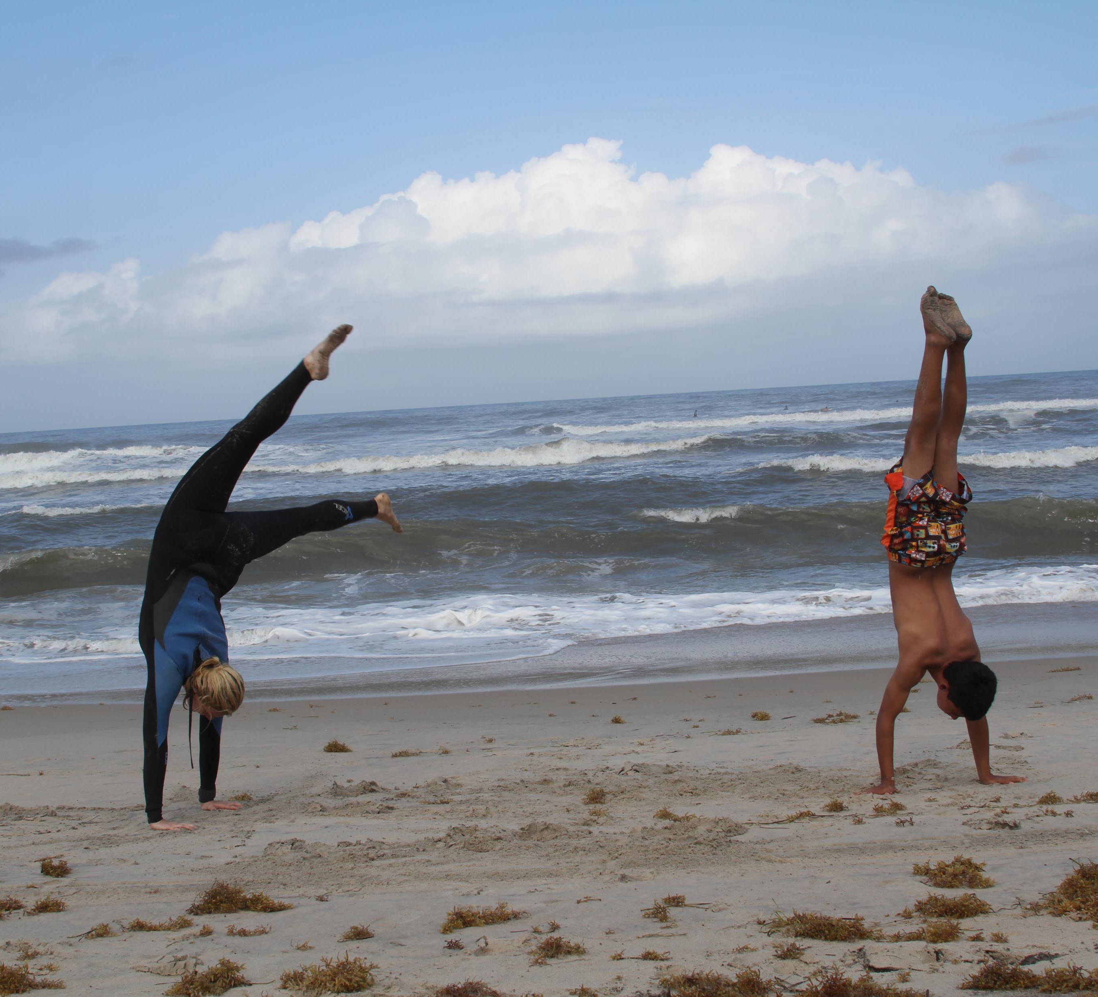
What are the Skills, Talents, & Attributes that Our Board Needs?
Source: https://www.flickr.com/photos/jenniferwilliams/7289560470
Notes:
How do we know what are the skills, talents and attributes we require on our library Board?
Best practice in developing a succession plan involves developing an inventory of current trustees' skills, talents and attributes that are then matched against the requirements of the organization. Identifying the requirements of the organization will involve a mix of the professional skills that make up a high performance Board (accounting, legal, strategic etc), the talents that trustees will be required to use (e.g. networking, questioning skills, nonjudgmental, conscious awareness etc), and the attributes that each trustee represents(male/female, age, ethnicity, geographic location etc).
Need to assess your board member’s current skills, talents, and attributes – and figure out what you are missing. Do you have someone connected to the business community? Do you have someone connected to young families? How about someone good at marketing? Fundraising?

Slide 66
How Do We Find People with these Skills, Talents, & Attributes?
Source: https://www.flickr.com/photos/stevepj2009/6857101082
Notes:
Legwork – going out into the community, talking with people, going to service organization meetings (Rotary, Kiwanis, PTA, etc.) and talking with folks. Going to church meetings. Speaking at different organizations. Talking to business owners. Talking to local schools/colleges. Make it known what qualities you are looking for and talk it up in as many places as you can. It takes work to actively recruit people – and it takes time. Start doing it well before you need someone. And don’t rely on passive recruitment. Putting out notices on FPF.

Slide 67
Once We’ve Found Them, How Do We Attract Them to the Board?
Source: https://www.flickr.com/photos/brendan-c/5388970247
Notes:
Think of it in terms of marketing – Good, exciting job description that shows your passion and excitement for the work you do.
People are more likely to volunteer when asked specifically. Make sure you tailor your message to the desires of the person you are asking. Are they a boomer who is concerned about leaving a legacy? Can you tap into that? Are they a young parent who is concerned about creating a library that will benefit children? Are they interested in community building? On literacy? These are all things that you can appeal to.
Be strategic – figure out who the board should ask, who on the board would be best for approaching each person, and what they should say.

Slide 68
United for Libraries www.ala.org/united
Notes:
United for Libraries offers this Board Planning Matrix to help you assess the diversity of skills, age, connections…

Slide 69
United for Libraries www.ala.org/united
Notes:
Style, and expertise on your board.

Slide 70
Job Descriptions for Board Officers
Source: https://www.flickr.com/photos/29792566@N08/6140852961
Notes:
Another good practice for succession planning is making sure you have good job descriptions for your board officers.
Describe what each officer does, when they do it, and any applicable information. Example: Treasurer – whose names are on the bank accounts? How do you change those names and how long does that process take? Who gets the bank statements? Do you have online banking? What is log-in information?

Slide 71
Calendar Detailing Yearly Tasks
Source: https://www.flickr.com/photos/dafnecholet/5374200948
Notes:
Help with planning and to keep the board on track if something happens to the chair – when do you start working on the budget – and what’s the process for that? Which policies are reviewed in when? How often do you review your bylaws? When do you usually review your Director – and what steps are taken in that process? When do you elect officers?

Slide 72
Updated Bylaws
Source: https://www.flickr.com/photos/60588258@N00/3293465641
Notes:
Review regularly –and make sure you are following. These are force of law – so need to make sure you have a clear understanding of what they say and follow them.

Slide 73
What if your library director resigns?
Source: https://www.flickr.com/photos/127226743@N02/26616054891
Notes:
What is the process? What skills does a library director need to succeed in your library? In your community?

Slide 74
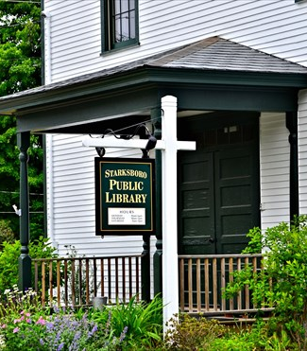
How do you know if Your Library meets the needs of its patrons? Community Needs Assessment as an Integral Part of Strategic Planning

Slide 75
Initial Information Gathering: Community Assessments By Others & Census Data

Slide 76
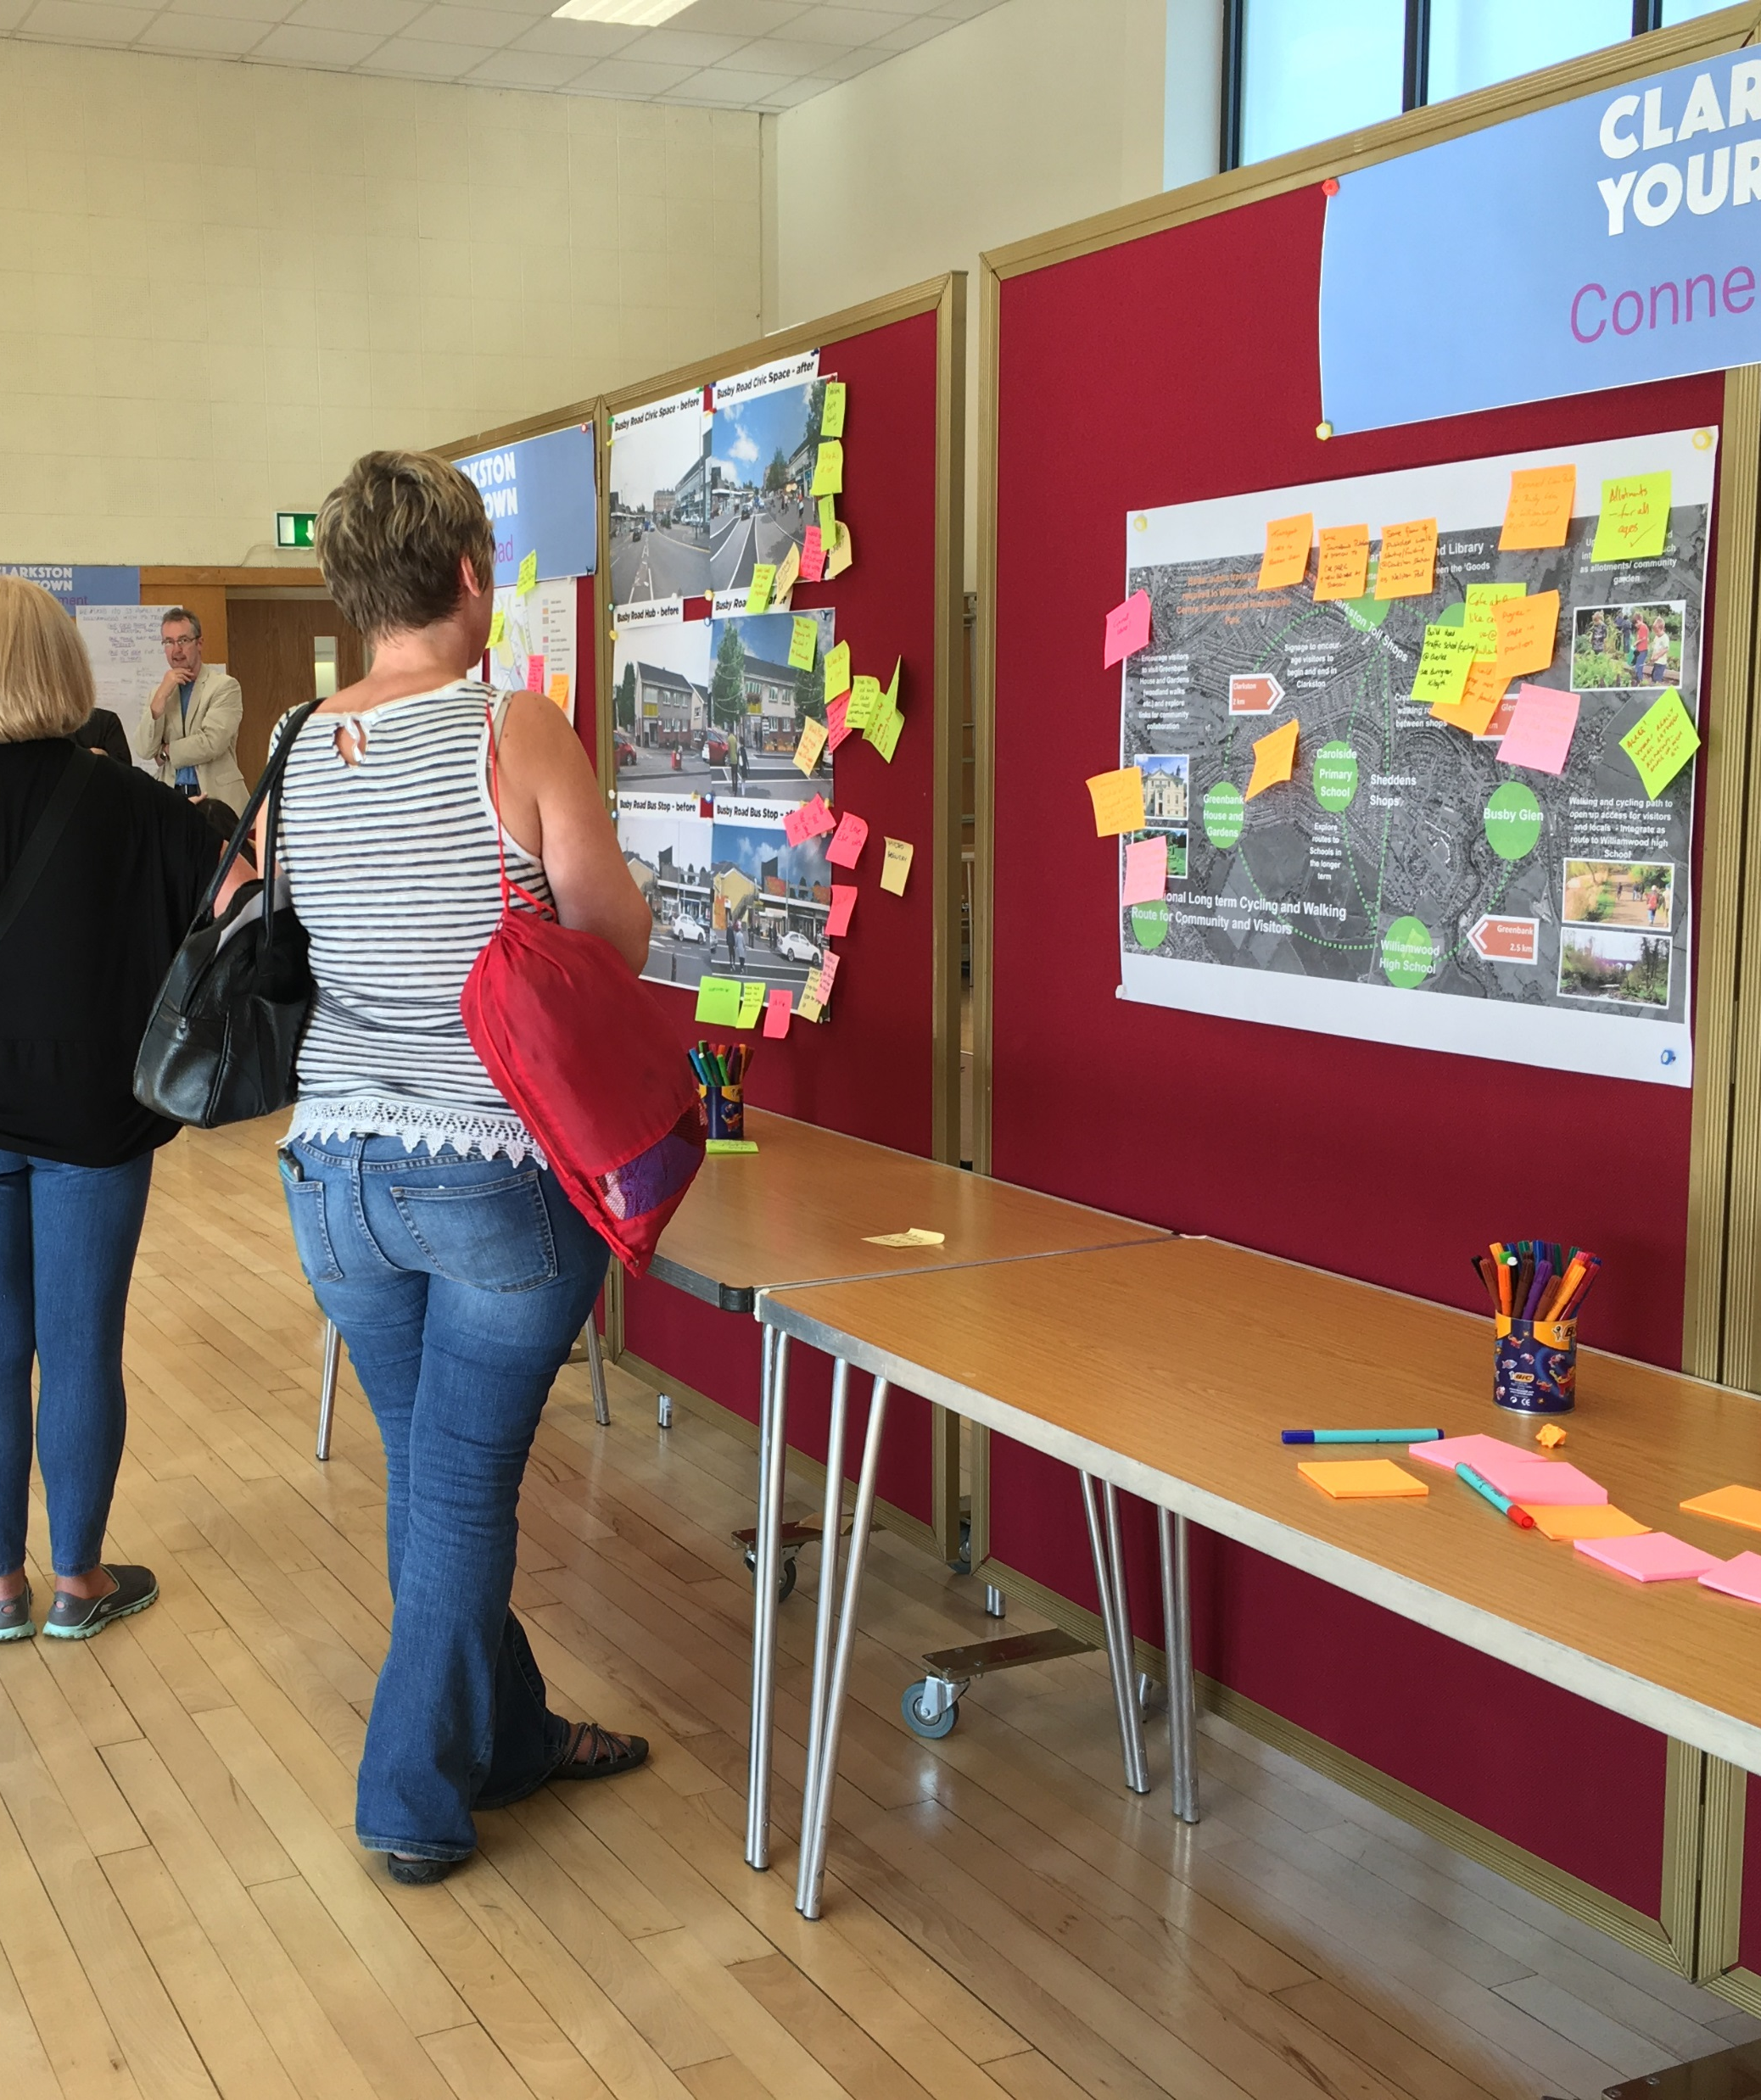
What other local groups have done a community needs assessment/survey recently?
Town Plan? Town Department Effort?
Another Nonprofit, Civic, or Religious Organization?
What did they learn that you can build from?
Source: https://www.flickr.com/photos/nwplanning/30130854111/

Slide 77
Census Data
Michael Moser – UVM Center for Rural Studies
802-656-0864
Michael.Moser@uvm.edu
American Community Survey: 5-year Increment Sampling of Census Data (for smaller towns): https://www.census.gov/programs-surveys/acs

Slide 78
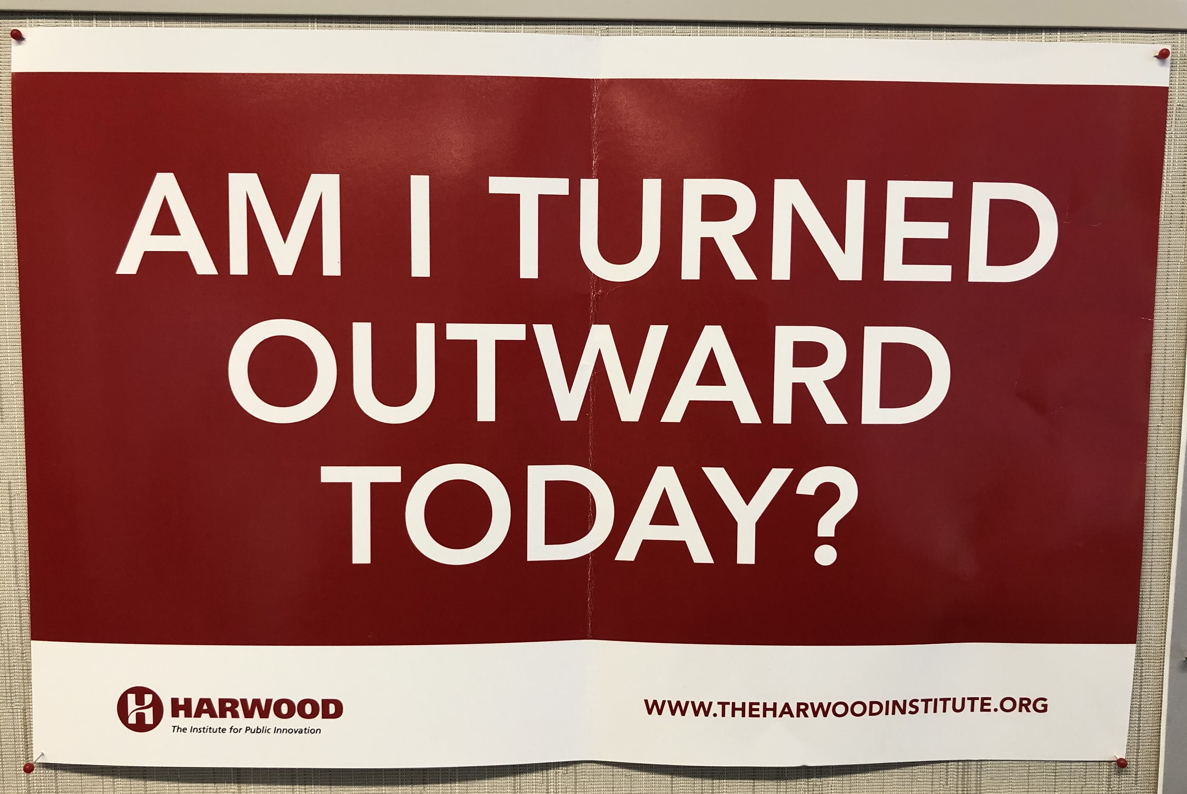
The Importance of Turning Outward: Expert Knowledge vs. Public/Community Knowledge

Slide 79
What Groups Exist in Your Town & Where Do People Gather
Religious Groups
Social Groups
Civic Groups
Nonprofit Orgs
Parent/Youth Groups
Business Groups & Businesses
Places: Dump, Park, Stores, Events, etc.
Local
Gov’t
Notes:
1. Civic Groups – Rotary, Kiwanis, 4H, etc.
2. Religious Groups
3. Social Groups – book clubs, sporting leagues, art groups, revitalization groups
4. Parent/Youth Groups – PTO, Homeschooling, Soccer, Youth Baseball

Slide 80
How Do You Find Out Your Community’s Needs?
Focus Groups?
Surveys? – How administer? Where administer?
Go out into the community? – grocery, coffee shop, farmer’s market, community events, etc.
Go to community meetings? – Rotary, PTA, Church Groups, etc.
What questions do you ask, how do you ask them, and who does the asking?
Notes:
Who do you invite? Where hold? What size?
Are there any other surveys being done by – or in coordination with – the Town or any other group that you can make use of?
Being in community – you can connect with ppl who might not even use the library – and do more important outreach work.
Same as above
I have some resources for this. And whether you do this process yourself or hire someone depends on the level of community needs assessment that makes sense for your community.

Slide 81
Meeting Community Needs
How do you assess the current and future needs of your community? Why is this important to do?
Which of these needs should (and can) be addressed by the library, given the library’s limitations?
Should the library partner with other organizations to meet certain needs? (Create library advocates)
How does the library’s mission statement/vision help guide you to an answer? Strategic Planning?
Notes:
How do you know what the overall needs are of your community?
How do you know if the things your library is doing meet your community’s needs? How make it sustainable? Limits on hours, staff, & budget. Requires an understanding of what’s involved in the basic running of a library, hours that takes (ordering, book reviewing, receiving books, cataloging books, paying bills, solving building issues, developing programming – and that’s all outside of helping patrons and keeping the library open).
People love libraries. There is – in general – a lot of goodwill extended towards libraries. You can share that goodwill strategically by carefully picking partners who will benefit from that association. And, by partnering with them, you will help turn them into library advocates, and extend the library’s reach into the community. The deeper you can embed your library, the more support you will have around budget time. But this also takes a lot of time outside of keeping the library open.
Need to think strategically about the library’s survival. You are dependent on your funders – so you need to make sure they understand your mission, that they understand what you are doing and why it’s valuable, and that they feel their needs are being met. So you need to think strategically about what makes the most sense – which needs are most important and why – and how you know that.

Slide 82
Your Library’s Mission Statement

Slide 83
Community Needs & Strategic Planning
Aspen Institute Action Guide V. 2.0: http://www.libraryvision.org/download_action_guide
Harwood Institute Turning Outward Tools: http://theharwoodinstitute.org/tools/
ALA Turning Outward Tools for Libraries: http://www.ala.org/tools/librariestransform/libraries-transforming-communities/resources-for-library-professionals
VT Department of Libraries Professional Collection
Notes:
Three items that can help you in strategic planning. You can also feel free to connect with me if you’d like a facilitator in the future.
Assess ways to engage your community – Focus Groups? Go out into community and meet ppl where they are?

Slide 84
Advocacy: Community Connections
Talking up your library & getting others to talk up your library
Talking Points you can use & get others to use on your behalf.
Solicit Patron Stories to Share: How has the library changed your life? What do you love about the library?
Source: https://www.flickr.com/photos/volunteermatch/27677155485/

Slide 85
Advocacy: Community Connections
United for Libraries: Power Guide for Successful Advocacy: http://www.ala.org/united/powerguide
Turning the Page Library Advocacy Training: http://www.publiclibraryadvocacy.org/
Tribute: Library Patrons Expressing Love – Pierson Library: https://www.youtube.com/watch?v=xFwS4_cllJo

Slide 86
Future of Public Libraries
“Community Hub”
Access to New Types of:
Resources
Programs
Services
Altering the “Look and Feel” of the Library

Slide 87
The Work of Library Trustees
Vital to Our Democracy
Vital to Our Communities
Vital to Our Citizens
Thank you for the work you do!

Slide 88
Contact Me
Lara Keenan
State Library Consultant, Governance & Management
60 Washington Street, Suite 2, Barre VT 05641
802-636-0026 | lara.keenan@vermont.gov

