Slide 1
BEYOND BOOK SALES Friends of the library today
Presentation for the VT Library Friends Conference
by Christine Graham
Fall 2017

Slide 2
What’s Happening To Libraries?
People want a gathering place
And they are less focused on the books…
They want a coffee shop but with more stuff to look at...
It’s a place to do business
A place for ‘after school’
A place for programs, learning, hearing, and doing, not just reading and research
It’s a place to take care of personal business: apply for jobs, fill out forms, file your taxes, renew your license...

Slide 3
Who’s going to pay for this?
Today’s library requires more space, technology, staff, and money
The traditional municipal funding pays for a traditional library….not today’s library
Just as we outgrow our library, we are also feeling pinched by taxes!

Slide 4
Challenges for Libraries
Funding the library is perceived as ‘government’s job’
People assume libraries are FINE with just town funds.
Some people think libraries are obsolete.
Others think everyone has a computer at home, so libraries don‘t need to provide technology or research.
Most volunteers would rather do a book sale than a fundraising solicitation.

Slide 5
And The Biggest Problem:
People don’t want to DONATE to their TOWN!!
“We pay our taxes, that’s enough”
“There’s nothing VOLUNTARY about taxes!”
“Taxes are the fair way to share municipal costs… a few people shouldn’t have to GIVE to relieve the muncipal budget!”

Slide 6
The Friends Can Help
The Friends of a Library can be a 501(c)(3) public charity
With this designation, the Friends can:
Accept donations
Give tax deductions for gifts
Retain endowment and cash reserves restricted for the library
Fund special needs and projects
Respond to community needs without a vote.

Slide 7
How To Do This?
Encourage the community to feel philanthropic toward the library
Encourage gifts at all levels, not just ‘angel’ gifts
Encourage gifts at annually, not just bequests
Create a habit of giving
Teach people they can give MONEY in addition to time and books!
Be responsive to community needs.

Slide 8
Tools and Moves…
A Fundraising Database: Excel and Access are starters, but you’ll need more sophistication
Rethink your membership system…. A tiered membership discourages other giving
Build relationships and major giving for the future
Develop Planned Gift policies beyond bequests
Create online giving options
Review the efficiency and demands of your events.

Slide 9
Rules and Regulations..
Volunteers can always ask for donations, no registration or regulations
State law provides basic protection for volunteers
If you need more insurance you can get Officers and Directors Insurance commercially
All donations go directly to the organization
You should never pay anyone to raise money based on commission or percentage

Slide 10
The Friends Need to Evolve…
The role of The Friends is changing, because your community needs a library that goes beyond municipal responsibilities.
You need to leverage your fundraising capacity
You can listen and respond to community needs
You can make GIVING to the library an attractive, appreciated, philanthropic experience.

Slide 11
How do you get started?
Understand the Basic rules and methods of fundraising that apply to all types of organizations
Like most things, your fundraising will benefit from:
Planning and Focus
Common sense
Strategic thinking
Listening
Relationships
Fundraising is ageless: learn from others’ wisdom!

Slide 12
Seek Balance
You can always raise more money from a few big donors than many many ‘small’ donors, but you need both for the long haul.
You need to ask frequently because people forget, but if you ask TOO frequently, they are annoyed.
If you don’t ask, most people won’t give.
The more traditional and visible the cause (libraries, hospitals, humane societies) the more likely small annual gifts will lead to a bequest!

Slide 13
Why People Give to Libraries
We believe everyone should have access to information, education and entertainment.
Because we loved going to the library as a child…
Because we feel good when we help our community
Because someone they respect asked us
Because the library is in the center of the community
Because we want to make a Difference
Donors are like you….

Slide 14
What Donors Need To Know
What do you do besides loan books?
Who uses the library today?
What is your impact on the community, individuals, kids, the future, our families?
Where does the money come from to run the library?
What happens when you don’t have enough money?
Are libraries going to survive?
What does the library of the future look like?
These answers form your CASE STATEMENT

Slide 15
Options
Annual Campaign:
raise it now, spend it now
operations, programs, acquisitions, all OK
Capital Campaign:
permanent assets like buildings and endowment
Planned Giving:
for sustainability and permanence
You can and should do all of these….in time

Slide 16
The Organizational Life Cycle of Gifts
Library cards and/or Membership
Capital and endowment gifts
Planned gifts
Special project gifts
Annual gifts

Slide 17
The Way It Works
$$$$$$ Major Donors
7-11 individual donors giving 40-70% of the total $
$$$ Transition donors:
10-50% of donors giving 20-50% of the $
$ Grassroots and Community
90% of donors giving 2-10% of the $

Slide 18
Your Goals
Identify the financial needs of the library for the short and long term. Balance realism and dreams.
Create a culture of philanthropy for your library, building an annual campaign first
Seek a combination of larger and smaller gifts (donors)
Foster relationships with prospects and volunteers
Listen to your library users and your community
Develop a simple, accessible, ongoing planned giving program
If you need a capital campaign, give yourselves time to plan!

Slide 19
Essentials for Annual Fundraising
A Plan with solid timing
A theme or message (don’t tell the whole story every time!)
Short, readable, visual impact, personal touch materials
A growing prospect list
A core group of top donors who get personal attention
At least two mailings for grassroots and mid-level prospects
Reliable, easy database (and someone to use it!)
Correct and appreciative thank-you’s
Annual report of some type
An event: but not too many, not expensive, not a time-killer!

Slide 20
Essentials for a Capital Campaign
A true, expressed need: something that will support the library in perpetuity!
A plan that includes
Assessing your donors’ interest and capacity
Justified budget
A manageable timeline
A powerful ‘quiet phase’ that tests your goal before going public
Modest, appealing, informative materials
A strong team of trained volunteers not afraid to ASK!
Understanding of donor interests, benefits, demands.

Slide 21
Stages of a Capital Campaign
Test #1: develop the Case Statement and Draft Goal, conduct a feasibility study
Expand or contract your plans based on the study
Quiet Phase: aim to raise 60+% from fewer than a dozen donors before public announcement
Test #2: determine your final goal based on quiet phase results
ANNOUNCE your goal and plans
Raise the next 20-35% in very personal ways from mid-level donors
Launch the Grassroots Campaign to attract as many donors as you can, and finish the campaign with the last 1-5% of gifts.
Celebrate!

Slide 22
Essentials for Planned Giving
Learn about the wide variety of planned gifts…..
libraries are traditional recipients of estate planning, even from low level donors and people you don’t know!!
You don’t need to be an expert, but you need basic knowledge and an estate planning attorney on call in case you need them.
Prepare before it happens: develop policies, materials, get a list of local estate planners and attorneys who can help.
Use a story-telling approach. Keep it low-key.

Slide 23
For more information
Christine Graham, Principal Consultant
CPG Enterprises Inc.
www.cpgfundraising.com
802-343-0659
Based in Burlington and North Bennington VT
Check out our publications available online

Slide 24
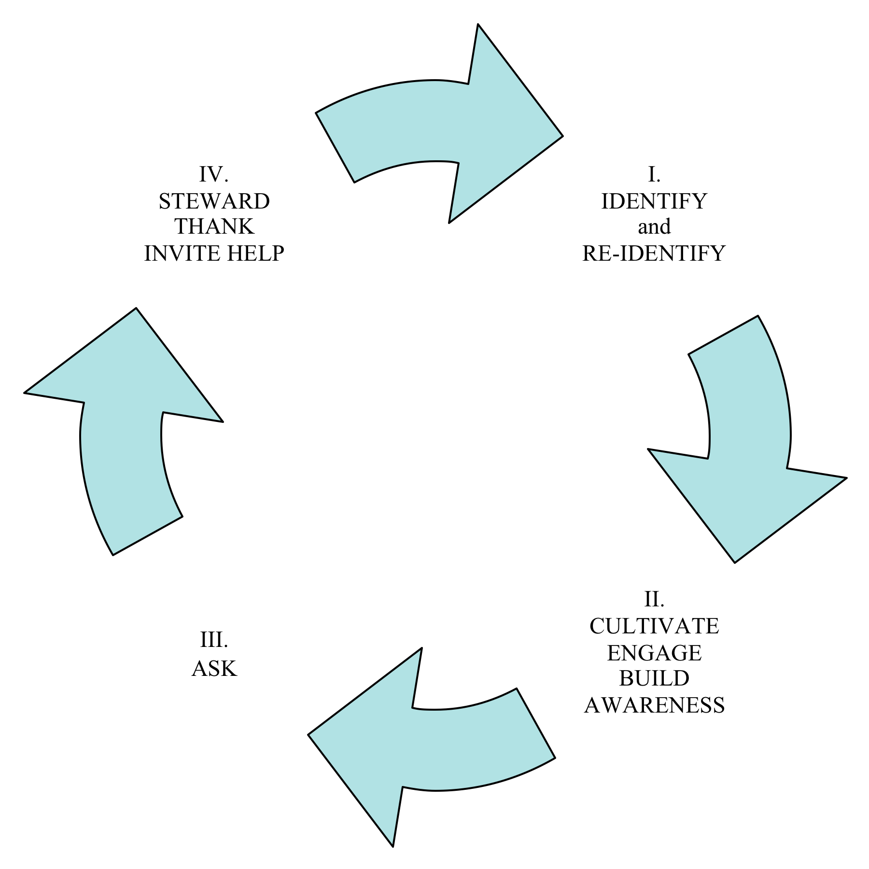
How You Develop Support

