Slide 1
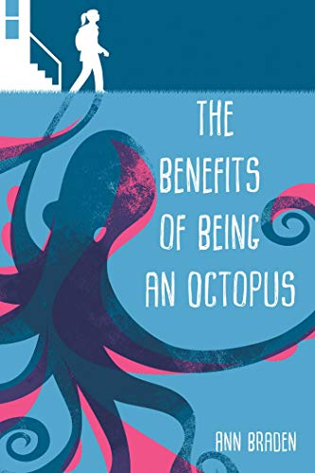
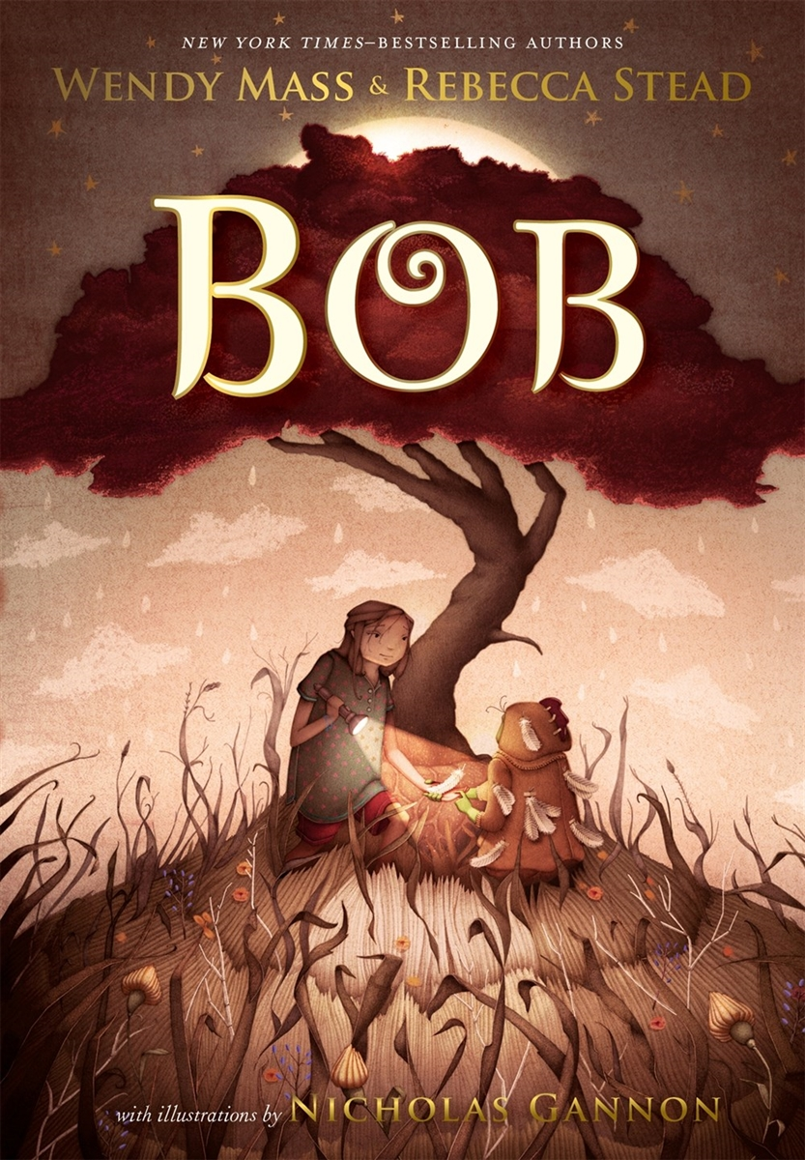
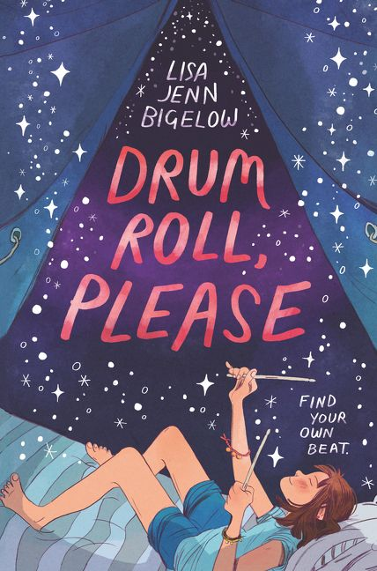
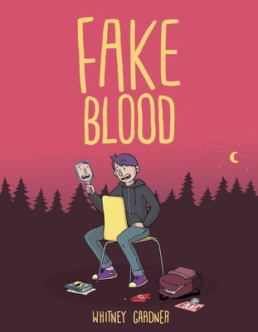
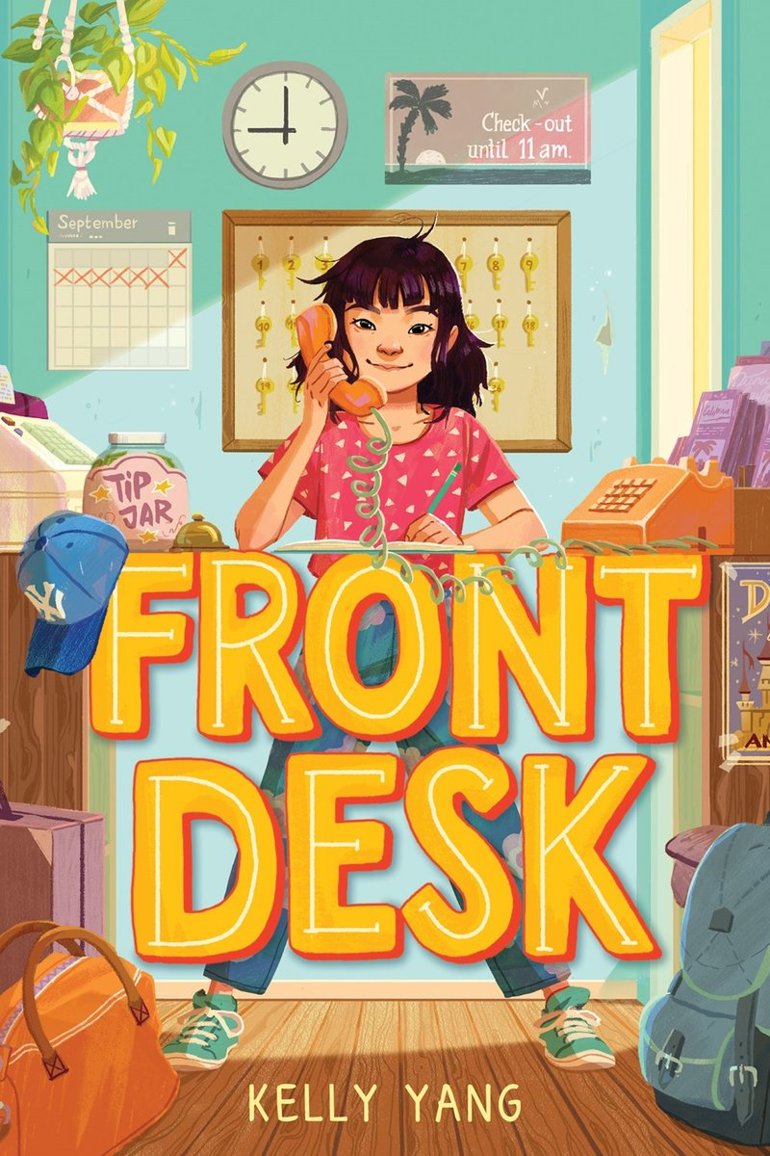
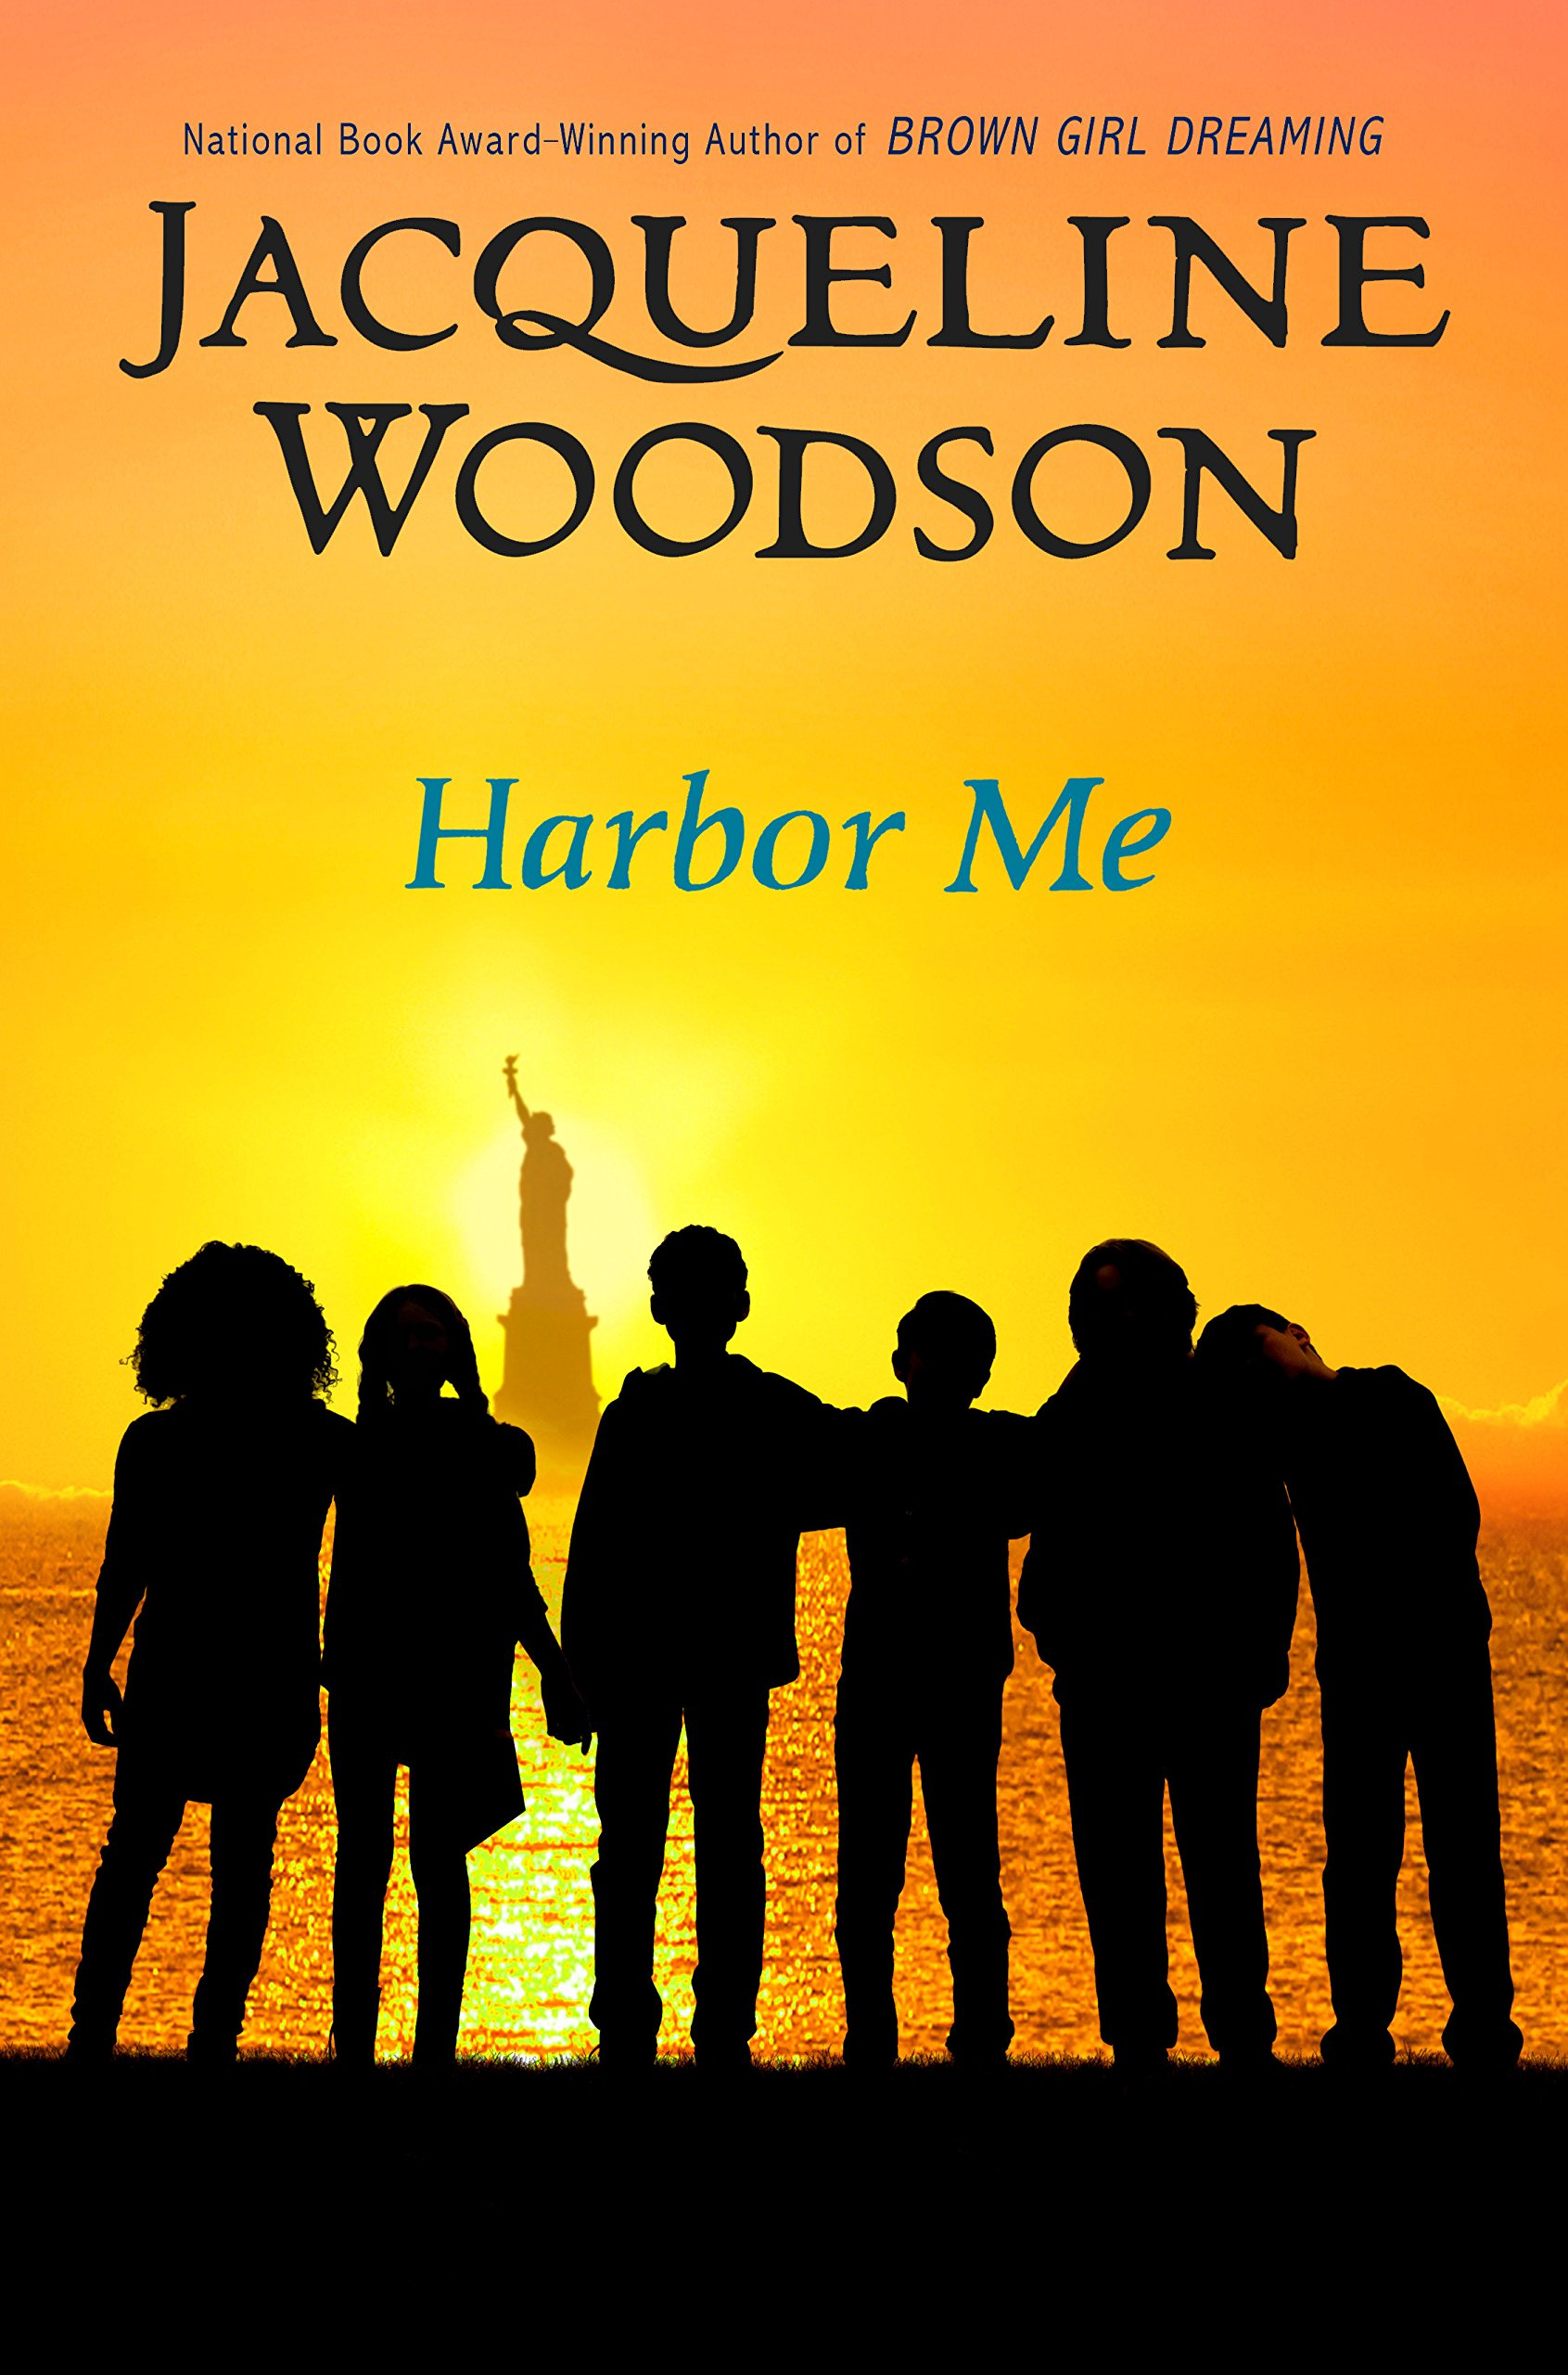
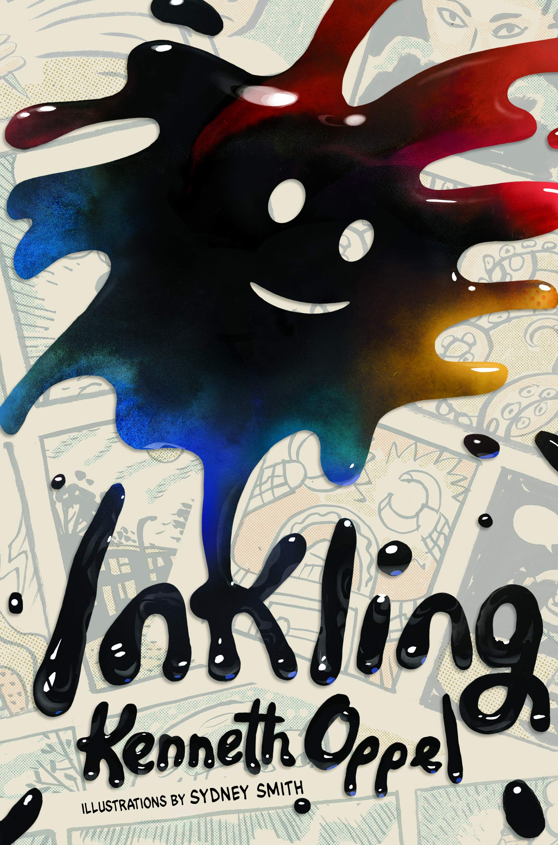
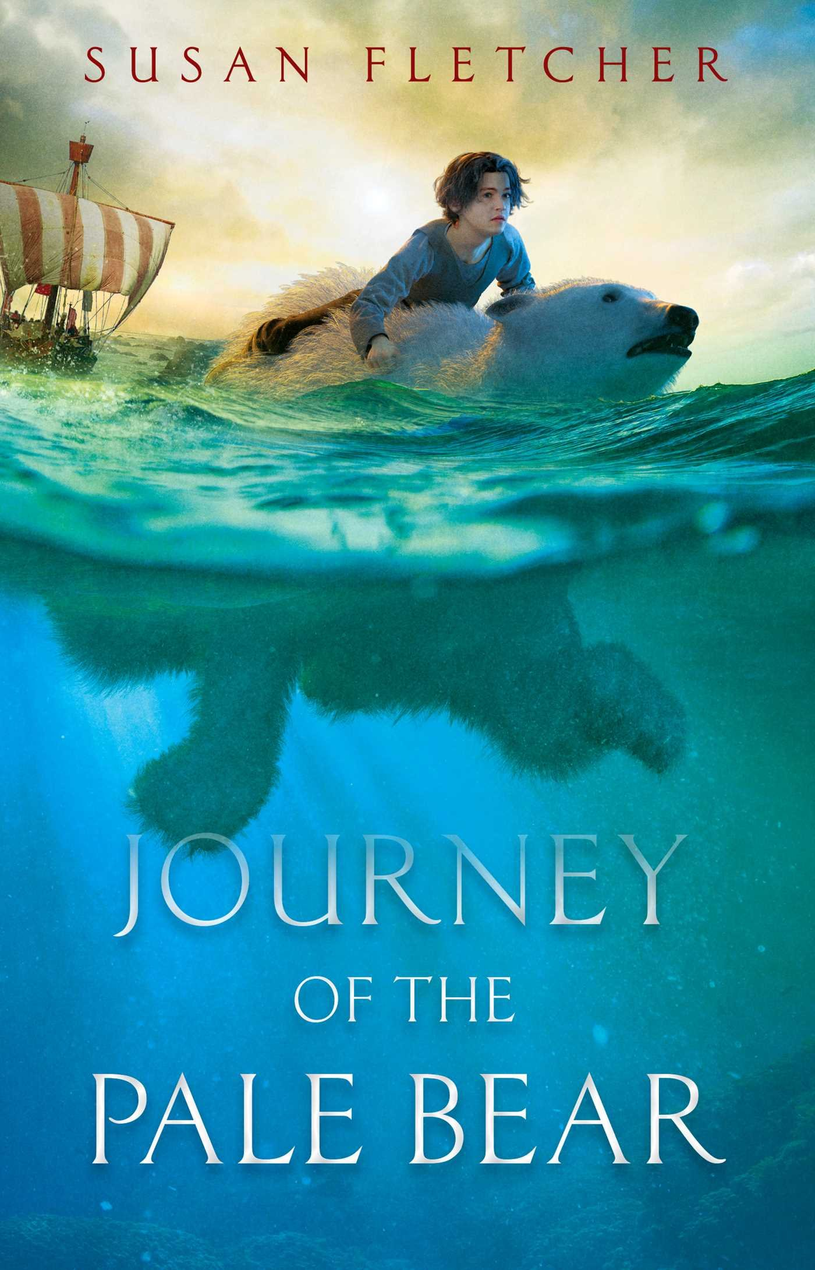
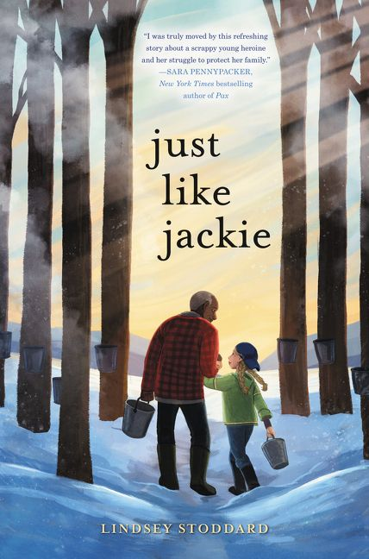
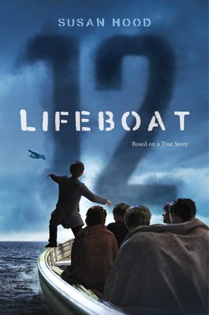
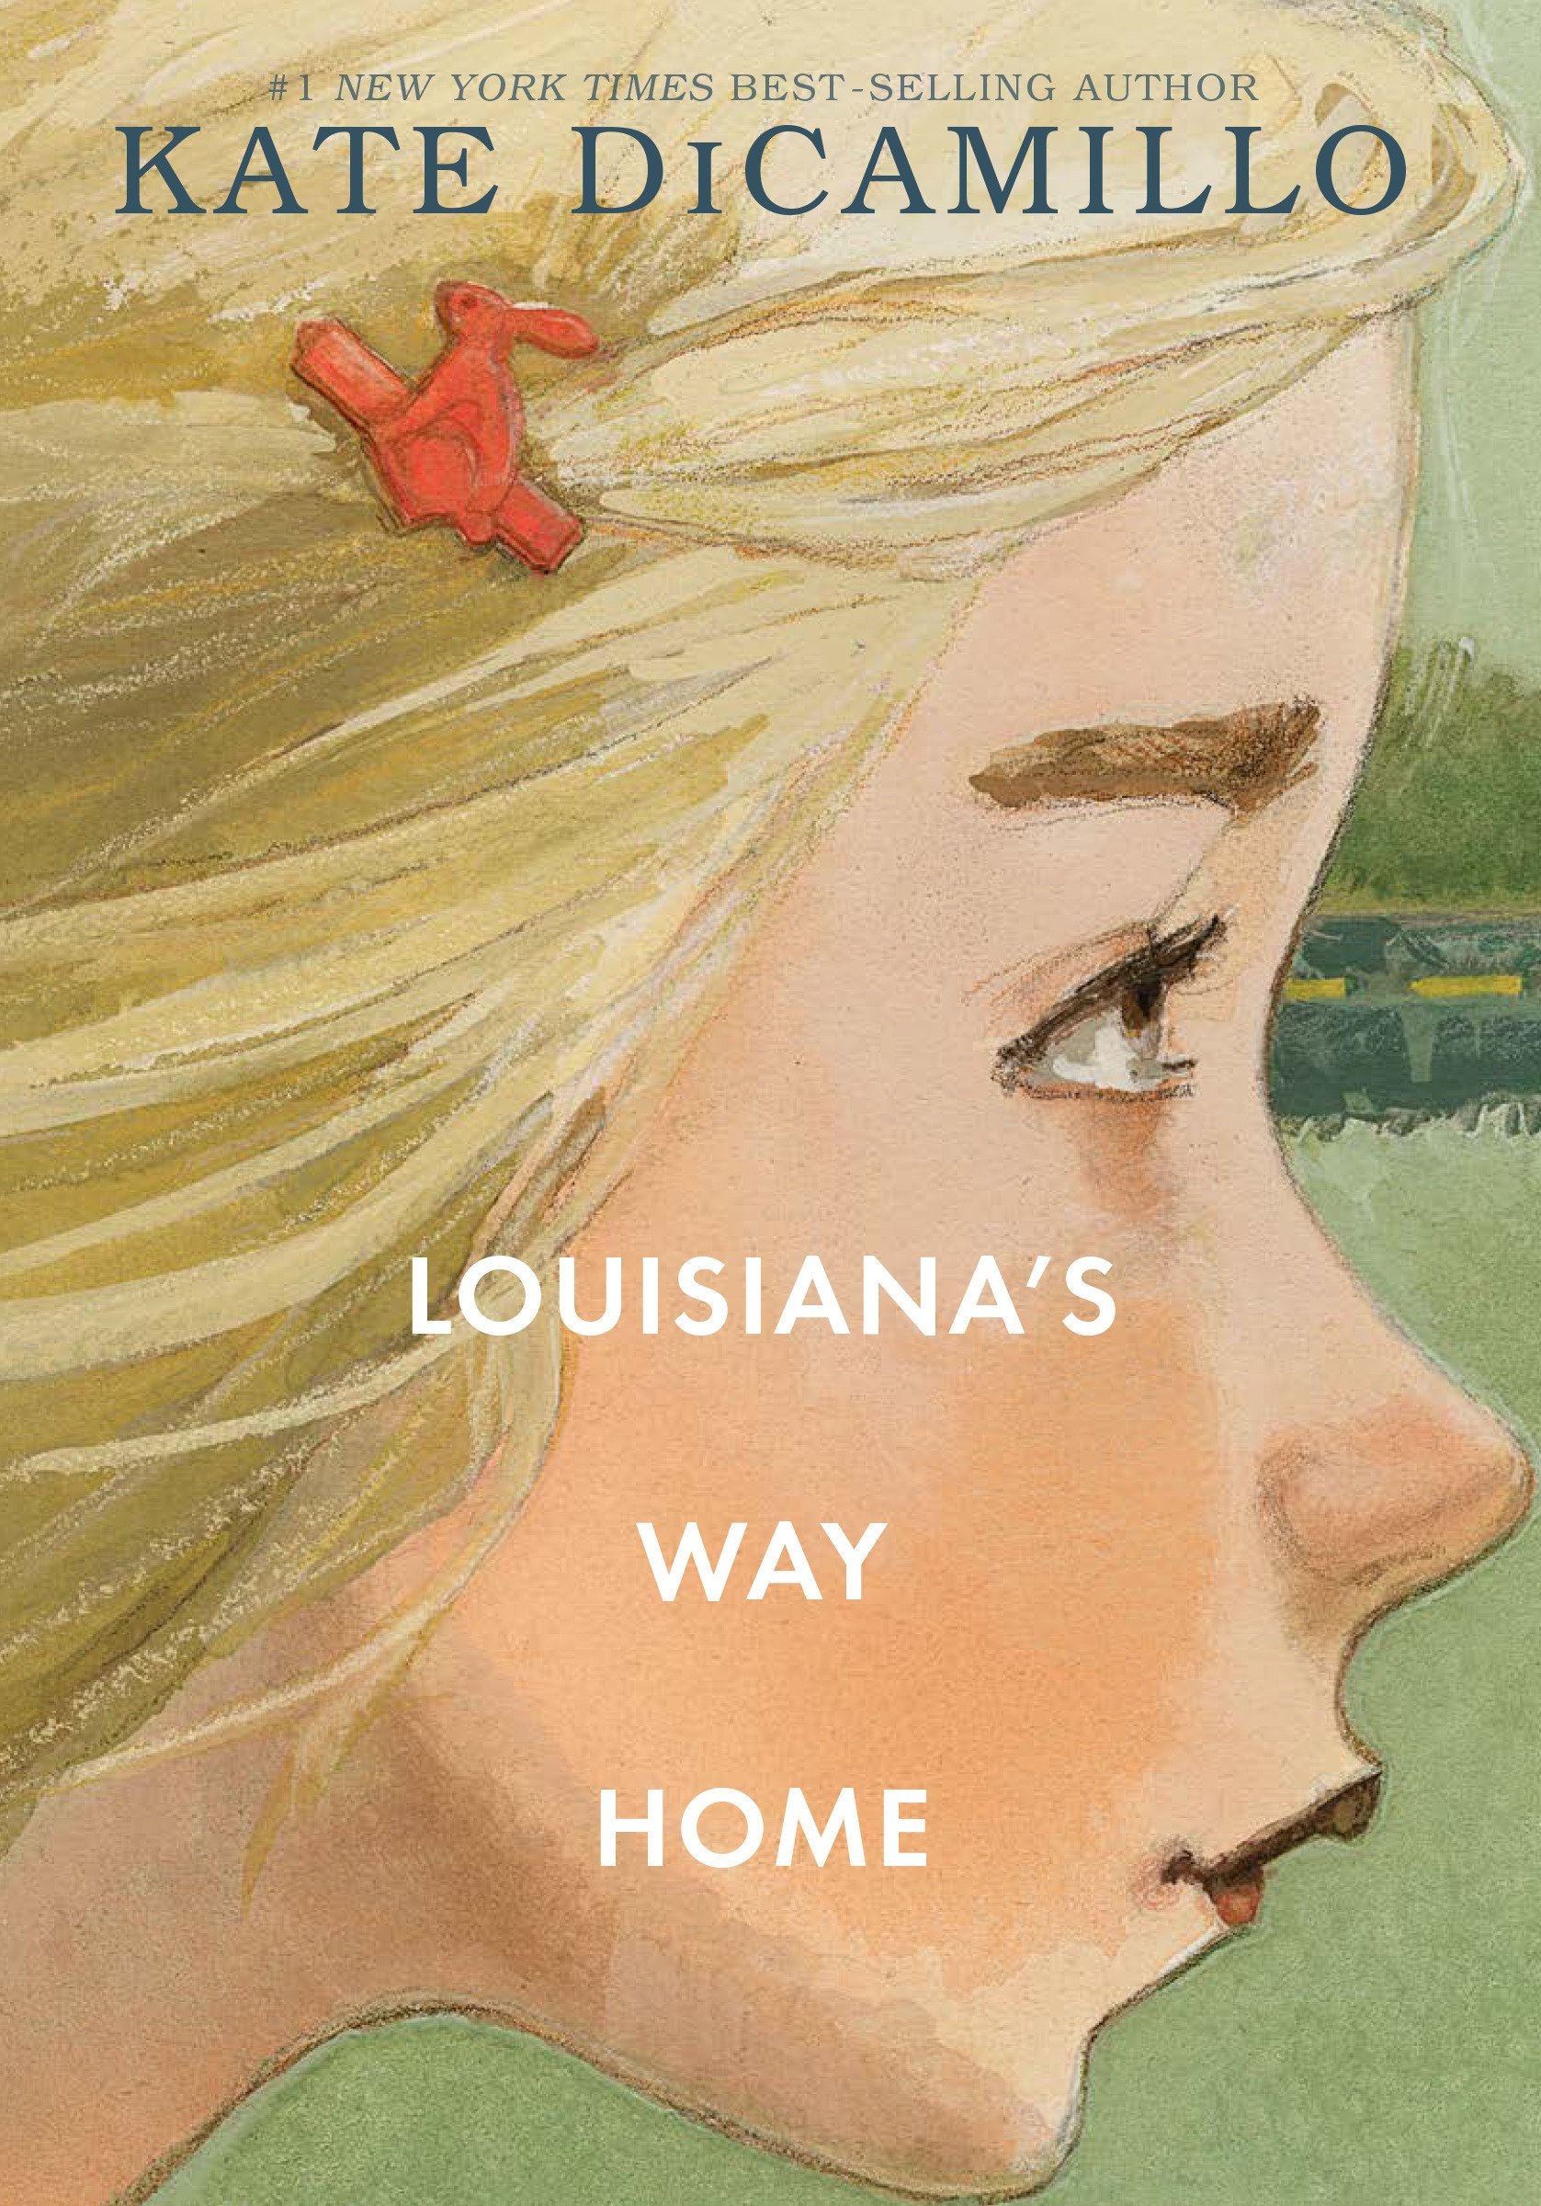
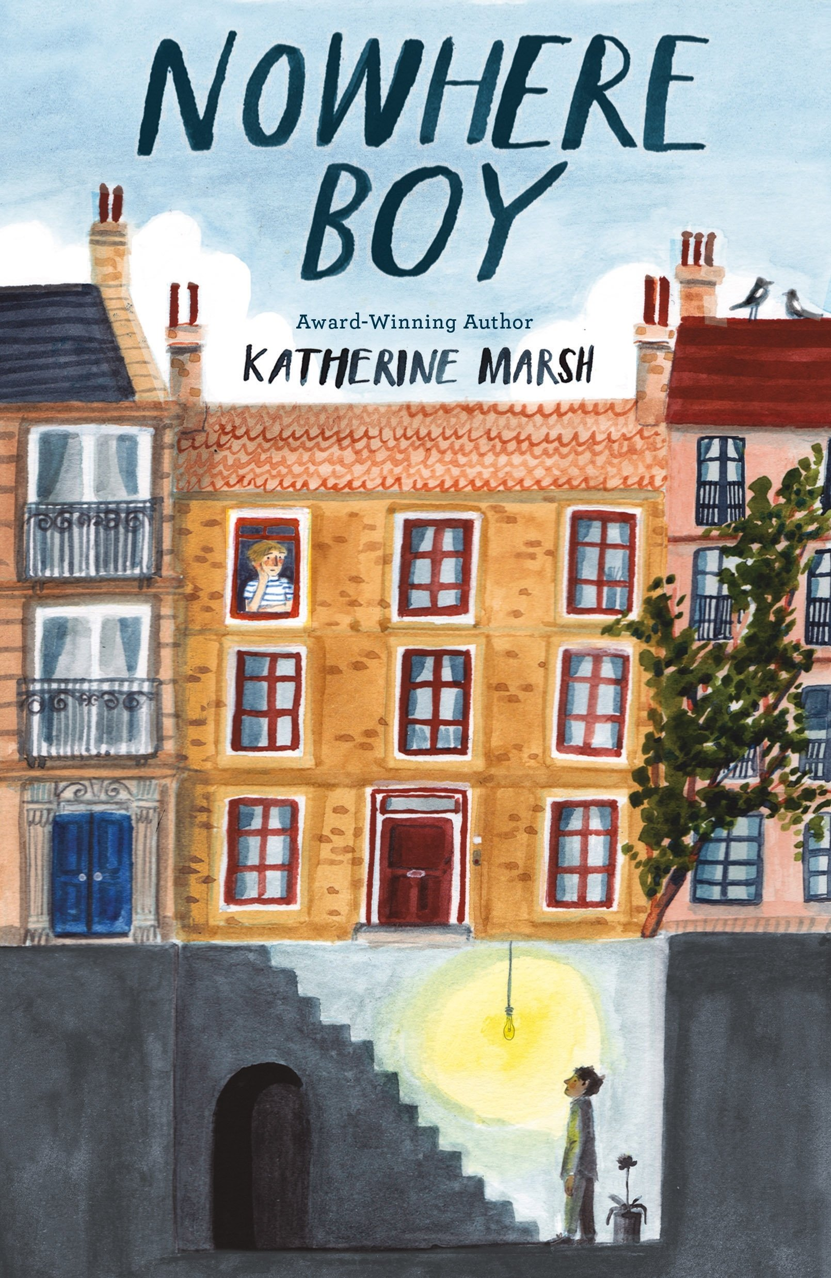
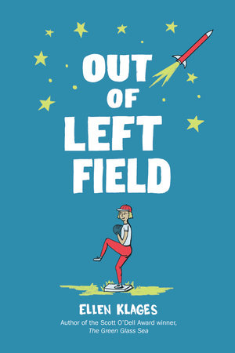
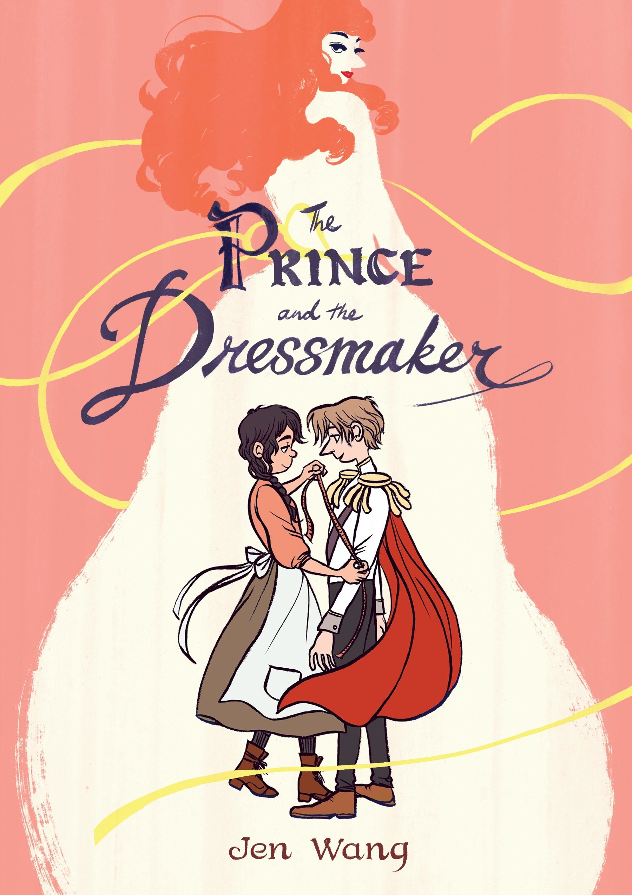
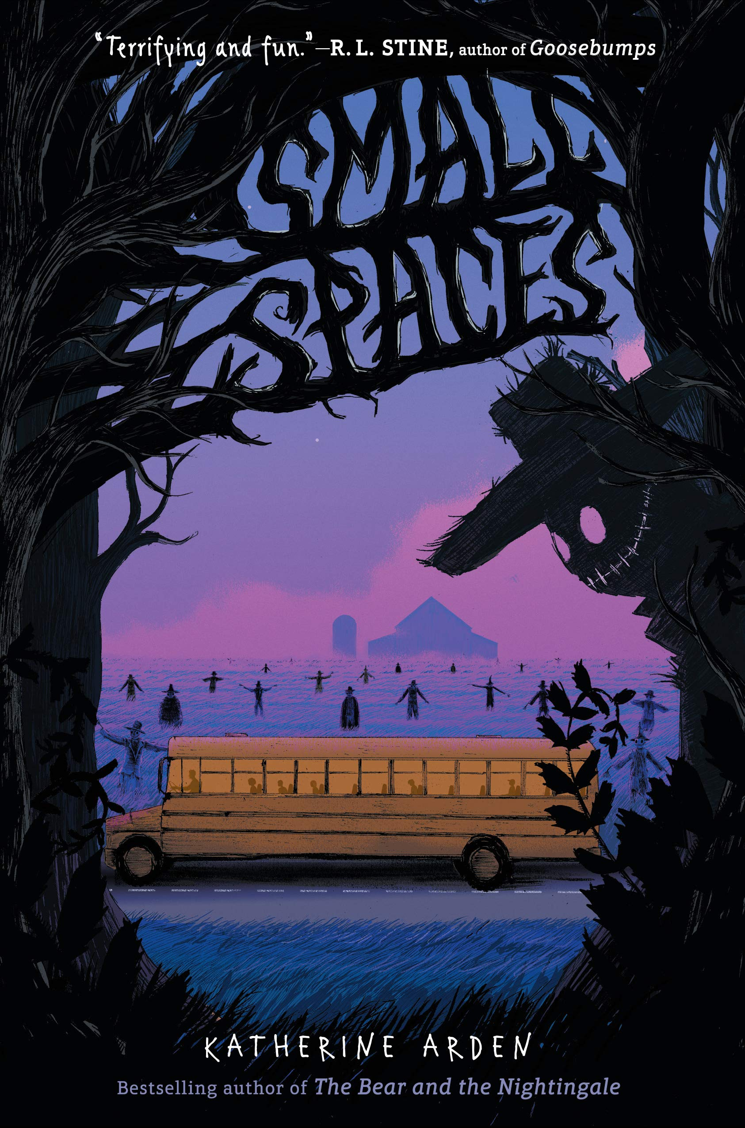
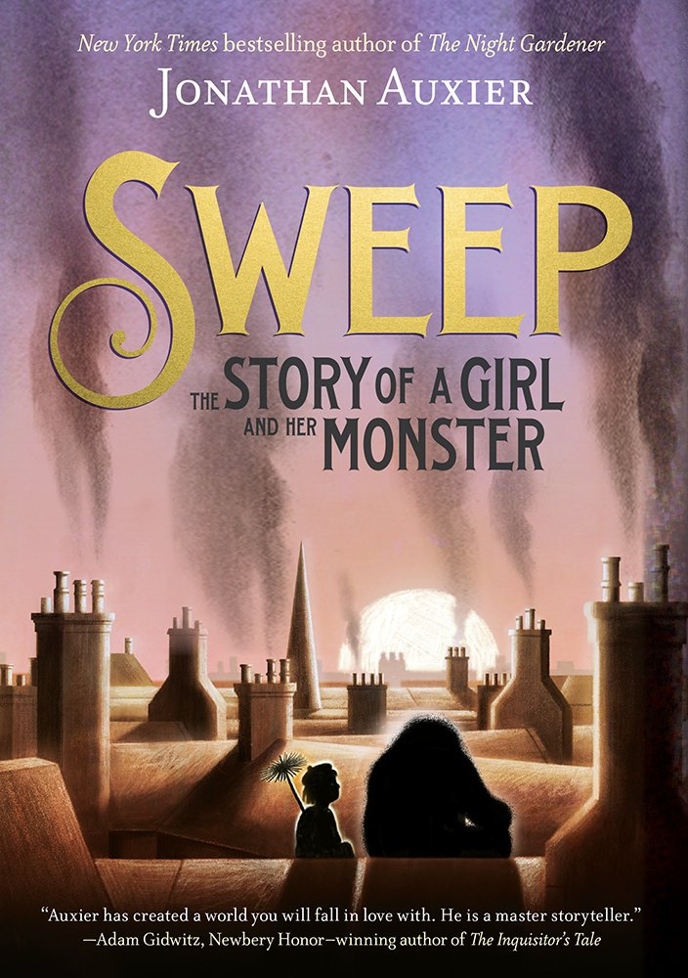
Dorothy’s List
2019-2020 Dorothy Canfield Fisher Book Award Nominees

Slide 2
Small Spaces
By Katherine Arden
Ollie Adler saves an old book from a distraught woman threatening to throw it into a river. The book leads Ollie into a dangerous, supernatural struggle for survival at a local farm. Ollie and her friends can only survive if they can hide in the “small spaces” and follow the mysterious messages that appear on her “broken” digital wristwatch.
Author’s Website:
www.katherinearden.com
Psst: If you loved these,
you might like
Small Spaces!

Slide 3
Sweep: The Story of a Girl and Her Monster
By Jonathan Auxier
Nan, a young chimney climber in Victorian London, has to carry on without her protector the “Sweep” when he disappears, leaving behind only his hat and a small piece of coal. The coal comes to life in the form of a golem to save Nan from a near death experience and together they protect each other from the grim realities of nineteenth century London. Combining fantasy, history and Jewish folklore, this is a heartwarming, funny and adventurous tale of love, friendship and loyalty.
Author’s Website:
www.thescop.com
Psst: If you loved these,
you might like Sweep: The Story of a Girl and Her Monster!

Slide 4
Willa of the Wood
By Robert Beatty
Willa is a young night-spirit living in the Smoky Mountains who must use her grandmother’s old magical ways to save human children stolen by the misguided leader of her own clan.
Author’s Website:
www.robertbeattybooks.com
Psst: If you loved these,
you might like Willa of the Wood!

Slide 5
Drum Roll, Please
By Lisa Jenn Bigelow
In Melissa “Melly” Goodwin's mind, she and her best friend Olivia are about to experience the most epic summer ever at Camp Rockaway, a music camp located deep in the woods of Michigan. It starts looking like Melly’s dream summer may become more of a nightmare, when her parents announce the day before camp begins that they are getting a divorce. Add to that a scary band instructor, Olivia’s sudden infatuation with “Noel”, a cute fellow camper, and Melly’s own confusing feelings towards Adeline, a girl to whom she finds herself drawn. Will Melly’s summer hit all the right notes or be a flat-out disaster?
Author’s Website:
www.lisajennbigelow.com
Psst: If you loved these,
you might like
Drum Roll, Please!

Slide 6
The Benefits of Being an Octopus
By Ann Braden
Seventh grader Zoey has a lot on her plate. She is constantly taking care of her younger siblings, being bullied or ignored at school, and worrying about things like the power being turned off or not having enough food to eat. This novel, set in Vermont, exposes the reality of living in poverty, being both child and care-giver, and simply the ups and downs of being a middle school girl. A timely tale, The Benefits of Being an Octopus blends both politics and economics in a heartwarming tale about finding one’s own voice.
Author’s Website:
www.annbradenbooks.com
Psst: If you loved these,
you might like
The Benefits of Being an Octopus!

Slide 7
Back from the Brink: Saving Animals from Extinction
By Nancy Castaldo
Activists and animal-lovers alike will be inspired by this non-fiction resource about saving endangered species, complete with full color photography. This book discusses seven threatened species, the threats to their survival, and the ways scientists and other concerned people have worked to pull them away from extinction.
Author’s Website:
www.nancycastaldo.com
Psst: If you loved these,
you might like Back from the Brink: Saving Animals from Extinction!

Slide 8
The Truth as Told by Mason Buttle
By Leslie Connor
Mason Buttle is a large, sweaty kid with learning disabilities. Mason also has a big heart. When his best friend dies under suspicious circumstances, Mason becomes the focus of Lieutenant Baird’s investigation.
Author’s website:
www.leslieconnor.com
Psst: If you loved these,
you might like The Truth as Told by Mason Buttle!

Slide 9
Louisiana’s Way Home
By Kate DiCamillo
Louisiana Elephante’s world gets turned upside down the night her Granny announces that the day of reckoning has arrived and they must leave their home immediately. For Louisiana that means leaving behind her best friends Raymie and Beverly as well as her beloved cat, Archie. As fate would have it, Granny’s mouth full of bad teeth land them in Richford, Georgia, a place that Louisiana at first desperately wants to leave. As Louisiana begins to settle into the rhythm of the town and learns more about her past, she begins asking herself: what is the true meaning of home?
Author’s Website:
www.katedicamillo.com
Psst: If you loved these,
you might like Louisiana’s Way Home!

Slide 10
Journey of the Pale Bear
By Susan Fletcher
In this riveting adventure set in the 13th century, 12-year-old Arthur – in hopes of claiming an inheritance in Wales - sets out from Norway on a ship bringing a polar bear as a gift from Norwegian King Haakon to England’s King Henry. Though the bear terrorizes the crew, Arthur forms a bond with it. A wonderful coming-of-age story based on the true tale of a polar bear who lived in London’s Tower Menagerie.
Author’s website:
www.susanfletcher.com
Psst: If you loved these,
you might like Journey of the Pale Bear!

Slide 11
Fake Blood
By Whitney Gardner
AJ has been wondering for years how to get ultra-cool Nia’s attention. When he finds out about her obsession with vampire lore, he decides to try something really different-- he pretends to be a vampire. Will his plan work?
Author’s Website:
www.heywhitney.com
Psst: If you loved these,
you might like Fake Blood!

Slide 12
Missing Mike
By Shari Green
Eleven-year-old Cari is devastated when encroaching wildfires force her family to quickly evacuate their home before she can find her beloved dog, Mike. After a harrowing escape, Cara’s family is housed by a host family with a foster daughter whom Cara befriends and enlists the support of to find Mike. Faced with the realization that her home is gone, Cara will do whatever it takes not to lose Mike too.
Author’s Website:
www.sharigreen.com
Psst: If you loved these,
you might like Missing Mike!

Slide 13
Game Changer
By Tommy Greenwald
An accident at the end of high school football practice leaves Teddy Youngblood in a coma...or was it an accident? Rumors swirl as Teddy, the team, and the town try to recover, and while Teddy is unable to share what he knows, there are plenty of others who just aren’t willing to share.
Author’s Website:
www.tommygreenwald.com
Psst: If you loved these,
you might like Game Changer!

Slide 14
Lifeboat 12
By Susan Hood
This riveting novel-in-verse is the story of thirteen-year-old Kenneth Sparks and his experience on a lifeboat after surviving a torpedo attack during World War II. This is truly an edge-of-your-seat survival tale based on a true, but little-known disaster. The book has a broad genre and audience appeal. It will appeal to children of all ages.
Author’s Website:
www.susanhoodbooks.com
Psst: If you loved these,
you might like Lifeboat 12!

Slide 15
Spooked! How a Radio Broadcast and The War of the Worlds Sparked the 1938 Invasion of America
By Gail Jarrow
In this conflicted era of fake news and alternative facts, what could be more timely than an account of Orson Welles’s famous Halloween-Eve radio broadcast that convinced much of America that the Martians were invading? Filled with period photos, art reproductions, newspaper headlines, and quotations.
Author’s Website:
www.gailjarrow.com
Psst: If you loved these,
you might like Spooked! How a Radio Broadcast and The War of the Worlds Sparked the 1938 Invasion of America!

Slide 16
Deep Water
By Watt Key
Desperate to save his business, Julie’s ailing father agrees to take a father/son team of rich, arrogant clients to a deep-sea site, but he needs 12-year-old Julie, an experienced diver, to actually take them on the dive. Julie quickly discovers that the clients aren’t interested in doing things the right way, and their recklessness results in the trio being lost at sea. With no boat and little hope, it is up to Julie to fend off tragedy and find a way to survive.
Author’s Website:
www.wattkey.com
Psst: If you loved these,
you might like Deep Water!

Slide 17
Out of Left Field
By Ellen Klages
In 1957, Katy Gordon is denied the opportunity to play Little League baseball even though she is a talented pitcher with an unhittable “Sunday pitch”. Katy researches famous women baseball players to convince officials that girls can play and play well.
Author’s Website:
www.ellenklages.com
Psst: If you loved these,
you might like Out of Left Field!

Slide 18
Nowhere Boy
By Katherine Marsh
How does a community absorb an increasingly desperate group of refugees, while keeping everyone safe from terrorism? Max is unhappy about his family’s one-year stint in Brussels, Belgium, until he meets Ahmed, a Syrian refugee boy who’s been secretly living in his basement. Max’s neighbors are angered by terrorist attacks in the news and would gladly report Ahmed if they saw him. The boys form a bold plan to help Ahmed stay under cover in Marsh’s gripping and suspenseful novel.
Author’s Website:
www.katherinemarsh.com
Psst: If you loved these,
you might like Nowhere Boy!

Slide 19
Bob
By Wendy Mass & Rebecca Stead
Illustrated by Nicholas Gannon
It’s been five years since Livy last visited her grandmother in Australia – and when she finally returns she finds Bob, a greenish zombie-like creature in a chicken suit, who has been obediently waiting in her closet all this time. (He’s spent the years crying and building LEGO® pirate ships.) A tale of friendship, love, and magic, told in the alternating voices of Livy and Bob.
Authors’ & Illustrator’s Websites:
www.wendymass.com
www.rebeccasteadbooks.com
www.nicholasgannon.com
Psst: If you loved these,
you might like Bob!

Slide 20
The Miscalculations of Lightning Girl
By Stacy McAnulty
Although she doesn’t remember it, Lucy Callahan was struck by lightning, which gave her genius level math skills and a severe case of OCD. Since then she has been homeschooled. She is technically ready for college, but her grandmother gives her one more test to pass: middle school. This beautifully written novel teaches us that sometimes numbers aren’t all that matters, no problem is unsolvable, and if you have a few friends who accept you for who you are, you’re pretty lucky.
Author’s Website:
www.stacymcanulty.com
Psst: If you loved these,
you might like The Miscalculations of Lightning Girl!

Slide 21
Merci Suárez Changes Gears
By Meg Medina
Merci Suárez is grateful to go to an excellent private school. Really, she is. Even if she was able to forget how fortunate she is, the extra required community service hours would be there to remind her. She also knows how lucky she is to be surrounded by family- even though that has its own challenges, as her grandfather ages and her family relies on her in more ways. How can Merci navigate her changing worlds at home and at school?
Author’s Website:
www.megmedina.com
Psst: If you loved these,
you might like Merci Suárez Changes Gears!

Slide 22
No Fixed Address
By Susin Nielsen
What do a Westfalia van, a hamster named Horatio and a gnome all have in common? To 12 and ¾ year old Felix Knuttson, they are all important parts of his rapidly changing world. The van is his home that he shares with his depressed and not always dependable mom. The hamster is named after the host of his favorite TV quiz show, which with some luck, Felix thinks he could win. Mel is his steadfast tomte that Felix believes protects he and his mom from all that could go wrong. Life living in a van isn’t easy and Felix must keep his living arrangement a secret, from everyone, even his best friends. Can Felix find a solution to his family crisis before it is too late?
Author’s Website:
www.susinnielsen.com
Psst: If you loved these,
you might like No Fixed Address!

Slide 23
Inkling
By Kenneth Oppel
Illustrated by Sydney Smith
Only the cat was awake to see Inkling form on Ethan’s father’s sketch pad, but soon Ethan’s whole family is caught up in the wonder of this ink blot that can read, draw, and communicate with humans...Inkling can even do your homework! But as Inkling soon discovers, even an ink blot’s efforts and adventures can lead to misunderstandings and danger. Sometimes trying to help people get “unstuck” can make things even more sticky for everyone.
Author’s & Illustrator’s Websites:
www.kennethoppel.ca
www.sydneydraws.ca
Psst: If you loved these,
you might like Inkling!

Slide 24
The House That Lou Built
By Mae Respicio
Lou loves woodshop, her family, and her dream to build a 100-square foot “tiny house” on a beautiful piece of land her Dad left her when he died. But when back taxes and a possible move to another state threaten Lou’s dream, she’s got to build on her resources and resilience to find a way to make it come true!
Author’s website:
www.maerespicio.com
Psst: If you loved these,
you might like The House That Lou Built!

Slide 25
Ghost Boys
By Jewell Parker Rhodes
Jerome is twelve and mostly just a quiet kid, until one day when he is playing with a friend’s toy gun. A police officer mistakes him for a threat and shoots him. But this isn’t the end of Jerome’s story. As a ghost, Jerome meets Emmett Till, another boy who was killed in a racially charged misunderstanding. Jerome learns about Emmett’s life and the aftermath of his own death. Through the two stories, more questions are asked than answered, in a necessary exploration about the prejudices of society.
Author’s Website:
www.jewellparkerrhodes.com/children
Psst: If you loved these,
you might like Ghost Boys!

Slide 26
Amal Unbound
By Aisha Saeed
Amal dreams of being a teacher, but soon she discovers that for a girl in Pakistan, an education is not guaranteed. After a car accident, she is forced to be an indentured servant in the household of the village landlord, a luxurious estate financed by illegal dealings. Amal discovers the depth of the corruption of the landlord and his family, but she must weigh the risks of trying to expose them in a small village where girls are not always believed and their dreams are not always honored.
Author’s Website:
www.aishasaeed.com
Psst: If you loved these,
you might like
Amal Unbound!

Slide 27
Just Like Jackie
By Lindsey Stoddard
Robbie Hart has a fierce temper and a big heart. She’s been covering for her Grandpa at home and at his auto repair shop: she worries the authorities will learn about his Alzheimer’s and take her away from her only family. Robbie wishes he’d tell her about her mom, though, and her anger issues lead her into fights and other trouble at school. Vermont author Lindsey Stoddard’s debut deftly mixes themes of family, acceptance, race, gender, and friendship.
Author’s Website:
www.lindseystoddard.com
Psst: If you loved these,
you might like Just Like Jackie!

Slide 28
The Adventures of a Girl Called Bicycle
By Christina Uss
Bicycle, raised at the Mostly Silent Monastery where the monks are permitted only eight words (yes, no, maybe, help, now, later, sleep, and sandwich), is being sent to the Friendship Factory to improve her social skills and make friends. Instead she runs away and sets off on an incredible solo cross-country journey to meet her cyclist hero at San Francisco’s Blessing of the Bicycles – encountering en route a host of quirky characters, among them a lonely Civil War ghost.
Author’s Website:
www.christinauss.com
Psst: If you loved these,
you might like The Adventures
of a Girl Called Bicycle!

Slide 29
The Prince and the Dressmaker
By Jen Wang
A graphic novel with a modern, fairy tale vibe. Prince Sebastien has a secret: at night, he loves to dress up in fantastic ball gowns and go out on the town as the fashionable Lady Crystallia. Frances is the lowly seamstress who becomes his special designer. Charming, romantic, joyful and subversive, this is a story about gender identity, self-expression, family pressure, and the joy of truly beautiful clothes.
Author’s Website:
www.jenwang.net
Psst: If you loved these,
you might like The Prince and the Dressmaker!

Slide 30
Harbor Me
By Jacqueline Woodson
Six kids meet weekly in the ARTT (A Room to Talk) room without any adults and discover a safe haven to share their struggles and to find support. Issues of identity, bullying, racism, immigration, incarceration and more are shared and as each story unfolds in this safe space the students find courage, hope and strength in the community they’ve created and the bonds they’ve made.
Author’s website:
www.jacquelinewoodson.com
Psst: If you loved these,
you might like Harbor Me!

Slide 31
Front Desk
By Kelly Yang
While some kids are at sports practice or music lessons after school, ten-year-old Mia Tang is manning the front desk of the motel in which she and her Chinese immigrant parents live and work. The Calavista Motel owned by the cruel Mr. Yao is not only a respite for weary travelers, but also home to a colorful cast of full-time residents and it doesn’t take long for kindhearted Mia to be drawn into the trials and tribulations of day to day life at the motel. Even though she is faced with daily challenges, Mia has big dreams for herself, as well as her friends and family. Does Mia have what it takes to turn dreams into reality?
Book Website:
www.frontdeskthebook.com
Psst: If you loved these,
you might like Front Desk!

